Slide 1
Welcome to Cincinnati
Exploring the City and Finding Home
Notes:
Think you know something about the city? Or a complete newbie? Either way, we are sure to surprise you.

Slide 2
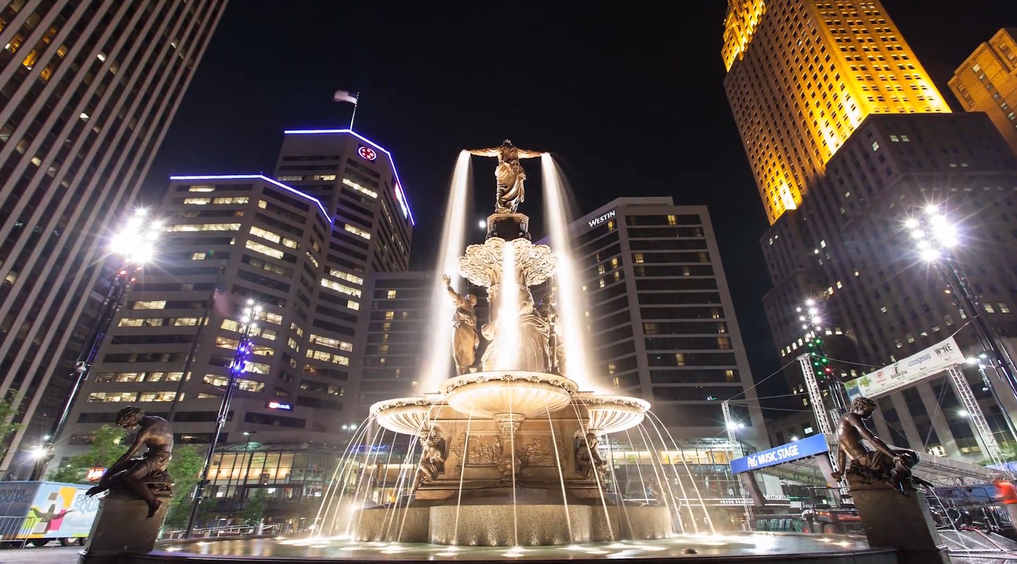
A snapshot
A postcard from Cincinnati
Notes:
Here’s a time-lapse view of where the city is now. . . Some cool highlights.

Slide 3
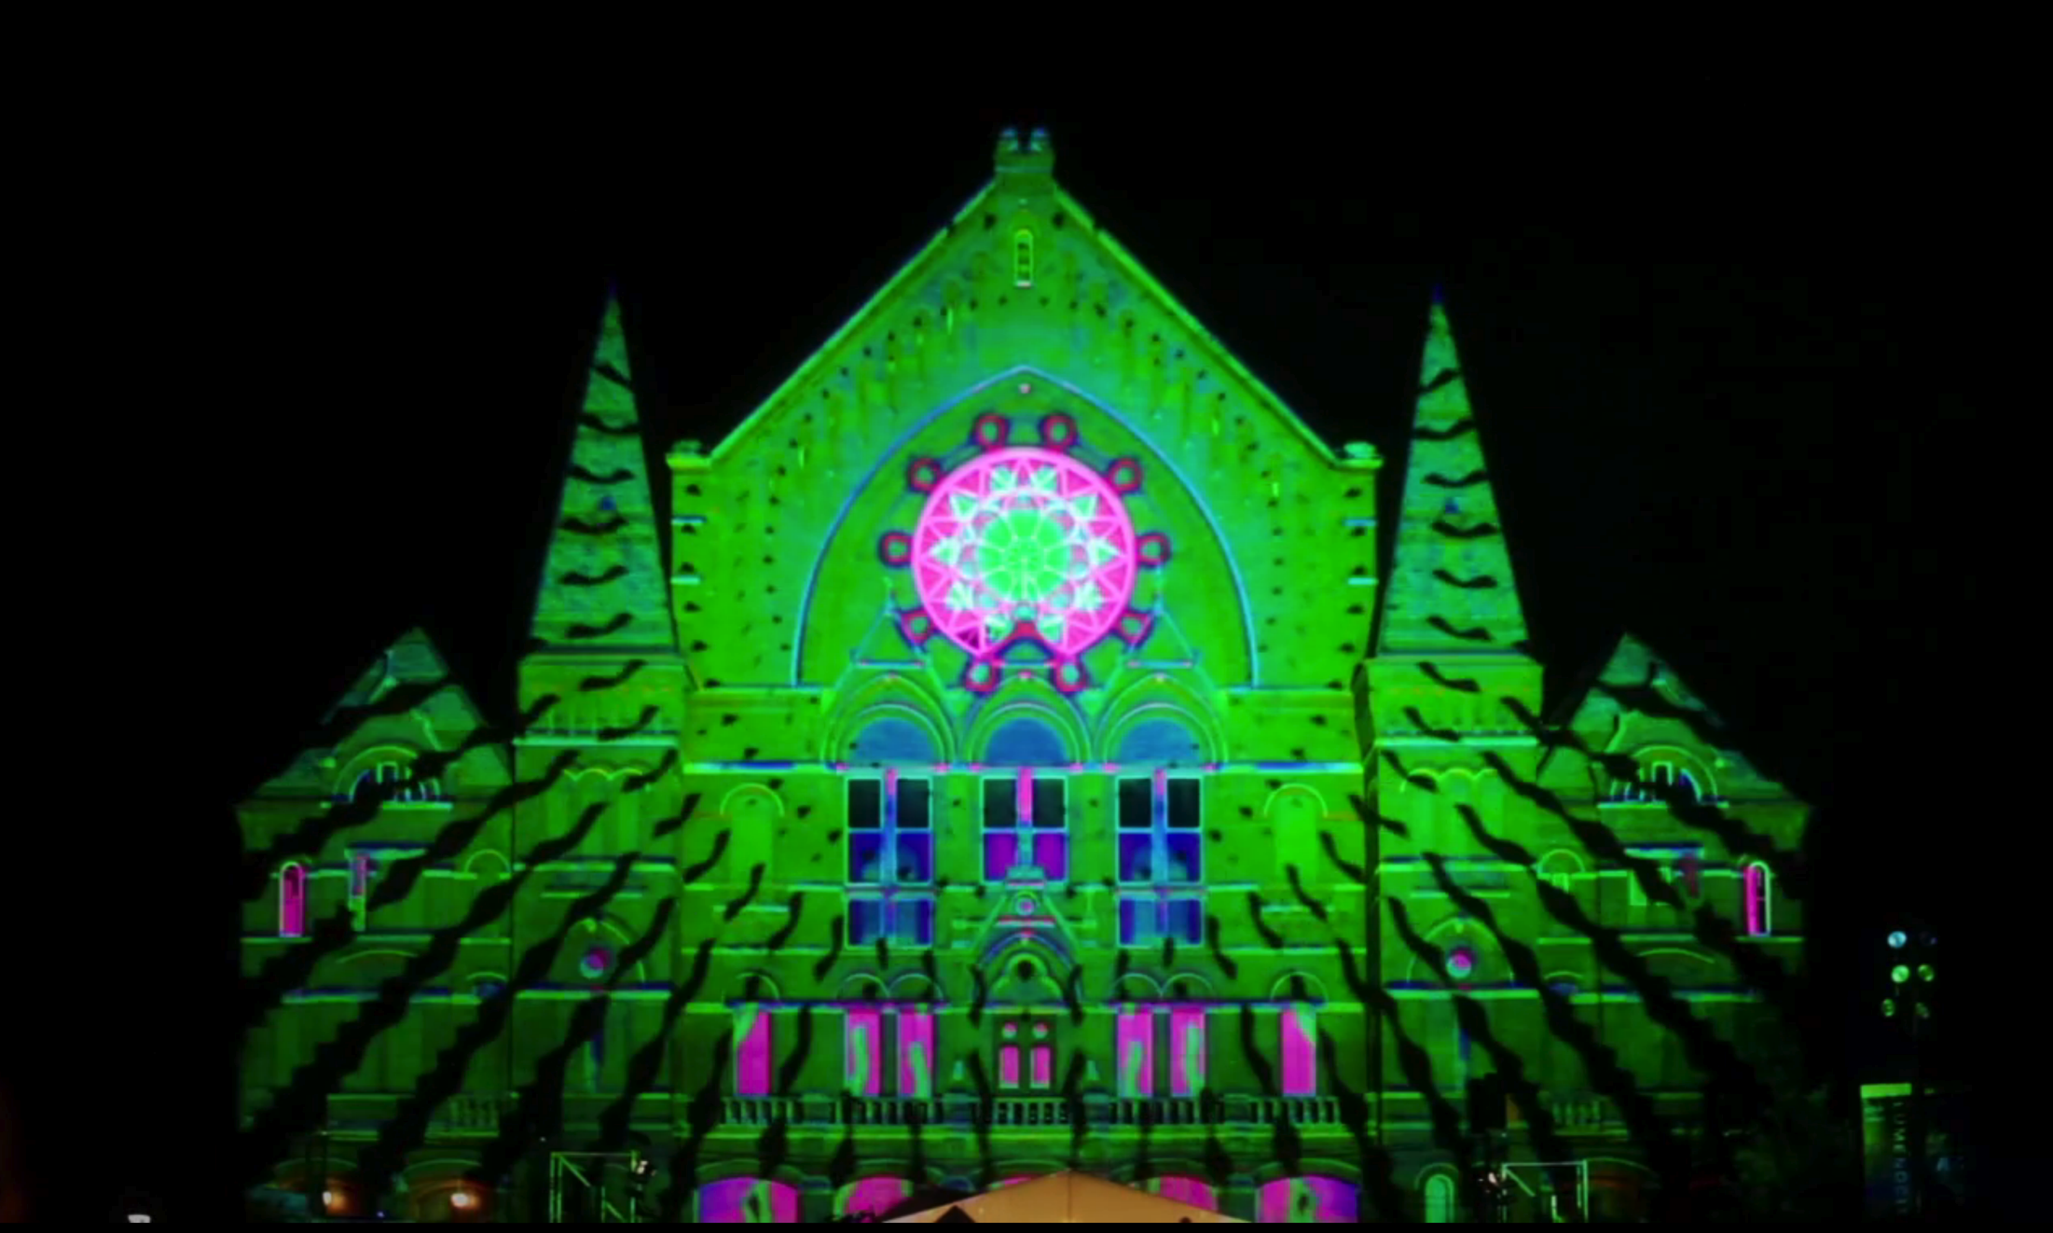
The arts
Lumenocity 2013
Notes:
With symphony, ballet, opera, theater and more (plus pro sports), Cincinnati has some pretty classy roots.

Slide 4
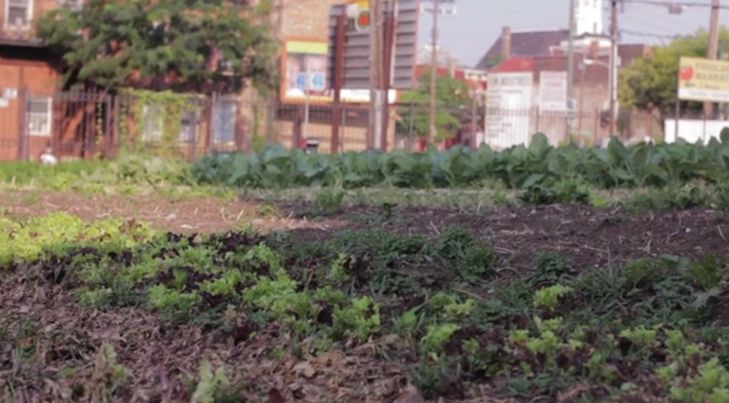
The eats
Public market mainstays
Notes:
Neighborhood markets abound through the region, and none is more valuable than Findlay Market.

Slide 5
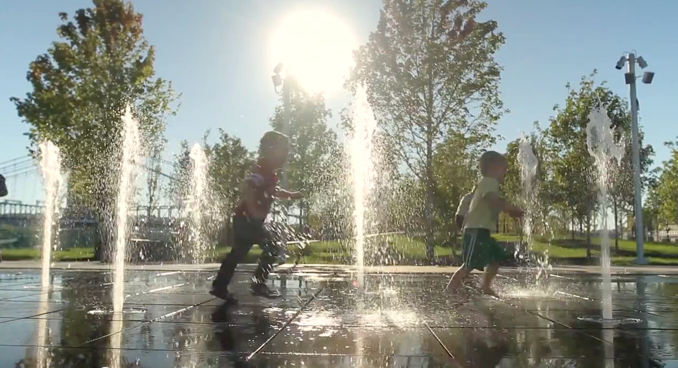
The water
Riverfront’s power
Notes:
Let’s not forget we are a river city. Let’s celebrate.

Slide 6
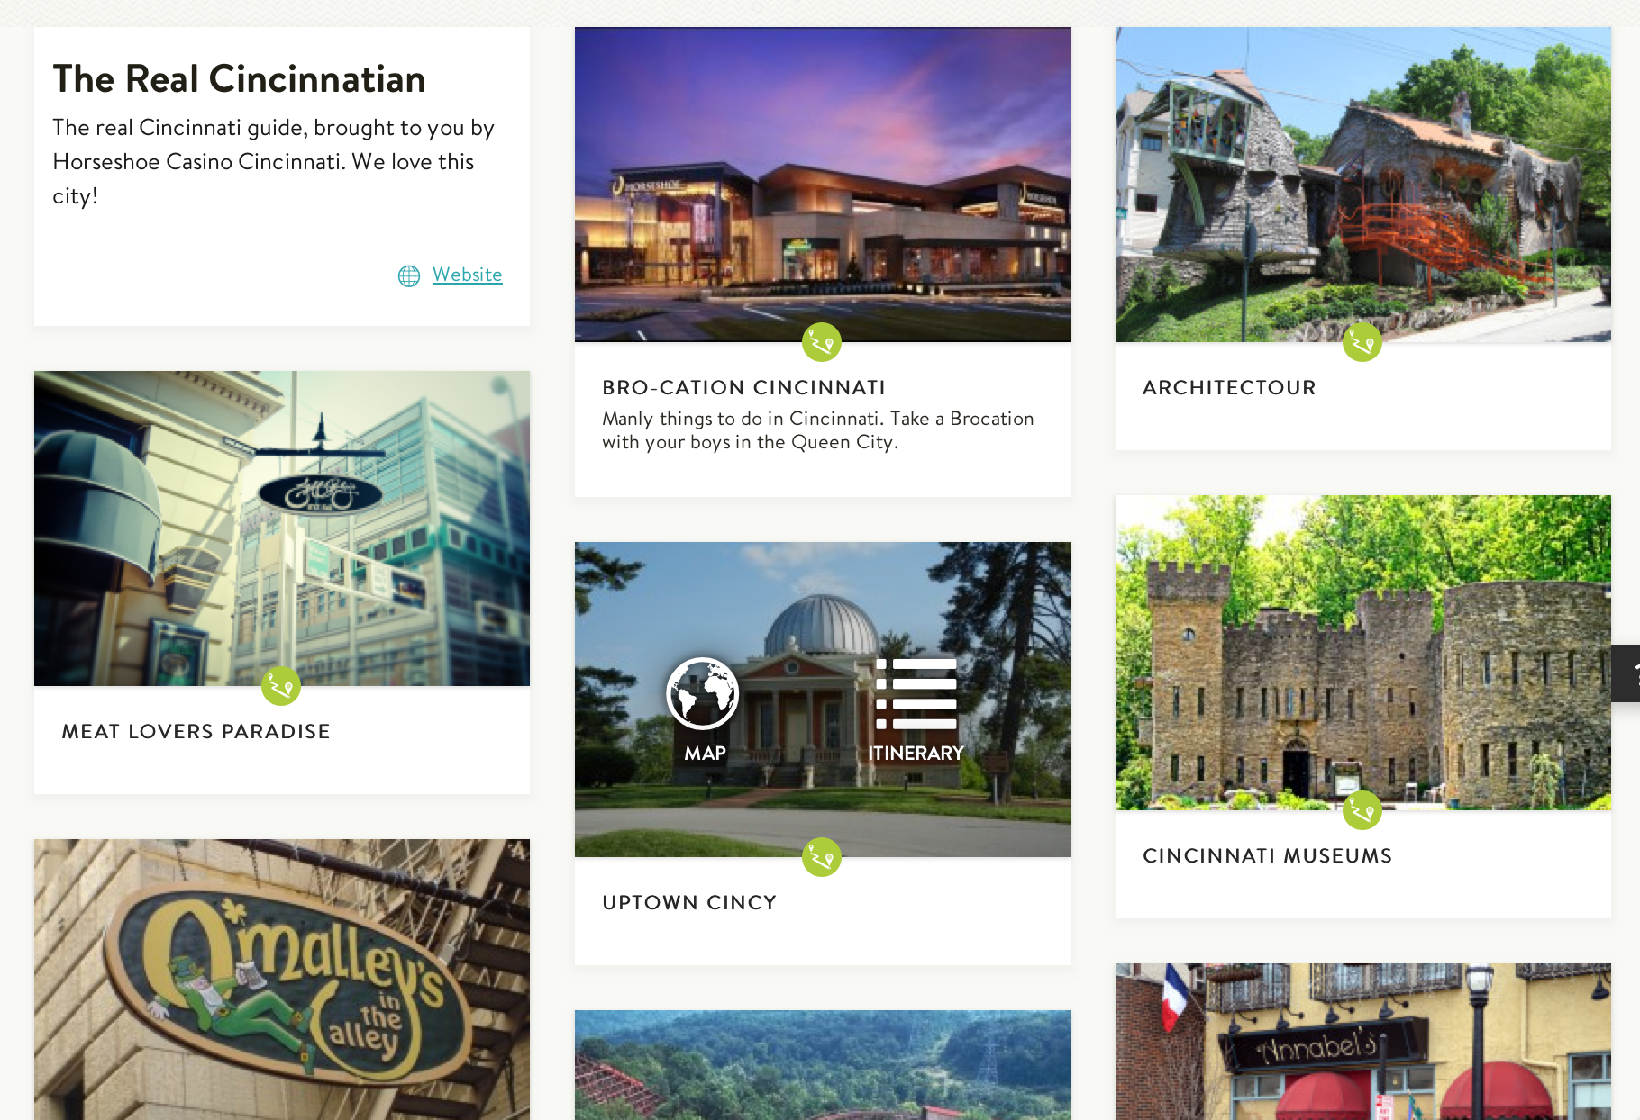
The resources
Soapboxmedia.com
Roadtrippers.com
Downtown Cincinnati
Cincinnati Magazine
WCPO Digital
Cincinnati Enquirer
Notes:
Here are sites, traditional and non, where you can find out a lot about what’s happening in Cincinnati.

