Slide 1
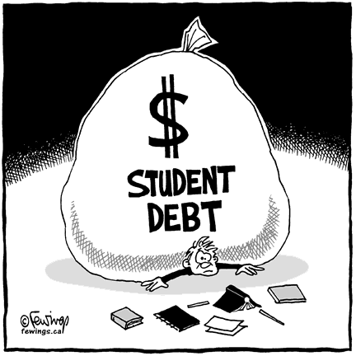
Got Debt?
Laurah Turner, PhD
Assistant Director
Center for the Enhancement of Teaching and Learning (CET&L)

Slide 2
Public Service Loan Forgiveness Program (PSLF)
2007- Congress created PSLF to encourage full-time public service jobs.
Borrowers may qualify for forgiveness of eligible federal student loans:
After making120 payments
Under certain repayment plans
While employed full time by certain public service employers.
Such as UC!

Slide 3
How are Direct Loans forgiven under the PSLF Program?
You must be employed full time by a public service organization
for each of the required 120 monthly payments
at the time you apply for loan forgiveness
at the time the remaining balance on your eligible loans is forgiven.
Payments must be made under a qualifying repayment plan.
You must make 120 on-time, full, scheduled, monthly payments on your Direct Loans.
Only payments made after October 1, 2007 qualify.

Slide 4
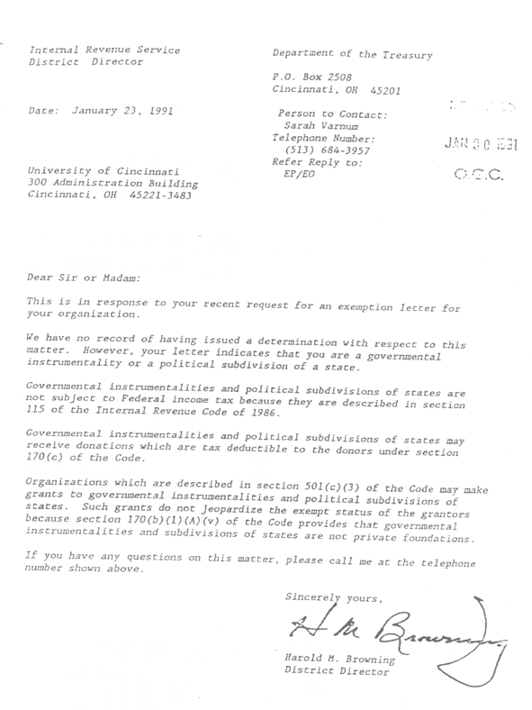
What kinds of employment qualify?
Any federal, state, or local government agency, entity, or organization
Non-profit organizations that have been designated as tax-exempt by the IRS.
Includes most not-for­ profit private schools, colleges, and universities

Slide 5
What loans are eligible for forgiveness?
Only William D. Ford Federal Direct Loans (Direct Loan) are eligible
Federal Family Education Loans (FFEL), Perkins Loans, or any other student loan program are not eligible
If you have FFEL and/or Perkins loans, you may consolidate them into a Direct Consolidation Loan to take advantage of PSLF.
Only payments you make on the new Direct Consolidation Loan will count
Payments made on your FFEL or Perkins loans, do not count

Slide 6
What is a qualifying repayment plan?
Income-Based Repayment (IBR) Plan
The Income-Contingent Repayment (ICR) Plan
10-year Standard Repayment Plan
any other repayment plan where monthly payment amounts equals/exceeds what you would pay under a 10-year Standard Repayment Plan
Notes:
Calculator link/picture

Slide 7
What is full-time employment?
PSLF definition: at least an annual average of 30 hours per week.
Teacher, or other employee of a public service organization
If under contract for at least eight out of 12 months
AND work an average of at least 30 hours per week during the contractual period
AND receive credit by your employer for a full year's worth of employment

Slide 8
What if I work at multiple qualifying part-time job?
You may meet the full-time employment requirement if you work a combined average of at least 30 hours per week with your employers.
Job 1
Job 2
Job 3
30 hrs/wk

Slide 9
PSLF Eligibility
Submit this form annually to keep track of your eligibility!
Step 1 — Complete, employer's certification
Step 2 — Submit the completed form to FedLoan Servicing, the PSLF servicer
Step 3 — FedLoan Servicing will review your PSLF Employment Certification form, ensure it is complete, and, determine eligibility.
Step 4 — FedLoan Servicing will notify
If your employment qualifies
how many payments have qualified
the total number of qualifying payments you made
how many payments you have left before you can qualify for PSLF
You are Eligible!

Slide 10
What should I do after I become eligible for PSLF?
After your 120th qualifying payment, you will need to submit the PSLF application to receive loan forgiveness.
The application is under development
will be available October 2017.
You must be working for a qualified public service organization at the time you submit the application for forgiveness and at the time the remaining balance on your loan is forgiven.

Slide 11
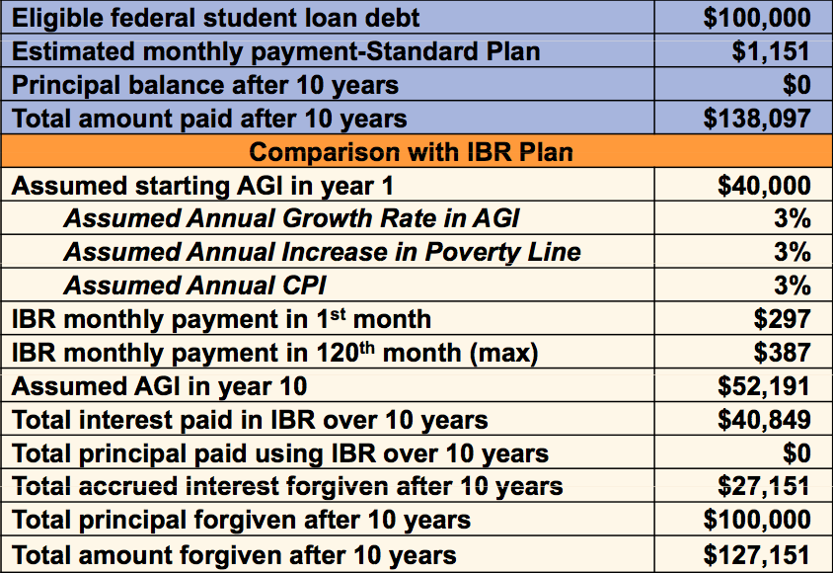
Ex: Leslie the Anthropologist Debt = $100,000 AGI = $40,000

Slide 12
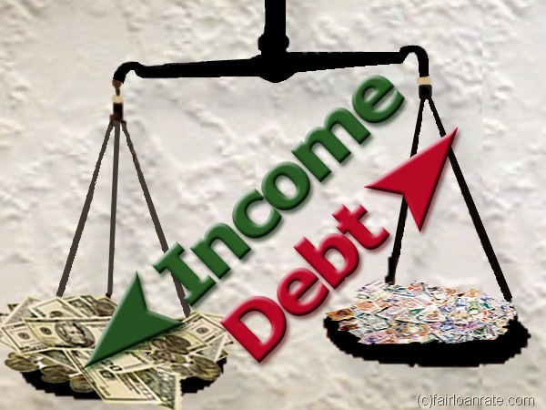
PSLF Summary
Potential Pros
Potential Cons
May make it financially possible to pursue public service career
Portion of debt may be forgiven
Necessitates annual documentation of eligibility
Borrowers with low debt and/or high income may not be eligible.
PSLF is an all-or-nothing benefit; must put in full 10 years
Only Direct Loans can be forgiven

Slide 13
Questions?
For more information, please visit the CET&L website or http://www.studentaid.ed.gov
References:
www.studentaid.ed.gov
www.uchastings.edu/financial-aid

