Slide 1
Student Wellness Center
675 Steger Student Life Center
Monday-Friday|9am-5pm
556-6124|www.uc.edu/wellness

Slide 2
Who We Are
The purpose of health promotion on college campuses is to support student learning; as students thrive in other areas of their lives, they can focus on academic achievement and campus involvement (American College Health Association, 2005).
SA&S –Student Life
Staffing
The BACCHUS Network

Slide 3
What We Know
Academic Impact
Within the last 12 months, UC students reported the following factors affecting their individual academic performance:
National College Health Assessment (NCHA)
SWC surveyed 757 random UC students in 2010. We conduct the survey every 3 years.
2010 University of Cincinnati complete results available at www.uc.edu/wellness/health_data
National results can be viewed at www.acha-ncha.org
Alcohol Use | 8.0% | Participation in Extra Curricular Activities | 8.1%
Anxiety | 13.5% | Relationship Difficulties | 12.1%
Cold/Flu/Sore Throat | 12.4% | Sleep Difficulties | 16.2%
Depression | 9.8% | Stress | 26.9%
Internet Use/Computer Games | 11.6% | Work | 17.0%

Slide 4
Our Services
Wellness Workshops
Presented by Peer Educators
By request
Variety of topics and formats
Free Health Products
3 per day (Condoms, lubricant, cold medicine, ibuprofen, antacids & Band-Aids)
Trial size products

Slide 5
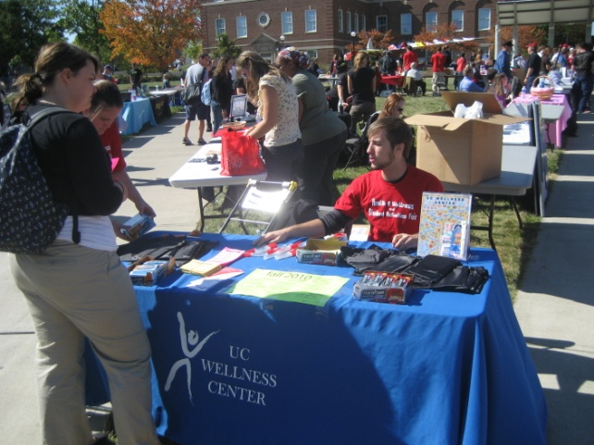
Our Services
Resource Center
Journals, books, brochures
Referral information
STI Testing
Other UC offices
Informal consultations
Awareness Events
Health and Wellness Fair, World AIDS Day, Stress Awareness Day, HIV Testing
Health Hut

Slide 6
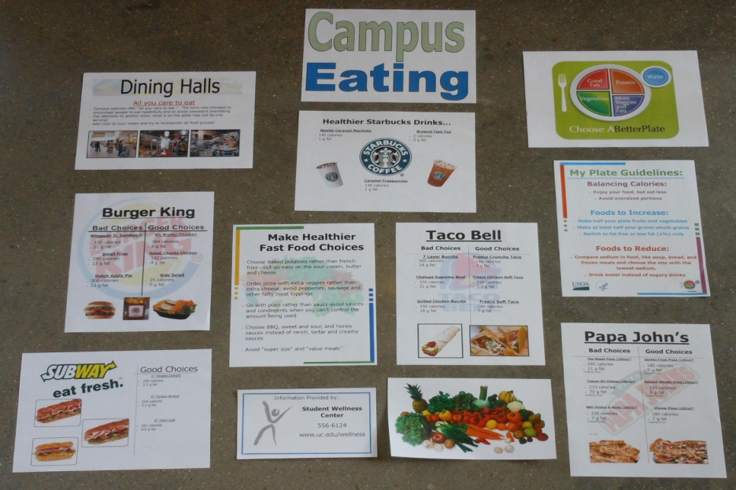
Our Services
Passive Programs
Bulletin Boards
Commode Chronicles
Posters
Health Initiatives
21st Birthday Emails
Gotcha Covered
Friday Night Live
Events
Student Committee
Collaboration

Slide 7
Poster Examples

Slide 8
Our Goal
Collaborate!
With other campus entities to promote existing university programs and assets
To address the issues and challenges students have both academically and personally
Questions?

