Slide 1

Building an eAccessibility Roadmap
Andy Alderson
MS, LSSMBB, PMP, PMI-ACP, CSM

Slide 2

Overview
Background
Central HR Strategy
eAccessibility Roadmap

Slide 3

Background
4 ½ years @ UC
UCIT
  Project manager
  Accessibility Network
Central HR
  Project management & Lean Six Sigma
  Facilitate cross-functional initiatives

Slide 4
Central HR Strategy
Background
Central HR Strategy
eAccessibility Roadmap

Slide 5

Strategy Process & Components
Development of 3 to 5-year Strategy began Fall 2020
Full process spanned months
  Core values & guiding principles
  SWOT analysis & strategic landscape
  Mission & vision
  Long term goals
  Key initiatives

Slide 6
Core Values & Guiding Principles
Core Values
  Impact, Inclusion, Innovation
  Inclusion: Intentionally engaging all people and the contribution of diverse ideas
11 Central HR Guiding Principles
  Embed inclusive practices into our work

Slide 7
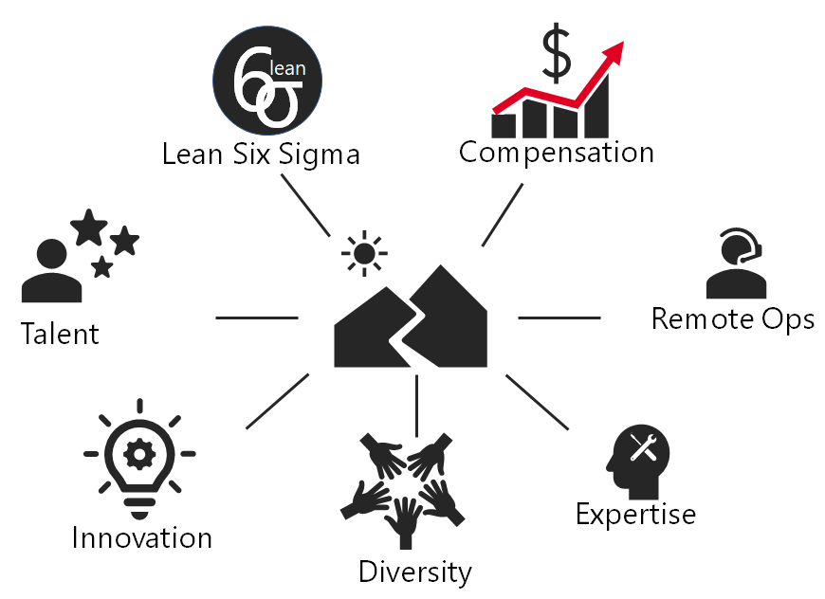
SWOT Analysis & Strategic Landscape
Themes
  Strive to maintain equity & fairness
  Central HR strengths
    Diversity
    Openness to new ideas

Slide 8

Vision
Best-in-class services
Customer-facing
Components for the journey
  Innovation
  Collaboration
  Inclusion

Slide 9
Four Long Term Goals
Innovative HR solutions in place with an eye toward continuous improvement
An established framework that effectively communicates and collaborates both inside and outside of Central HR
Outreach & education opportunities that assist managers on Labor Relations topics
Products & services that are more inclusive with an emphasis on eAccessibility

Slide 10
Key Initiatives
Products & services that are more inclusive with an emphasis on eA11Y
  Develop an Accommodation Plan(s) for SuccessFactors and provide its
  vendor with a list of accessibility blockers and barriers for improvement
  Provide basic & intermediate levels of training on eAccessibility
  Move policies, forms, & toolkits away from PDFs to eForms and webpages
  Integrate considerations for accessibility into other training programs
  Develop and execute a 3-year eAccessibility Roadmap

Slide 11
eAccessibility Roadmap
Background
Central HR Strategy
eAccessibility Roadmap

Slide 12

eA11Y Roadmap Buckets
More specific & timebound than strategy
Roadmap buckets
  Central HR staff competency
  Third party software
  Public website & Bearcats Landing
  Forms
  Accommodations
Bucket origins
  Accessibility Network for staff competency, third party software, websites & BL
  Central HR focus areas for Forms & Accommodations

Slide 13
Central HR Staff Competency
Incorporate access and inclusion as a basic HR competency
By April 30, 2023, achieve 100% compliance with UC's Electronic Accessibility Training
Increase participation in UC Digital Inclusion Day to at least one
individual / Central HR department
Host internal training sessions on eAccessibility tips and share best practices
Seek other learning opportunities to improve eAccessibility skills

Slide 14
Third Party Software
Continue to improve the accessibility of SuccessFactors, and ensure all third-party software is properly vetted for accessibility
Host quarterly SuccessFactors collaboration meetings with Central HR business owners, BCS, and the Accessibility Network
Periodically meet with the vendor (SAP) and continue to highlight and prioritize identified blockers and barriers for remediation
Develop and execute an accessibility audit plan for content posted in the learning module with an emphasis on best practices (includes alt-tags for images, closed captioning for videos, and accessible tables)
Closely follow the University process for the purchase and renewal of other third-party software

Slide 15
Public Website & Bearcats Landing
Ensure content posted on Central HR's public website and Bearcats Landing follow best practices
Audit Central HR's public site and Bearcats Landing annually
Incrementally reduce the number of PDFs on Bearcats Landing to reach an 80% reduction by June 30, 2024
Improve the accessibility of the UC Careers and job site

Slide 16
Forms
Use the Lean Six Sigma methodology to develop a plan and implement a holistic solution to Central HR forms
Move to accessible, browser-based forms and workflows
Incrementally reduce the number of non-browser based forms
(includes PDFs, Word, Excel versions) on Bearcats Landing to reach
an 80% reduction by June 30, 2024
Incrementally eliminate, streamline and/or transition other PDFs to reach an 80% improvement rate by June 30, 2024

Slide 17
Accommodations
Improve the Accommodation process for staff/faculty through the use of the Titanium system
Determine costs and feasibility, secure funding, and purchase the system
Update and develop processes that leverage the Titanium system, and train license holders accordingly
Go-live by December 31, 2022

Slide 18
Lessons Learned
Start early and high level
  Focus first on aligning unit strategy w/ NLH and University priorities
  Make eA11Y a part of that endeavor and work toward a roadmap
  Brainstorm with the Accessibility Network
Include what you have to do anyway
  Give yourselves credit!
Be transparent and hold yourselves accountable
  Refer to strategy & roadmap at the beginning of each FY
Celebrate small and large successes
Resources
  Central HR Strategy
  Central HR eAccessibility Roadmap
  Accessibility Network

Slide 19

Questions?

