Slide 1
Navigating Captioning
Katheryn Lane
Electronic & Digital Accessibility Specialist
UC Accessibility Offices
University of Cincinnati

Slide 2
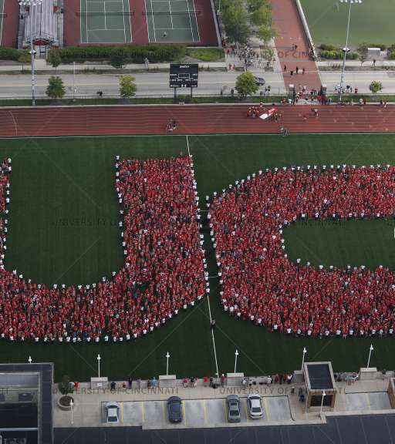
Overview
Recent changes in captioning at the University of Cincinnati
Options for captioning
Ins and outs of captioning your own videos
Elements of well-constructed captions
Notes:
This session will give an overview of captioning at the University of Cincinnati:
With recent changes in captioning at UC
Options for captioning your videos and recorded media
The ins and outs of captioning your own videos, and
The elements of well-constructed captions

Slide 3
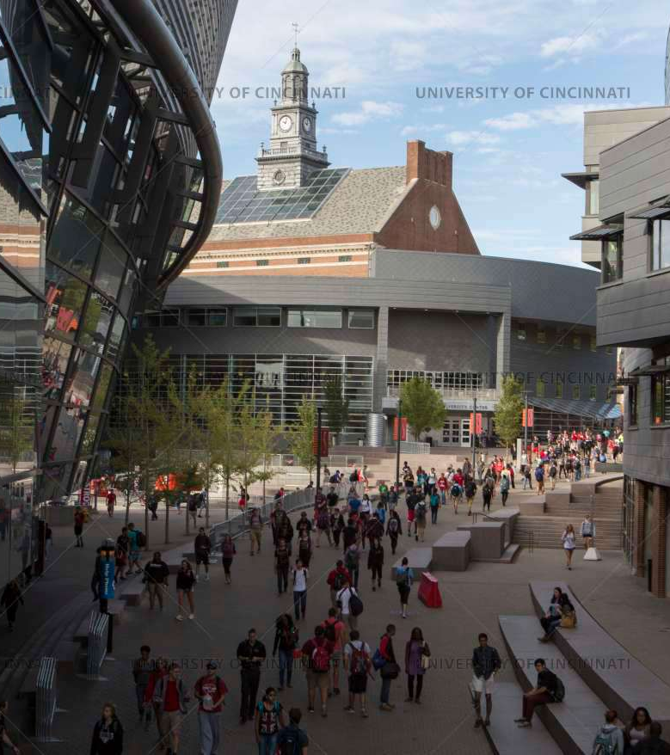
Key Points
Captioning is a shared responsibility
Having resources, training, and the right tools allows for ownership of captioning
Knowledge and collaboration facilitate creative approaches and solutions
Centralized support helps to strengthen priorities
Notes:
Key takeaways are:
That Captioning is a shared responsibility
Having resources, training, and the right tools allows for ownership of captioning
Knowledge and collaboration facilitate creative approaches and solutions for captioning
And centralized support helps to strengthen captioning priorities - to give access to resources, to equalize the barriers perceived with captioning, and the opportunities available.
While the key points get into the social model viewpoint of why we caption video, I would also like to touch on the foundation of the work. The Americans with Disabilities Act (or ADA), as amended, requires effective access to all people, for all programs, activities, courses, and services of the university. There are the Web Content Accessibility Guidelines (or WCAG) standards for guidance in making media content accessible to people with disabilities.​ The University made an institutional commitment to WCAG 2.0 AA specification, as our benchmark standard,​ which means that captions are provided for all prerecorded media with synchronized audio to our consumers of this media who rely on captions. I hope this helps to frame up why we do what we do, from a compliance perspective.
​

Slide 4
Increases in Captioning
Notes:
At the University of Cincinnati, the demand for captioning services has increased. Over the last three years the number of job requests for professional captioning related to disability accommodations have risen by 330%. The number of media minutes captioned has increased by 520% and costs related to captioning services have risen by 500%. As we all know, much of this growth can be attributed to the onset of COVID-19 and the rapid transition to online and hybrid learning in Spring of 2019. So far, we haven’t seen the volume of captioning returning to a pre-COVID state. Rapid growth underscored the access barriers for students and consumers who are d/Deaf or hard-of-hearing and to others who rely on captioning, and has been instrumental in fast-tracking UC’s captioning program.

Slide 5
Captioning at UC
Centralized Operational Model
Notes:
Captioning at the University of Cincinnati operates within a centralized model.

Slide 6
Centralized Operational Model
Accommodation
Process
Captioning
Vendor
Centralized
Captioning Credits
Financial Efficiency
Notes:
ACCOMMODATION PROCESS
Captioning for disability-related accommodations is centrally funded for UC students and employees. In the accommodation process, students engage with Accessibility Resources; employees engage with Human Resources,
making the accommodation process consistent for each.
CAPTIONING VENDOR
With the initial rapid growth in captioning, it quickly became clear that the captioning vendor we had at the time, was not equipped to sustain services at this increased level. We experienced declines in the quality of service and caption fidelity, and this impacted students and other consumers of captioning, as well as staff and faculty who were managing the captioning process. This past July, the University transitioned Kaltura, its enterprise video repository tool, to the REACH v2 platform which enabled, then, a transition to a new third-party captioning vendor, 3Play Media. We’re still experiencing adjustments that come with a new system integration, in terms of permissions, profile settings, notifications, things like that, but 3Play Media is better equipped to meet our needs in terms of volume, with fidelity, turnaround times, and customer service.
CENTRALIZED CAPTIONING CREDITS
For FY-2023, each of the fifteen colleges at the University of Cincinnati, was allocated Centralized Captioning Credits to professionally caption media content in academic courses without accommodations. The intent of this initiative has been to increase access and inclusion for UC students across colleges, and provide a more consistent student experience between courses and between colleges. Awards were based on percentage of student course enrollment per college, specifically targeting courses where delivery method was fully, mostly, or partially distance learning.
FINANCIAL EFFICIENCY
To create financial efficiency, the University made an upfront, lump sum purchase of credits, against which end users submit requests. Purchasing credits in bulk allowed the university:
To negotiate lower pricing per media minute at variable turnaround times
Allocate credits for accommodation requests
Distribute Centralized Captioning Credits to colleges to increase access and inclusion in alignment with accessibility goals
And to accept internal fund transfers for monies from departments leveraging high-volume discounted pricing, as well as Colleges contributing beyond their centrally allocated system credits

Slide 7
Inter-University Council Purchasing Group of Ohio (IUC-PG)
https://iucpg.com
Notes:
Additionally, the University of Cincinnati is a member institute of the Inter-University Council Purchasing Group of Ohio (IUC-PG) and was recently active in reviewing state-wide Captioning RFPs with anticipation of an announcement in the next few weeks regarding awarded agreement options under the IUC-PG for post-production and live captioning. For more information about the Inter-University Council Purchasing Group of Ohio, visit their website at iucpg.com.

Slide 8
Operational Procedures &
Service Options
Kaltura Integration
Notes:
How to engage captioning services.

Slide 9
Service Integration
Canvas Courses & Kaltura MediaSpace (KMS) Sites
My Media (your videos and recorded media)
Captioning Service
3Play Media
REACH v2
Integrations:
Zoom, Kaltura Capture/Express
Notes:
I’ve mentioned that Kaltura is UC’s enterprise video repository tool. My Media is the portal to your own media content in Kaltura (what you’ve created and what is shared with you). My Media is available in Canvas courses and Kaltura MediaSpace, (KMS) sites, and it is uniform across the board. Whether you go to My Media in a Canvas course or a MediaSpace site, your media content will always remain consistent. There is integration with video tools, such as Zoom, Kaltura Capture, and Kaltura Express, that save directly to My Media, and captioning services are integrated in My Media. So, the easiest way to caption your videos is to have them in Kaltura. It’s good practice and especially useful in being prepared for captioning accommodations. Another benefit is that Kaltura has analytics that can reveal how consumers are engaging with video content.

Slide 10
Captioning Service Options
3Play Media
Professional Captioning
For disability-related accommodations With allocated credits With purchased captioning credits
Kaltura REACH v2
Machine Captions
Auto-generated machine captions Transcript alignment
Edit Captions
Closed Captions Editor tool
Notes:
Our captioning service options are with Kaltura REACH v2 and 3Play Media and include both professional and machine captioning.
Professional captioning services are moderated and available for:
Disability-related accommodations
Use of Centralized Captioning Credits allocated to each college
Use of purchased captioning credits
Machine captioning services are unmoderated for:
Auto-generated machine captions
Auto-alignment of transcripts
This includes access to Kaltura’s Closed Caption Editor tool for editing both machine- and professionally-captioned media content. The Kaltura REACH v2 machine captioning, alignment, and editing options, are free for use by UC students and employees, and as I mentioned, all of these captioning service options are available in My Media, through specific pathways and it’s important to understand where to begin.

Slide 11
Which My Media?
Canvas courses or
UC KMS site
Add or view media
Order machine captions
Specific Unit KMS site
Request captions using Centralized Captioning Credits
Request captions using Purchased Captioning Credits
Auto-align a transcript
Edit captions
Accessibility Resources KMS site
Request professional captions for accommodations
Notes:
To use caption services, which My Media do you go to? It really depends on what you want to do.
MY MEDIA IN CANVAS COURSES OR UC’S MAIN KMS SITE
If you want to view your media content, or add new content; or make use of free options (order machine captions, upload & auto-align a script or transcript to create captions); if you want to edit caption, go to My Media, in either the main UC MediaSpace site (uc.mediaspace.kaltura.com) or go to My Media within a Canvas course (uc.instructure.com). These are no cost options for UC faculty, staff, and students, and you can get support through your local technical or instructional design staff, IT@UC services, or the Digital Access Team in the UC Accessibility Offices.
ACCESSIBILITY RESOURCES’ KMS SITE
If you want to request professional captioning for a disability-related accommodation, always, always, always, go to My Media in the Accessibility Resources KMS (accessibilityresources.mediaspace.Kaltura.com). In this process, funding is centrally maintained and support is available through the Digital Access Team in the UC Accessibility Offices. This is the only place where you can request professional captioning for accommodations. If you try and do it through a Canvas course, or through the main UC MediaSpace site, you’ll end up with machine captions that are not suitable for accommodations.
YOUR DEPARTMENT/COLLEGES’S KMS SITE
If you want to request professional captioning using either Centralized Captioning Credits or purchased captioning credits always go to My Media in your department or college’s specific MediaSpace site (like the College of A&S MediaSpace, or UC Clermont’s MediaSpace). Here, funding is the responsibility of the requesting department or college, and support is provided locally by that department or college’s MediaSpace administrators, or their designees, and by IT@UC services. Communicate with your MediaSpace administrator when you have questions regarding the use of Centralized or Purchased captioning credits.

Slide 12
Captioning Your Own Videos
Caption-it-yourself (CIY)
Notes:
We’re going to take a look at these tools and also, some other open source or freeware tools for Captioning-It-Yourself.

Slide 13
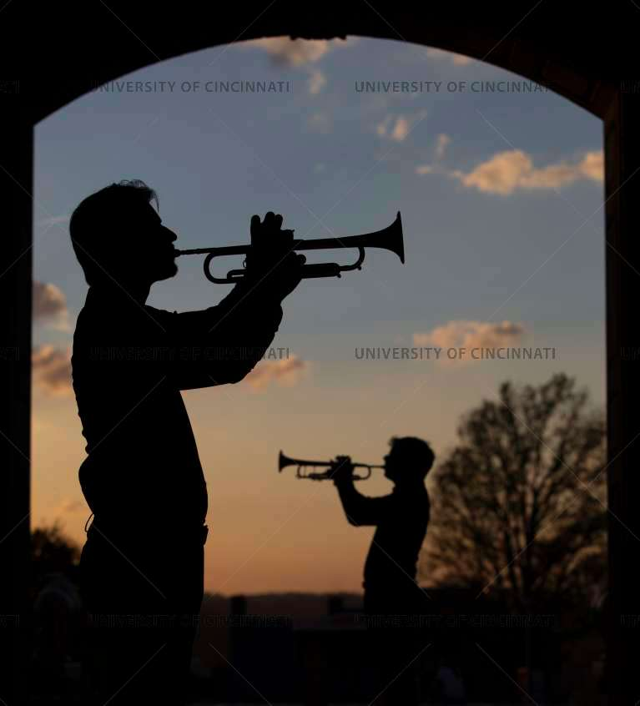
Centralized Resources
Accessibility Network public website
Digital Technology Solutions Captioning intranet site on Bearcats Landing
[LYRICAL TRUMPET DUET]
Notes:
Before we get started, I want to share that we are gathering captioning information in centralized locations to keep everyone consistent in how we talk about captioning options on campus. We currently have the Accessibility Network (AN) public website and the Digital Technology Solutions Captioning intranet site on Bearcats Landing. If you go to the AN website, you will find guides, tutorials, and best practices for captioning, while the Digital Technology Solutions Captioning intranet site includes step-by-step knowledge base articles about UC captioning tools. These are live resources to which guides and tutorials will continue to be added.

Slide 14

CIY with Captioning Service Tools
Kaltura My Media
Machine Captions
Auto-generated machine captions Transcript alignment
Edit Captions
Closed Captions Editor tool
Manage Captions
Upload, download, delete caption files
Notes:
So, I’ll start with the tools that are included with our captioning service.
And I will show you very briefly, how to:
Add machine captions
How to upload and auto-align a script or transcript of a video to create captions
How to edit captions
Ways to manage captions
[DEMOS]
Step-by-step guides are available on the Accessibility Network website.

Slide 15

CIY with YouTube
YouTube
Video Sharing Platform
Free to use Popular site Relatively easy to learn Captioning tools in YouTube Studio
Public Videos Integration with Kaltura Not all public YouTube videos can be captioned
Notes:
Another popular option for captioning your own videos is YouTube. YouTube is a video sharing platform with captioning tools built into YouTube Studio. It’s relatively easy to learn and has features similar to those in Kaltura. You can upload captions or transcript files, and edit YouTube’s auto-generated machine captions. You can download and delete caption files. There is a guide for YouTube Studio on the Accessibility Network website.
A word of caution about curating third-party YouTube videos that you do not own. There is an integration in Kaltura which allows you to bring in public YouTube videos for captioning, but there is also an optional permission setting in YouTube which restricts being able to play a YouTube video in a non-YouTube player. When this option is enabled, the video can’t be brought into Kaltura for captioning because it requires playing the YouTube video in a Kaltura player.
So, think about the potential problem, and this is just one example of what you might experience with curated media content. If there’s an accommodation which requires professional-level captioning and a third-party video you have selected cannot be captioned, then you can’t use that video. So, rather than wait for that problem to occur, we suggest that you curate content that already has professional level captioning. If you are considering content which would be difficult to caption in a timely manner, or could not be captioned, then you should make another selection.

Slide 16
Caption-Authoring Software
Online Tools
Amara*
Downloadable Tools
Caption And Description Editing Tool (CADET)*
AegiSub*
Video Editing Software
Camtasia
Adobe Premiere Pro
Subtitle Horse*
Final Cut X
*Free tool or free version available
Notes:
You can also add captions using caption-authoring software, and there are plenty of free tools.
ONLINE TOOLS
You can choose online Tools that are browser-based Like Amara and Subtitle Horse. they both have free plans, with simpler interfaces, that may be easier to learn and use.
DOWNLOADABLE TOOLS
CADET or AegiSub are both downloadable cross platform, robust captioning tools. I know captioners on campus who use AegiSub and really like it. I especially like CADET, which is the Caption And Description Editing Tool created by the National Center for Accessible Media at WGBH. With CADET, adjusting timestamps is more automated, you can work with many different caption file formats, and there are advanced features to add musical notes and generate audio-description scripts. It’s accessible to use (CADET won the 2018 FCC Chairman’s Award for Achievements in Accessibility), plus, they have created a series of free captioned tutorials on YouTube. You can check out the Accessibility Network website for more information and links to access these resources.
VIDEO EDITING SOFTWARE
Camtasia, Adobe Premiere Pro, and Final Cut X are commercial products with free trial subscriptions. They are primarily video editing software with options that enhance the captioning process - things like speech-to-text to auto-generate the captions from the audio track, placement of captions, caption inserts, and exports. While you may not want to invest in these tools just for captioning, if you are already using them, you may want to try their captioning options.

Slide 17
Elements of Well-Constructed Captions
Described and Captioned Media Program (DCMP)
Notes:
As you explore captioning, you need to be aware of the elements of quality captions so, you have well-constructed captions and can recognize when the quality of captions are not sufficient for accessibility. The Described and Captioned Media Program (or DCMP) comprises guidelines and best practices for captioning which are consistent with Federal Communications Commission (FCC) rules and WCAG 2.0 standards. The DCMP is funded by the U.S. Department of Education and administered by the National Association of the Deaf. I recommend their Captioning Key which can be found at https://dcmp.org/learn/captioningkey.

Slide 18
Described and Captioned Media Program (DCMP)
Accurate
Errorless captions – 99%+ accuracy
Consistent
Uniformity in style and presentation
Clear
Complete textual representation
Readable
Enough time to read In sync with audio Does not obscure
Equal
Meaning and intention is preserved
Notes:
The DCMP defines the Elements of Quality Captioning as:
Accurate
Errorless captions are the goal for each production
The standard for accessibility is 99%+ accuracy
Consistent
Uniformity in style and presentation of all captioning features which is crucial for viewer understanding.
Clear
A complete textual representation of the audio, including speaker identification and non-speech information, which provides clarity.
Readable
Captions are displayed with enough time to be read completely, are in synchronization with the audio, and are not obscured by (nor do they obscure) the visual content.
Equal
Equal access requires that the meaning and intention of the material is completely preserved.

Slide 19
Captioning Checklist
Captions appear on-screen long enough to be read.
No more than two lines per caption.
Captions are synchronized with spoken words.
Speakers should be identified when more than one person is on-screen or when the speaker is not visible.
Punctuation is used to clarify meaning.
Spelling is correct throughout the production.
All actual words are captioned, regardless of language or dialect.
Use of slang and accent is preserved and identified.
Sound effects are written when they add to understanding.
Notes:
Next is a captioning checklist, adapted from the Described and Captioned Media Program’s (DCMP) Captioning Key
Captions appear on-screen long enough to be read, at least one second and usually no more than six seconds.
No more than two lines per caption. Also, a single caption line should be no more than 32 characters – so 64 characters for two lines
Captions are synchronized with spoken words and should not persist on the screen longer than the spoken content.
Speakers should be identified when more than one person is on-screen or when the speaker is not visible. (EXAMPLE)
Punctuation is used to clarify meaning. (EXAMPLE)
Spelling is correct throughout the production - aim for errorless captions. The standard for accessibility is 99%+ accuracy.
All actual words are captioned, regardless of language or dialect. (EXAMPLE)
Use of slang and accent is preserved and identified. (EXAMPLE)
Sound effects are written when they add to understanding. (EXAMPLE)
And the captioning checklist is available on the Accessibility Network website

Slide 20
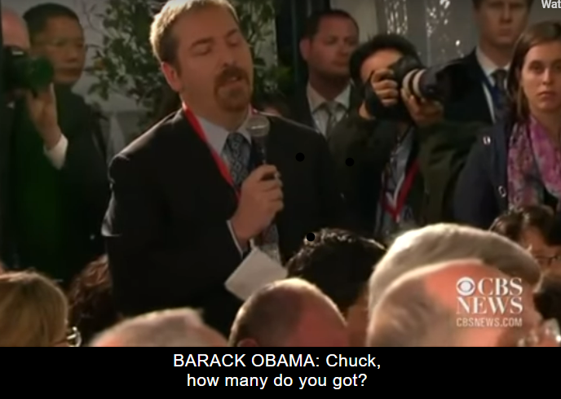
Example – Speaker Identification
Notes:
Speakers should be identified when more than one person is on-screen or when the speaker is not visible. In this example, both apply. There are multiple speakers, reporters, and Barack Obama is speaking to a reporter but he is not onscreen, so speaker identification is necessary.

Slide 21
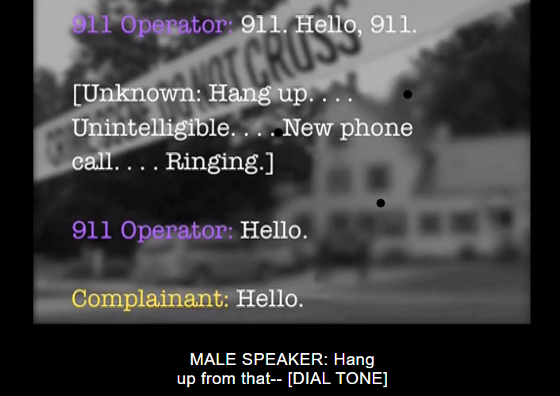
Example – Punctuation for clarity
Notes:
Punctuation is used to clarify meaning. In this example, a double hyphen (or single long dash) conveys that a speaker was interrupted.

Slide 22
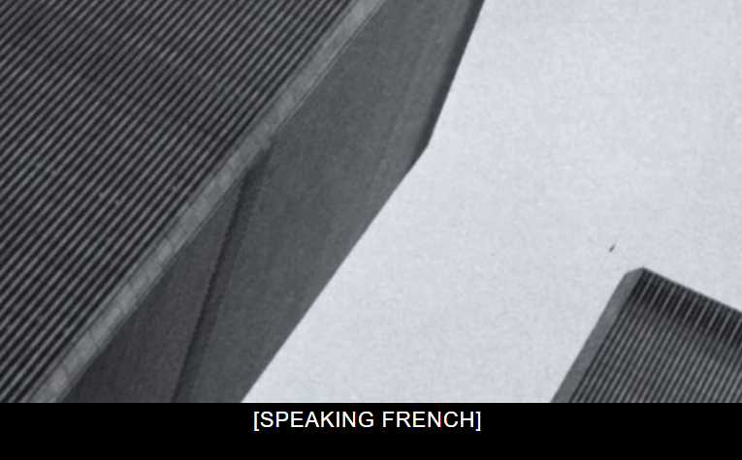
Example – Foreign words
Notes:
All actual words are captioned, regardless of language or dialect. This also applies to foreign words - caption the actual foreign words if you can. However, if it is not possible to caption the words, use a description (e.g., [SPEAKING FRENCH]). Never translate foreign words into English.

Slide 23
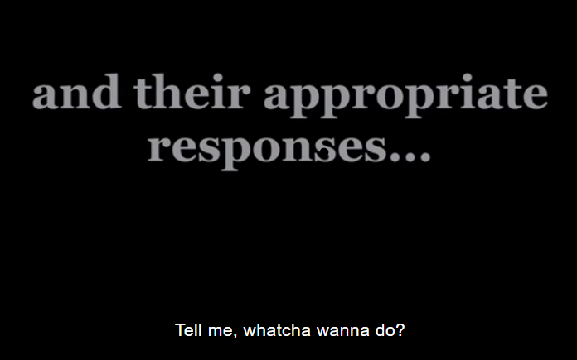
Example – Slang
Notes:
Use of slang and accent is preserved and identified. (e.g., “hey, y’all” or “wuddup”). Try to keep the flavor of dialect and the speaker's language. Indicate regional accent at the beginning of the first caption, if known.

Slide 24
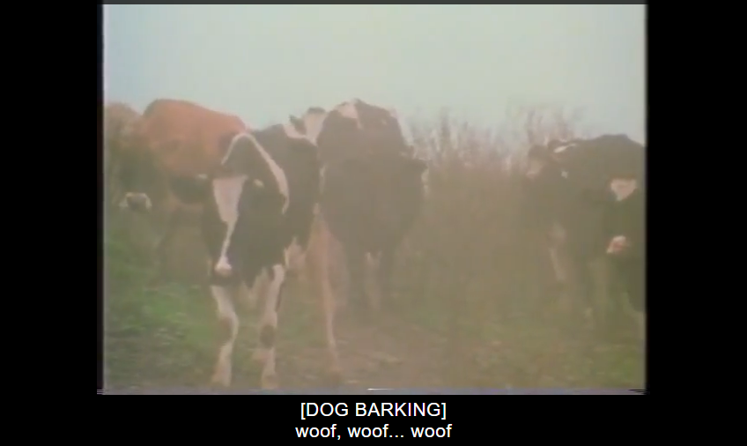
Example – Sound effects
Notes:
Sound effects are written when they add to understanding. A description of sound effects, in brackets, should include the source of the sound unless the source of the sound is visible onscreen. Include onomatopoeia when possible.

Slide 25
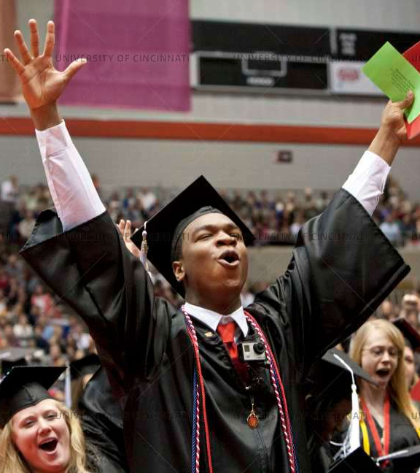
Captioning Tips
Bring videos and recordings into Kaltura
Add auto-generated machine captioning to videos at time of creation
Curate third-party content that already has professional-level captioning
Consider audio quality when recording
[CROWD CHEERING]
Whoo!
Notes:
Last of all I have some captioning tips that will make captioning easier, benefit our students and other consumers of captioning, and will set up your media content to be accommodation ready.
Bring videos and recordings into Kaltura
Add auto-generated machine captioning to videos at time of creation
Curate third-party content that already has professional-level captioning
Consider audio quality when recording

Slide 26
Bring videos and recordings into Kaltura
Upload existing audio/video content
Add public YouTube videos to Kaltura
Use enterprise tools such as Kaltura Capture and Zoom
Convert your narrated PowerPoint’s to MP4 files or use Kaltura capture to record your slideshow presentations
Notes:
BRING VIDEOS AND RECORDINGS INTO KALTURA
To bring videos and recordings into Kaltura:
Upload existing audio/video content
Add public YouTube videos to Kaltura
Use enterprise tools such as Kaltura Capture and Zoom
Convert your narrated PowerPoint’s to MP4 files or use Kaltura capture to record your slideshow presentations

Slide 27
Add auto-generated machine captioning to videos at time of creation
Builds a captioning habit
Easily replaced by professional captions
Captions can benefit all students
“Regardless of whether they had a disability of any kind, the majority of students used closed captions at least some of the time”
~ Oregon State/3Play Media national survey results on captioning in higher ed
Everyone has the option
Notes:
ADD AUTO-GENERATED MACHINE CAPTIONS TO VIDEOS AT TIME OF CREATION
Add auto-generated machine captions to your Kaltura videos at the time of creation. And I say this for several reasons. Machine captions are not suitable for accommodations but adding machine captions to your Kaltura videos will help you to be familiar with the captioning process and build in captioning as part of your content creation procedure. Plus if you can add machine captions to your videos in Kaltura, then you know that those captions can easily be replaced by professional captions, if requested. More people are using captions, not only people with disabilities, so by adding machine captions, you are giving everyone a choice.
A few years ago, Oregon State and 3Play Media conducted a national survey on captioning in higher ed and one of the outcomes was that, “Regardless of whether they had a disability of any kind, the majority of students used closed captions at least some of the time.”

Slide 28
Curate third-party content that already has professional-level captioning
UC Libraries
Free streaming video resources
Licensed streaming video resources
Streaming and download services
Notes:
CURATE THIRD-PARTY CONTENT THAT ALREADY HAS PROFESSIONAL-LEVEL CAPTIONING
Go to UC Libraries (Deborah Tenofsky)
Utilize:
Free, streaming video resources like Frontline, PBS Video, and TED: Ideas Worth Spreading
Licensed streaming video resources such as Films on Demand and Kanopy
Streaming and download services like Amazon Prime Video, Netflix, Hulu, iTunes, and Google Play.

Slide 29
Consider audio quality when recording
“We can all forgive imperfect video, but we can’t tolerate bad audio”
~Chris Mattia, LinkedIn Learning educator
Better audio results in better captions
Check and adjust your microphone levels
Minimize background noise
Use a USB microphone or headset/mic combo rather than a built-in system mic
Notes:
CONSIDER AUDIO QUALITY WHEN RECORDING
“We can all forgive imperfect video, but we can’t tolerate bad audio”
~Chris Mattia, LinkedIn Learning educator, specializing in LMS and ed tech
Better audio results in better captions - your captions will only be as good as your audio.
There are some small steps you can take to improve audio:
Check and adjust your microphone levels
Minimize background noise
Use a USB microphone or headset/mic combo rather than a built-in system mic (and check these - I know when I use Kaltura Capture it will default to my system mic even if I’m using a USB mic)
Webcam: Aesthetic Tips knowledge base article

Slide 30
Resources
UC Accessibility Network (https://www.uc.edu/about/accessibility-network.html)
Digital Technology Solutions Captioning intranet site on Bearcats Landing (https://mailuc.sharepoint.com/sites/ITatUC/SitePages/Captioning.aspx)
Described and Captioned Media Program (DCMP) Captioning Key (https://dcmp.org/learn/captioningkey)
Captioning And Described Editing Tool (CADET) (http://ncamftp.wgbh.org/cadet/)
Notes:
I’ve include a resource page with the resources I talked about today.

Slide 31
Contact
Katheryn Lane
Electronic & Digital Accessibility Specialist
UC Accessibility Offices
University of Cincinnati
Email: katheryn.lane@uc.edu
Digital Access Team Email: digitalaccess@uc.edu

