Slide 1
Leveraging Digital Accessibility Data to Gain Buy-in
Jessica Guess & Nakia Keathley
7/22/20

Slide 2
Learning Outcomes
Participants will be able to:​
Identify the types of data collected related to digital accessibility​
Identify the approach UC takes to sharing that data​
Understand how UC uses data to increase buy-in

Slide 3
Digital Accessibility Data Collection History
OCR Corrective Action Resolution Agreement
Creation of position dedicated to data collection
Creation of data collection plan

Slide 4
What Data We Collect
Categories
Website
Academic Content
Procurement
EIT Training
Student and Employee accommodation information
Document remediation
Accessibility review requests
(We collect other data that is not digital accessibility related as well)

Slide 5
Who We Share Data With Inside UC
Steering Committee: high level stakeholders​
Accessibility Liaisons: College/Unit representatives
Accessibility Network: core team doing the work and/or collaborating/training others to do the work
Colleges/Units: Directors/Deans
(This is in addition to formal reporting like our annual report)

Slide 6
How We Share Data
Monthly meetings with Stakeholders
Once per semester meetings with Liaisons
Regular meetings with Accessibility Network Core Team
New audit tool which will be rolling out this fall

Slide 7
New Audit Tool: How We Share it is Important!
Sharing high level information as well as specifics can help those in leadership positions understand the current state of affairs/needs/gaps and plan for the future
Sharing an overall picture of accessibility (broken down into subcategories) allows those in leadership positions to assign work and track progress
Future planning and progress tracking allows us to keep on track with our commitments to OCR and as a university
Leadership buy-in is increased when we present a clear picture of the data and provide guidance/encouragement to increase engagement

Slide 8
Audit Tool Categories
Website
Academic Content
Procurement
EIT Training

Slide 9
Sneak Peek at the Audit Tool Features
General information data
Top 3 issues
Use of gauges
Year-to-date and semester-to-date tracking/progress
Guided action planning

Slide 10
General Information Data
Information is shared across all 4 categories that is there to help paint a picture of accessibility for the stakeholders​
This information requires no action and is there only to help the user understand the current state of things
This information can include:
The number of students with disabilities enrolled in the specific college
General website accessibility scores
Academic content accessibility scores
The number of procurement (3rd party) accessibility review requests
The number of faculty and staff who completed the mandatory EIT course by the deadline

Slide 11
Top 3 Issues
The goal of sharing Top 3 Issues is to break things down and keep them from being overwhelming.
For example:
Ally in Canvas reports have 66 columns of information which is overwhelming
A website audit report could have dozens of lines of issues that only mean something to the person who is responsible for building the website or who handles website accessibility reports on a daily basis
We want people to be able to digest the information and make informed decisions about future action.

Slide 12
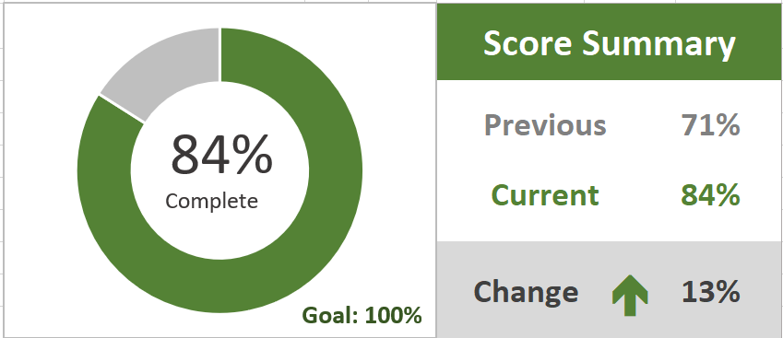
Use of Gauges
The goal: Use dashboard gauges to quickly highlight the status of key metrics.
We want to be able to show, especially to upper management, clear and simple visual indicators of progress relative to objectives.

Slide 13
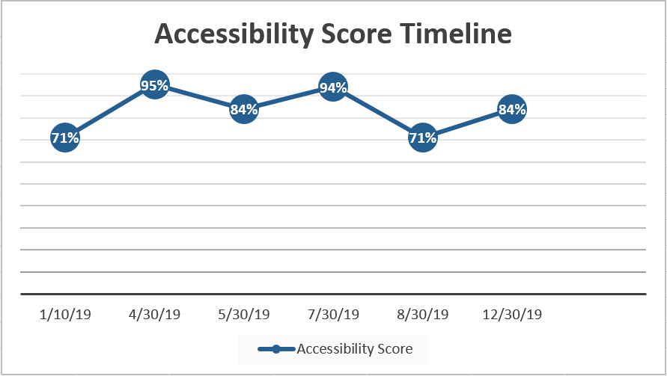
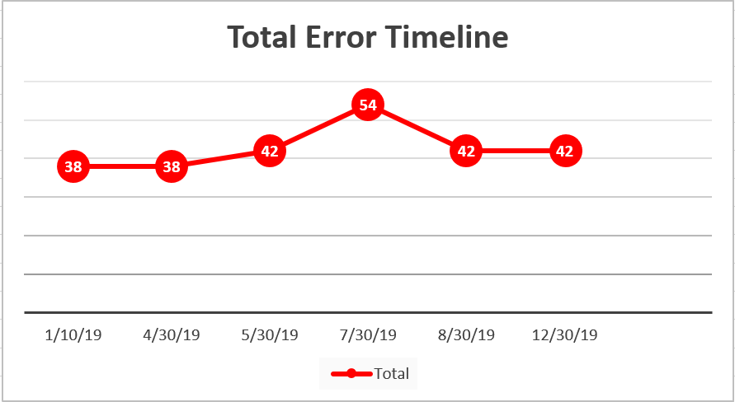
Tracking and Progress
The goal of using a Timeline is simply to show comparative progress, month-to-month.
Including these in a dashboard can highlight areas that need improvement quickly, as well as positive and negative trends that may need to be addressed.

Slide 14
Guided Action Planning
The college develops a roadmap
They analyze the data from dashboards and/or other accessibility scanning applications such as Level Access
Prioritize the issues
Depending on the issues found, it may be necessary to focus primarily or even exclusively on high priority issues first​
Establish a clear plan for remediation
Using the website audit tool, they can review progress and update the action plan as necessary

Slide 15
Tying it All Together
Sharing information with administration can encourage friendly competition
Putting it all in one place makes accessing it easy-no one has to hunt for the information
Allowing administration to assign tasks to those responsible for the work will get the information into the hands of those who can make changes while also keeping administration informed about needs/progress
Previewing this information with our Steering Committee and Liaisons allowed us to get feedback and work to develop something that will actually be useful and beneficial

Slide 16
Contact Information
Jessica Guess, Program Manager for Accessibility Compliance
Jessica.Guess@uc.edu
(513) 399-5997
Nakia Keathley, Accessibility Program Manager
keathlna@ucmail.uc.edu

