Slide 1
UC’s Mobile App: Helping with Accessibility
Jackie Freiermuth
07/22/2020

Slide 2
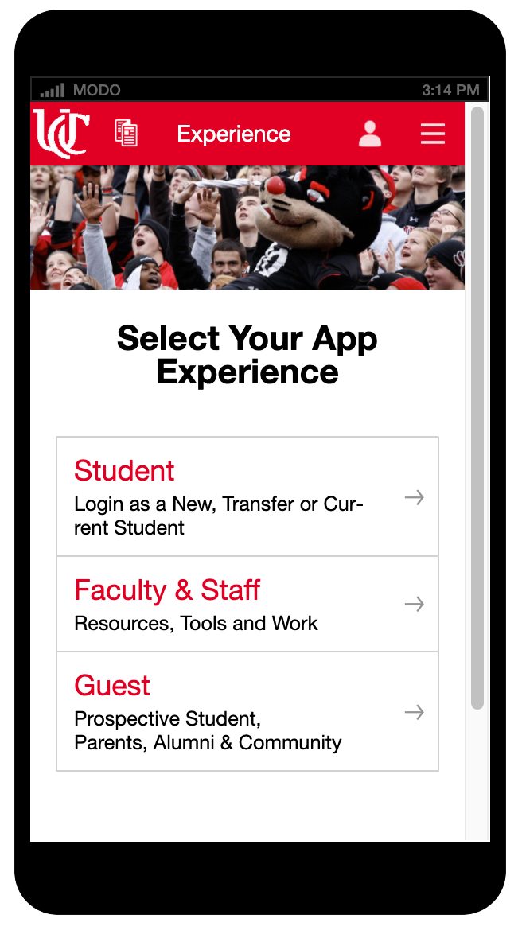
UC Mobile App
Multiple experiences across
one accessible platform

Slide 3
Features
Maps, Wayfinding
Shuttle routes
Campus Tours
Single Sign on for Student tools
Directories
Surveys
Event Schedules
News
Social Media Integration
Personalization

Slide 4
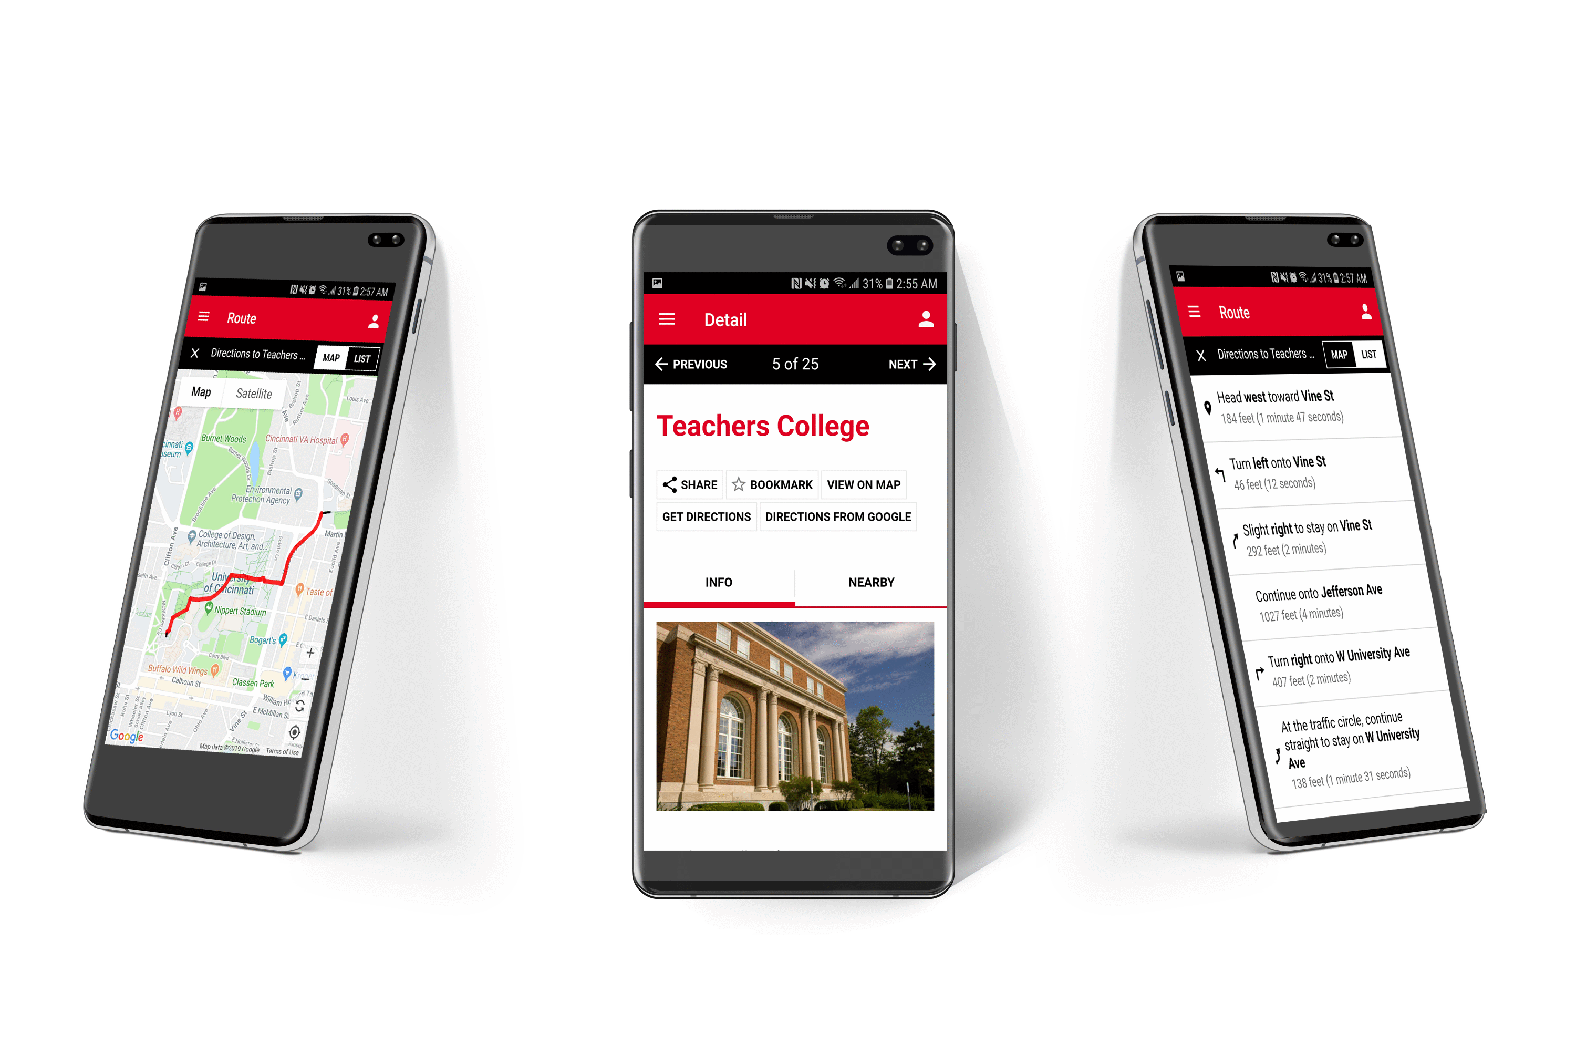
Wayfinding

Slide 5
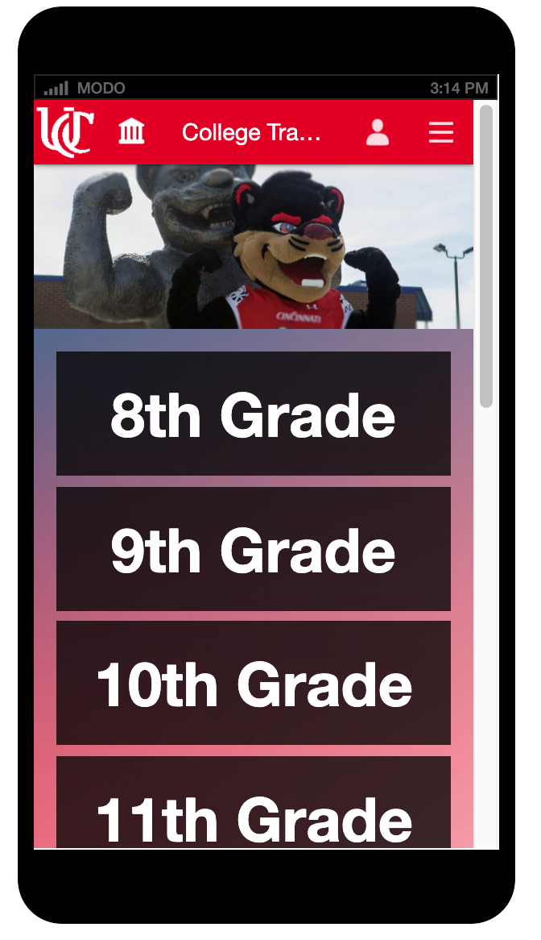
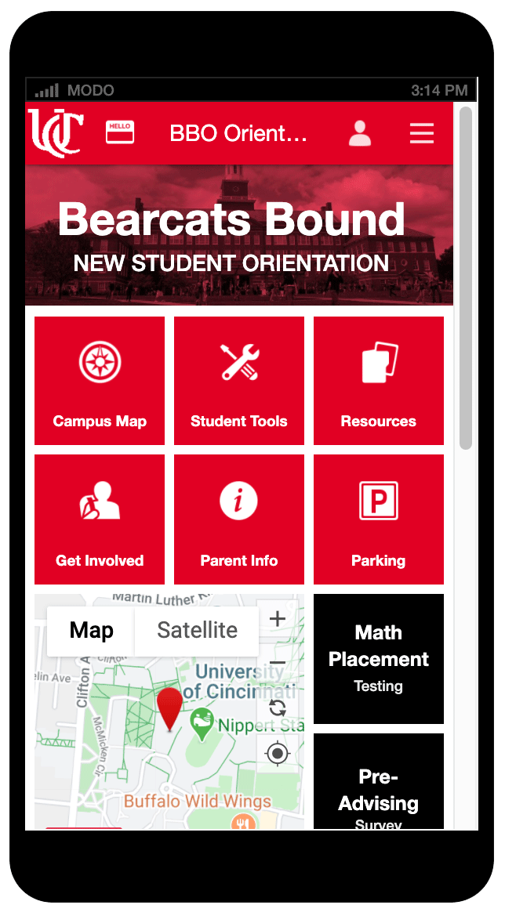
Personalized Content
Bearcat Tracker
Transfer Students
New Student Orientation

Slide 6
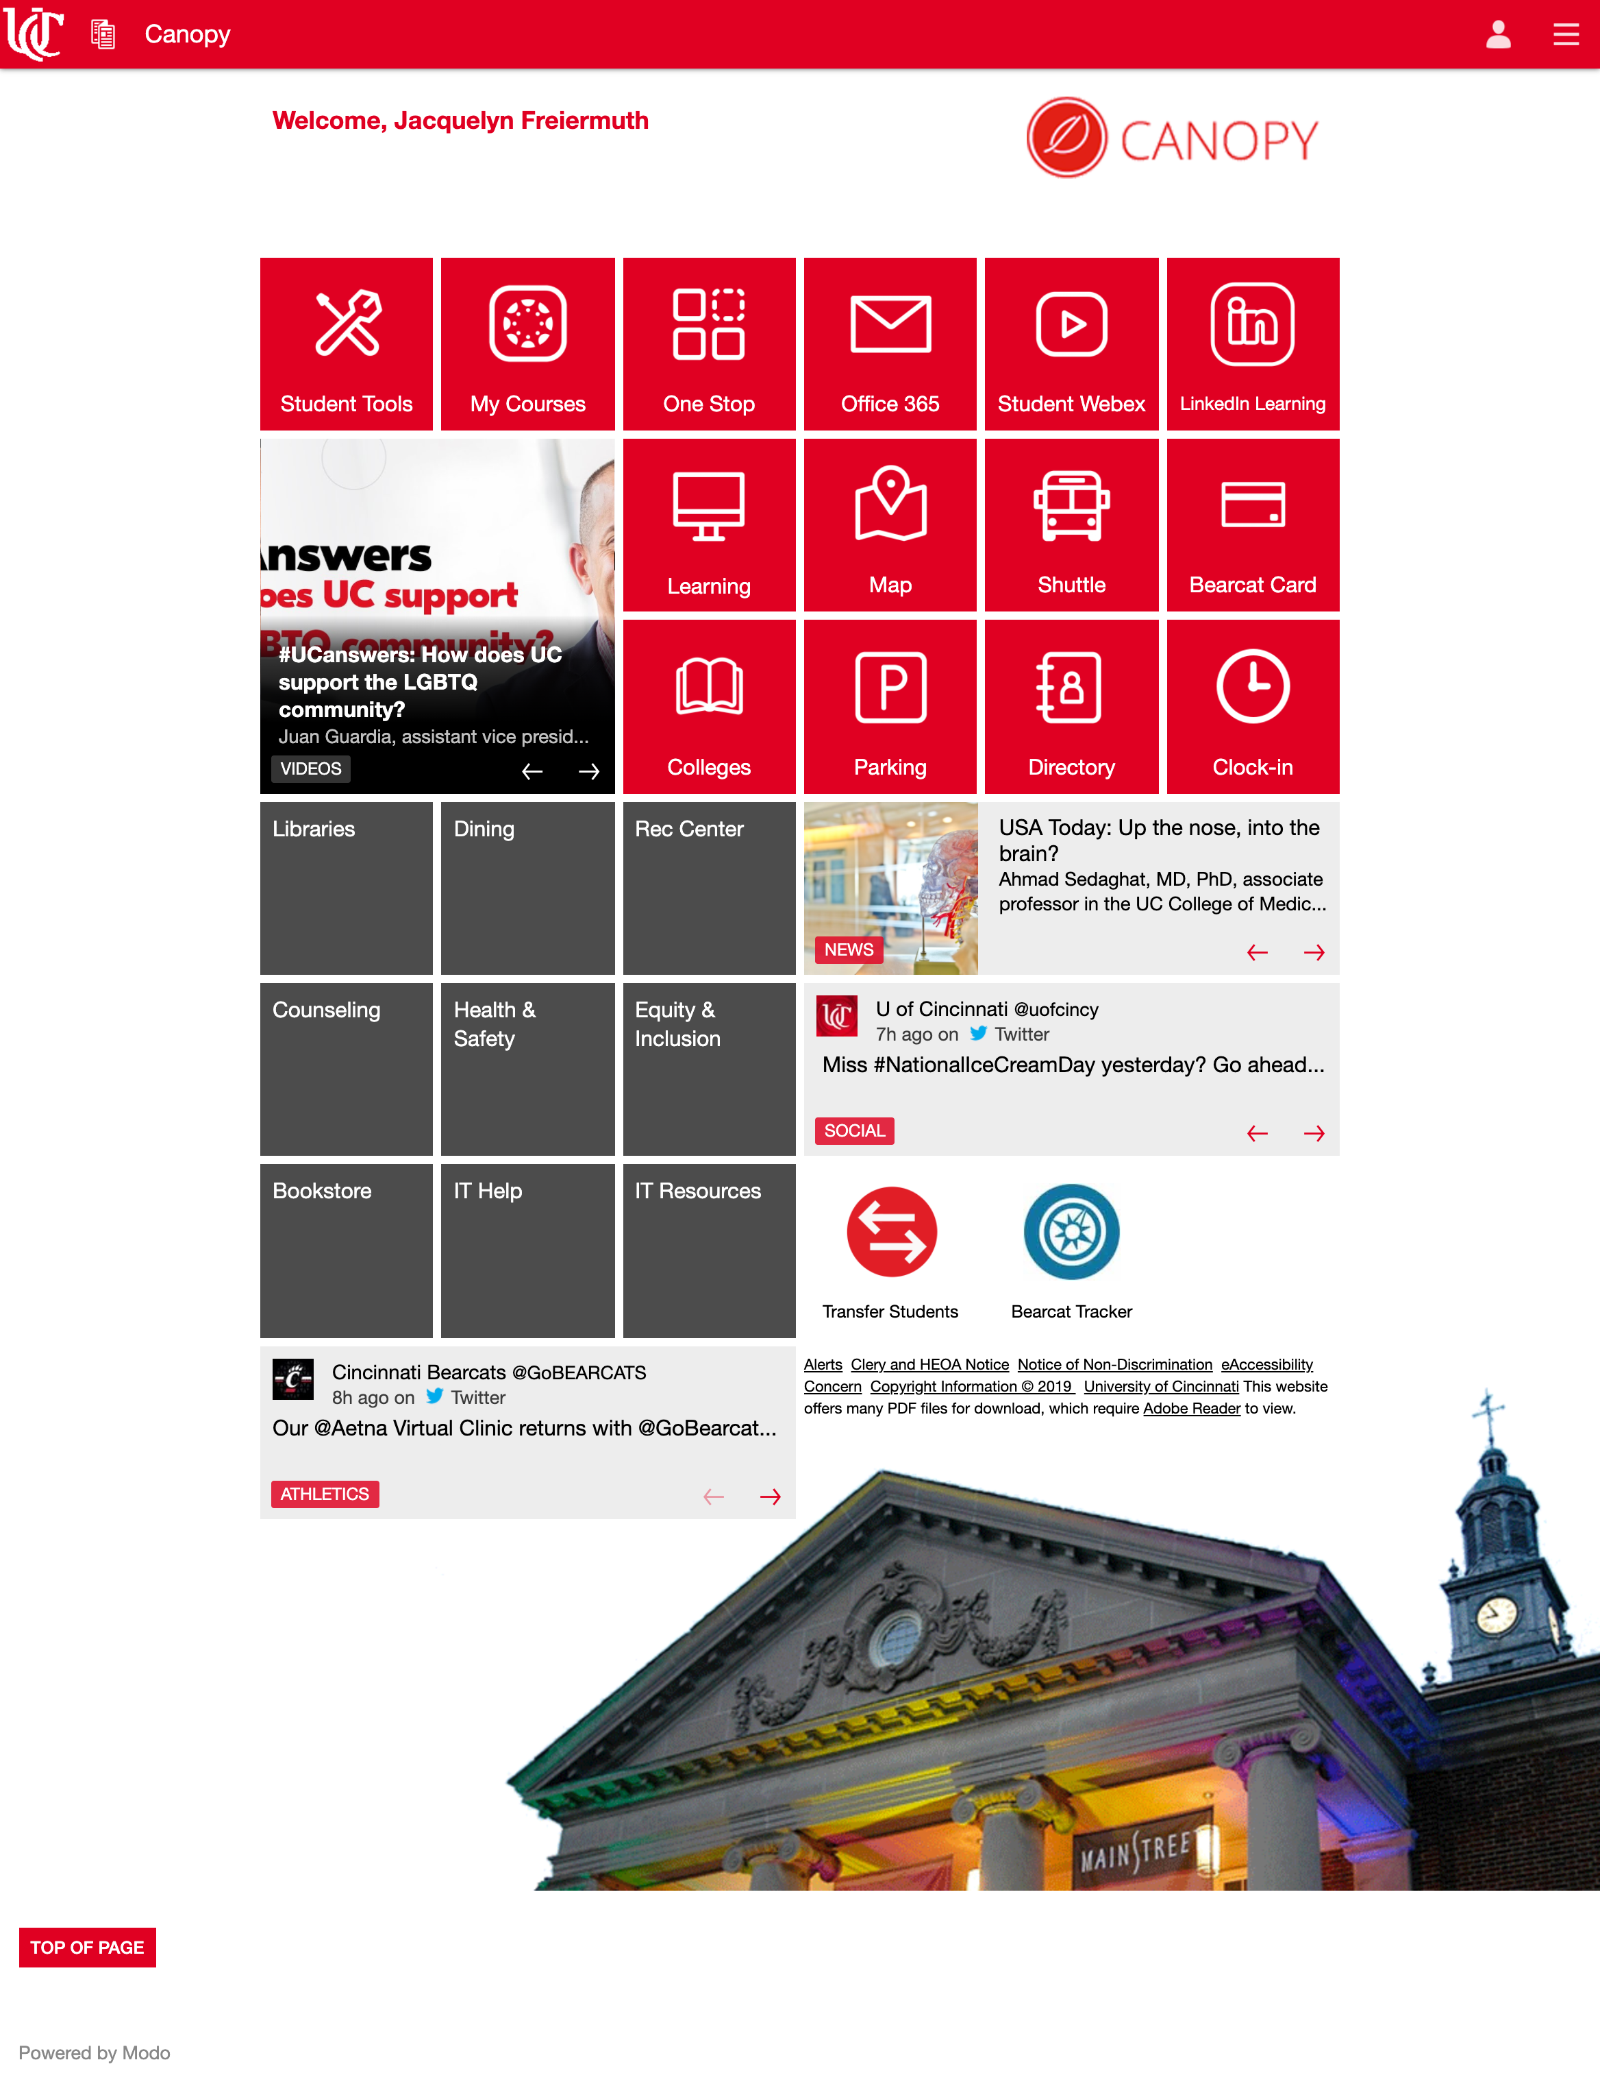
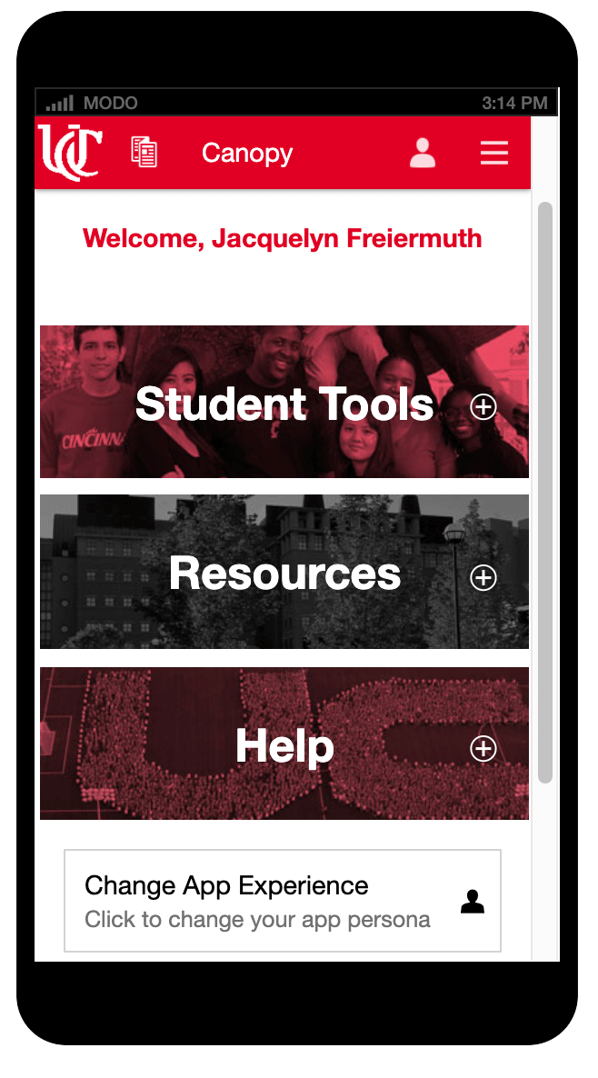
Canopy Portal
Two platforms, One app

Slide 7
Communication
“Creating and maintaining an engaged student body requires a personalized communication strategy that starts with understanding the student lifecycle. Communicating the right information at the right time can be the glue that retains students from orientation to grad school, and beyond.” - Modo

Slide 8
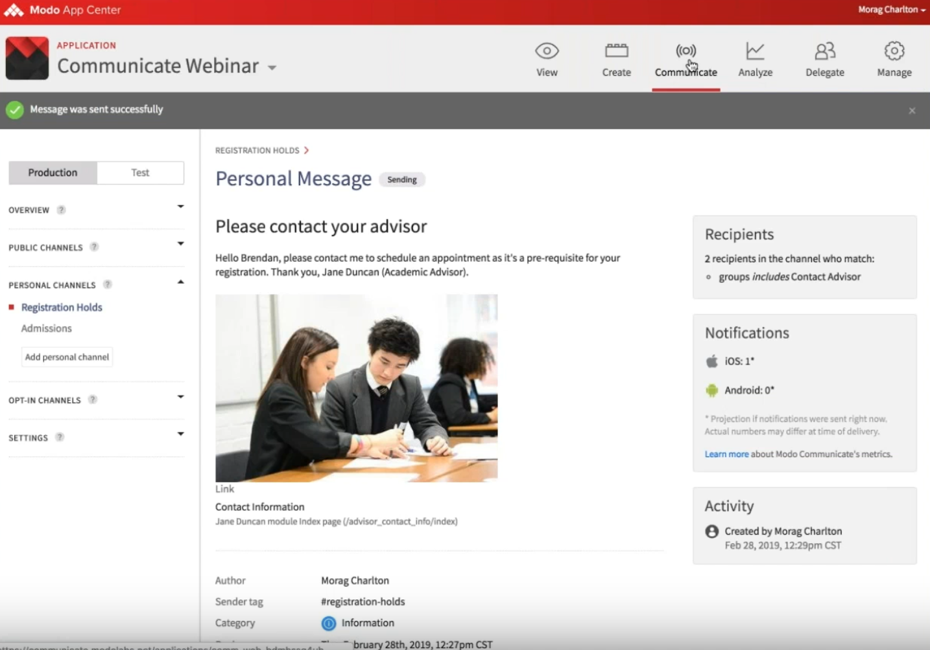
Communication
Personalized communication empowers both students and academic staff by enabling rich communication channels that can reach students, mentors and advisors with rich, timely and engaging information.

Slide 9
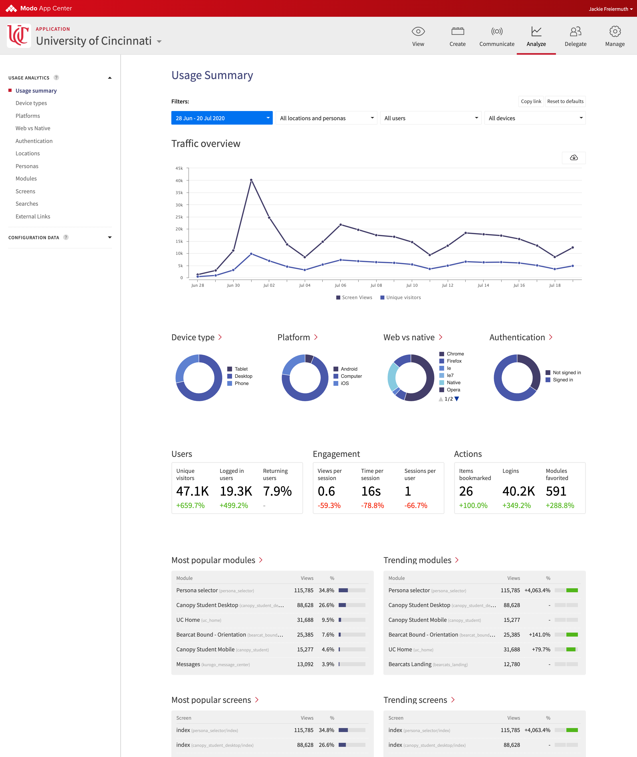
Analytics
Tracking and Analyzing:
Traffic
Device Type
Desktop vs Mobile
Popular Modules
Searches

Slide 10
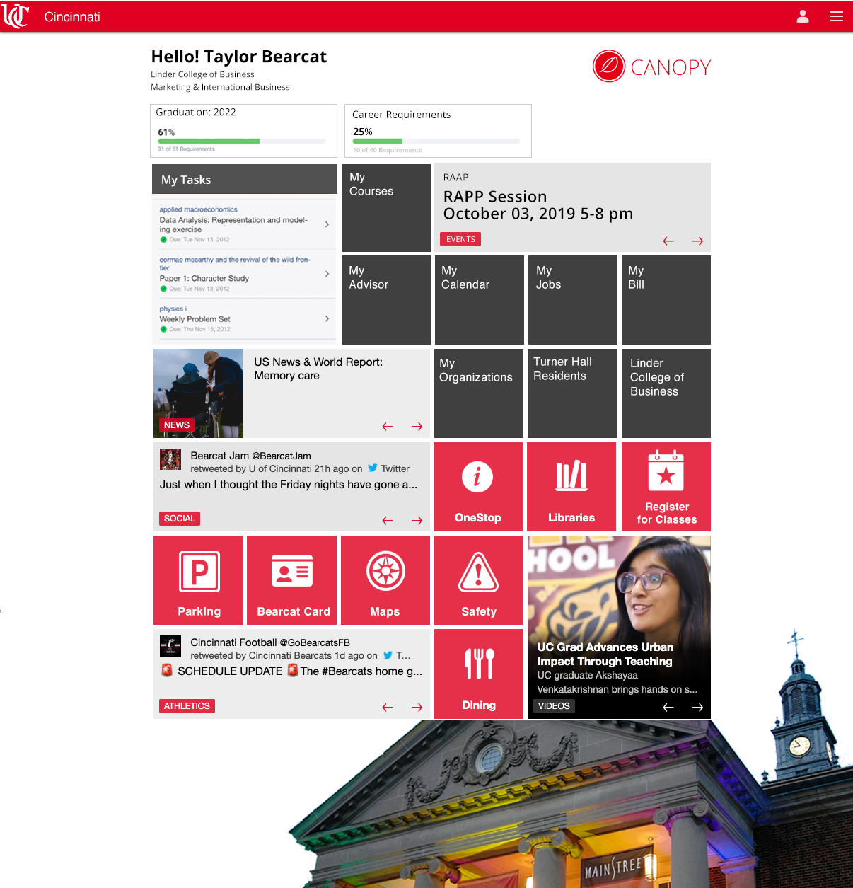
Future Additions
Student Events
Student Organizations
Marketplace
Personalized learning
Indoor wayfinding

