Slide 1
Using the Ally Course Accessibility Report
Megan Wuebker
July 22, 2020

Slide 2
Learning Outcomes
Attendees will be able to:
Find the Ally course accessibility report in their Canvas course
Identify how to use the course accessibility report to improve issues based on severity and ease of remediation

Slide 3
What is Ally?

Slide 4
What is the Ally course accessibility report?
The Ally course accessibility report (CAR) provides an accessibility summary and overview at the course level.

Slide 5
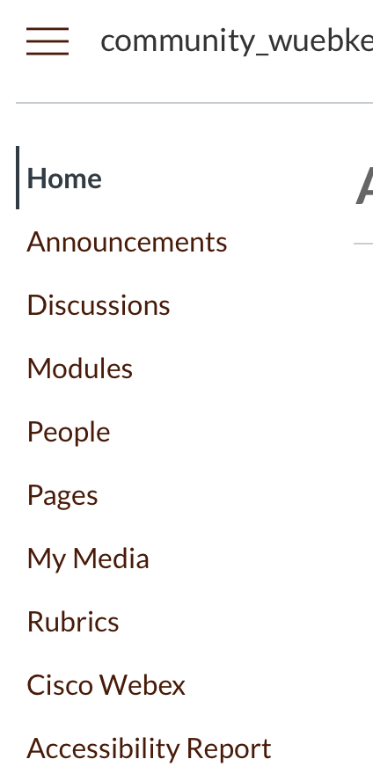
Where can I find the CAR?

Slide 6
What does the CAR look like?

Slide 7
What is included in the CAR?
The CAR includes Overview and Content tabs so that you can get the big picture as well as specific details about the accessibility of your digital course content.
The Overview tab shows the accessibility score for the course, course content grouped by content type, and a list of all issues identified in the course
The Content tab shows you the content with accessibility issues.

Slide 8
What does the accessibility score mean?
Scores range from Low to ”Perfect”:

Slide 9
”Perfect” means it’s fully accessible…right?
Nope. It means Ally didn't identify any accessibility issues, but further improvements may still be possible.
What may be ”perfectly accessible” for one student may be completely inaccessible for another.

Slide 10
What content does Ally check?
PDF files
Microsoft® Word files
Microsoft® PowerPoint® files
OpenOffice/LibreOffice files
Uploaded HTML files
Image files (JPG, JPEG, GIF, PNG, BPM, TIFF)
WYSIWYG/VTBE content (only appears in the course accessibility report and the institutional report)

Slide 11
How can I see the breakdown of my content types?

Slide 12
What about the WYSIWYG editor?
WYSIWYG stands for “what you see is what you get.”
This is the type of text editor in Canvas, also known as the Rich Content Editor.
Ally checks the content created through the WYSIWYG editor for accessibility issues.

Slide 13
What WYSIWYG content is checked?
Announcements
Assignments
Discussion topics
Quiz description
Syllabus
Page

Slide 14
How do I choose what to fix?

Slide 15
How do I determine what’s most important?
Issues are listed in order of priority from severe to minor.
Those at the top of the list should be addressed first.
Ally looks at the number of students impacted, how often the issue occurs, and the accessibility score to determine the priority.

Slide 16
What do the severity indicators mean?

Slide 17
What happens when I select an issue to fix?
The instructor feedback panel will appear, and you’ll go through the process as if you were accessing the content from a gauge in your course.

Slide 18
Faculty FAQs

Slide 19
Is Ally already in in my Canvas course?
Yes! Ally has been enabled for all courses in Canvas.

Slide 20
Can students see the CAR?

Slide 21
Do I have to fix everything at once?
No!
Our goal is continuous quality improvement:
For historic content that is no longer available, work with your college ID, the libraries, or the Accessibility Network to make this content accessible.
Make sure new content is accessible when it’s created.

Slide 22
Questions

Slide 23
For more information:
Megan Wuebker
wuebkemp@ucmail.uc.edu

