Slide 1
What to Expect with an Accessibility Review During the Procurement Process
Amanda Calvert & Nakia Keathley
August 2, 2021

Slide 2
Housekeeping
ASL Interpreters: This session has ASL interpreters. Using the Side by Side view should allow for the best view.
Closed Captions: Live transcript has been enabled for this session. To view the captions please click on the arrow/caret next to the CC icon and select “View Subtitles”.
Recorded Session: This presentation is being recorded and will be shared for future trainings.
Q&A: For any questions you may have, please select the Q&A icon in your menu bar and type your questions in the Q&A panel. Questions will be reviewed at the end of the session and answered as time allows.

Slide 3
Learning Outcomes
Learn why accessibility is important for third party EIT purchases.
Understand what an ACR and a VPAT are and their purpose at UC.
Know what to expect during the accessibility review process.

Slide 4
Fact or Fiction
It’s poll time!

Slide 5
Why is it important
It’s the law
It’s the right thing to do

Slide 6
Legal Requirement
Section 504 Rehabilitation Act "No otherwise qualified individual with a disability in the United States . . . shall, solely by reason of her or his disability, be excluded from the participation in, be denied the benefits of, or be subjected to discrimination under any program or activity receiving Federal financial assistance”
Notes:
Heidi

Slide 7
Legal Requirement cont.
Americans with Disabilities Act
Applies to employees, students, guests and visitors
Requires accommodations and access
Case law and DOJ repeatedly uphold that the ADA applies to electronic environments
Notes:
Heidi

Slide 8
How do we know this applies to third party products?
Section 508 of the Rehabilitation Act of 1973
In 1998, Congress amended the Rehabilitation Act of 1973 to require Federal agencies to make their electronic and information technology (EIT) accessible to people with disabilities. The law (29 U.S.C § 794 (d)) applies to all Federal agencies when they develop, procure, maintain, or use electronic and information technology.
https://www.section508.gov/manage/laws-and-policies
Notes:
Heidi

Slide 9
Beyond Compliance
Conforming to accessibility standards does more than keep us out of the news and the courts
Student experience and success
Visibility can lead to awareness and efficiencies
It’s the right thing to do!
Notes:
Student experience and success - having accessibility policies in the procurement process can assist in limiting the number of inaccessible technology on campus. If the technology is accessible or there is an adequate accommodation plan in place, students will not be left behind while waiting for the university to find an accommodation. Enabling the student to be successful from day one.
- Story – just want to be able to sit and do my work. This is not an unreasonable expectation.
Visibility can lead to awareness and efficiencies - Most people, including faculty and staff are not aware of the true need for accessibility. Making it a part of the procurement process is one step in the way we change the way people think. Similar to IT security, we should make accessibility a criteria when first researching and considering any technology.
- As we are reviewing, testing and tracking accessibility in our EIT, we have a central repository of technology and its accessibility compliance. Colleges may find other colleges that already have licenses to the same or similar products that they can piggy back from. Saving the university in resources and costs across the board.
It's the right thing to do

Slide 10
Who does UC’s accessibility process within procurement benefit?
All students
All faculty
All staff
Community
Our vendors

Slide 11
Accessibility in a buyer’s journey
Discovery
Consideration
Decision
Implementation
Renewal
Understand potential barriers
Make a11y a criterion
Ask about accessibility
Request an ACR/ VPAT
Include a11y language in RFP, contract, etc.
Request IT a11y review
Include a11y in requirements and customizations
Training and accommodations plan for known barriers.
Request updated ACR/VPAT
Request IT a11y review
Accessibility in a Buyer’s Journey
Note: a11y = Accessibility

Slide 12
Before the review request
Criterion
Google
Ask
ACR/VPAT

Slide 13
ACR or VPAT?
Voluntary Product Accessibility Template (VPAT):
a blank template that can be filled out to account for a product or service’s state of accessibility.
Accessibility Conformance Report (ACR):
a completed VPAT (i.e., the blank template is filled out) along with all of the other details in the report.
In the marketplace, the term VPAT dominates, even though it’s usage is technically incorrect. Vendors and procurement departments (including UC) use VPAT but what they really mean is ACR.

Slide 14
What is a VPAT?
Voluntary Product Accessibility Template
A document that explains how information and communication technology (ICT) products such as software, hardware, electronic content, and support documentation meet (conform to) the Revised 508 or WCAG Standards for IT accessibility. VPATs™ help organizational buyers to assess ICT for accessibility when doing market research and evaluating proposals.
Template: https://www.itic.org/policy/accessibility/vpat

Slide 15
What is a VPAT? – Simplified
Voluntary Product Accessibility Template
The VPAT is a document that the vendor completes. The document provides crucial information about potential accessibility barriers providing guidance to buyers during the procurement process.

Slide 16
Who creates a VPAT?
The owner of the product (vendor) is responsible for creating a VPAT.
The best VPAT’s are typically completed by an IT professional or a third-party vendor.

Slide 17
How does UC use VPAT’s
Guidance
  Procurement
  Testing
  Temporary Accommodation Planning
Audit trail

Slide 18
What do we look for in a VPAT?
508 or WCAG 2.0+ AA+
Version – VPAT 2.3+
Accessibility contact
Recent completion date (<12 months)
Detailed responses
Notes:
Pull up the file to share.

Slide 19
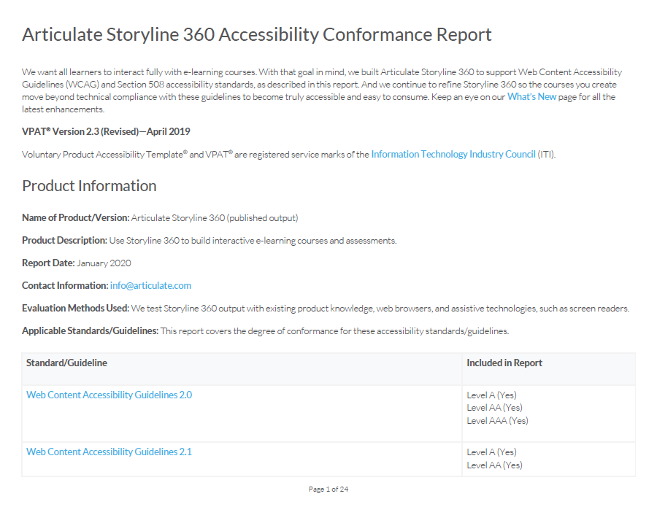
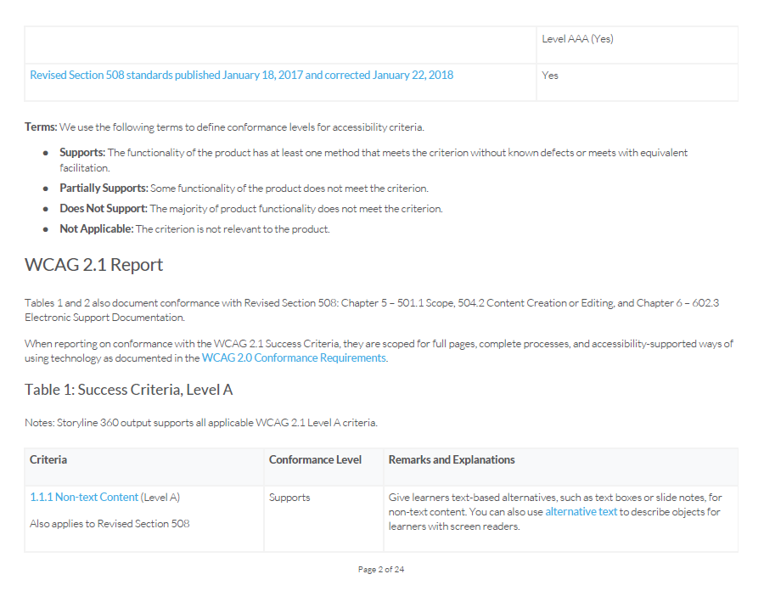
VPAT Example
Notes:
Pull up the file to share.

Slide 20
Accessibility Review Request Process
Submit A11y review request
IT Service Portal
Review
Assessment
Feedback
Accessibility Testing
Kick-off
A11y Test
Results
Access Plan
A11y Summary
Vendor Roadmap
Temporary Accommodation Plan
https://www.uc.edu/about/accessibility-network/purchasing/accessibility-review.html

Slide 21
Submit Accessibility Review Request
IT Service Portal
  Service Catalog: Accessibility Services, Accessibility Network
  UC Accessibility Network website
  UC Accessibility Network Intranet site

Slide 22
Accessibility Review Request Form Explained
Requested for: Purchasers should put the business owner’s name here. The business owner will then be included in communications and meetings.
Type of asset to be reviewed:
  Third Party Product: Use this form to request a third party product review. This includes app and websites from any third party vendor.
  Website or Webpage: Use this form to request an accessibility scan for UC websites only. (This does not include third party apps or websites.)
  Document: Use this form to request assistance making a UC document accessible. (Example: PDF and Microsoft Office Documents)"

Slide 23
Accessibility Review Request Form Explained – cont.
PACE
Function of product
Who will have access (audience)
Number of users
Integrated/embedded on UC website
Description

Slide 24
Accessibility Review
Risk Assessment
  Low, Medium, High
VPAT Review
Feedback
  Next steps

Slide 25
Feedback
Typically, within 5 business days
Email sent through IT Service Portal
Decision, responsibilities and next steps
Blockers and/or Barriers found in VPAT

Slide 26
Example Feedback Email
Decision
The Accessibility Conformance Committee has reviewed this request and determined that additional testing will need to be performed to provide information and the best guidance for purchase and/or use of this product in the fulfillment of equal access.
It is important to note that ability status of any person (ie: students, staff and faculty) may not be required to be disclosed and is not static, and as such, when you purchase a product that has known barriers to accessibility you are taking somewhat of a risk. Should you hire someone who needs to use this product who does have a disability or should someone who works/studies at the university now become disabled, the office requiring the use of this product would be responsible for ensuring that they can still do their work and accessibility issues would need to be addressed at that time.
If you have additional questions about this review or your next steps, please contact Nakia Keathley.
Next Steps
The Accessibility Network (AN) will perform an automated scan and a full manual accessibility test of the product.
  You will receive a meeting request where we will give you more information on what to expect and timeline.
  The AN will provide a summary and full report on our findings during the automated and manual accessibility testing.
  If blockers or significant barriers are found we will work with you to put together an access plan to ensure fulfillment of equal access.
Recommended: Work with Office of General Counsel to include accessibility language within your contract.
Responsibility

Slide 27
Decision
Need more information
Accessibility testing not required
Accessibility testing required

Slide 28
Next Steps
Communication plan
Testing plan
Accessibility rider for contract
Contract renewal

Slide 29
Accessibility Test Process
Kick off call
Accessibility testing*
Results review
Accommodation planning
*Accessibility Network only

Slide 30
Kick Off
Purpose: Gather all information needed to perform a test.
  Tester access
  Demo of product
  Scope defined
Attendees
  Business owner: can answer how to get access and provide a demo. Buyer/purchaser typically will not be able to answer these questions.
  Vendor: recommended but optional
  Accessibility Network: QA team member and program manager
Good to know
Always recorded
30 – 60 minutes
Accessibility Network will schedule

Slide 31
Accessibility Test
A full accessibility test consists of two types of tests, automated and manual. Each test is critical to identify any accessibility barriers within the product.
Automated tests
Automation tools
Noninvasive
15 - 30% of errors can be found
Manual tests
Human testing
Screen reader, keyboard
User experience
Review/confirm automated errors.

Slide 32
Results Review
Purpose: Review the results from the Accessibility test.
  Explanation of results and how to use the spreadsheet
  Next steps
    Vendor roadmap
    Accommodation planning
Attendees
  Business owner
  Vendor: recommended but optional
  Accessibility Network: QA team member and program manager
Good to know
30 – 60 minutes
Accessibility Network will schedule

Slide 33
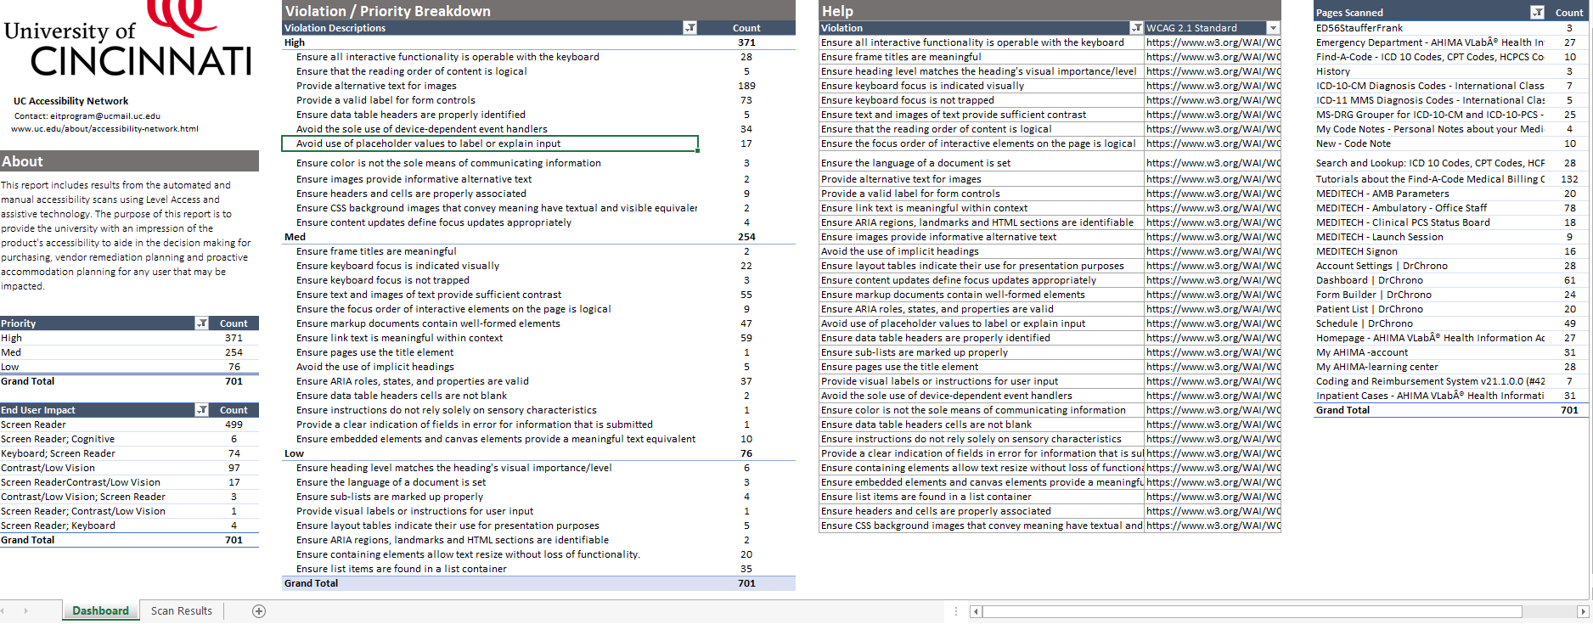
Results Summary Example

Slide 34
Vendor Roadmap
Vendor’s plan to remediate accessibility issues
Based on prioritization, vendor’s review
Should be scheduled as part of vendor’s development cycle

Slide 35
Temporary Accommodation Plan
TEMPORARY
Proactive
Communication and Process
Documented

Slide 36
Now what?
Communication
Contract renewal

Slide 37
Fact or Fiction repeat
repeat
It’s poll time, again.

Slide 38

Fact or Fiction Revealed
Revealed
If we purchase technology, we cannot make changes to the product; therefore, we are not accountable for the product’s conformance to accessibility.
I must always have a VPAT before I submit an accessibility request.
The course I teach requires you to have vision (pilot, doctor, nurse, digital design, etc) so my product, by nature, will not be accessible and I do not need to submit it for an accessibility review.
Because the accessibility review process can take time, it will hold up my purchase request.

Slide 39
Summarize
Accessibility as a criterion
Accessibility review request
Access plan
  Kick-off, Results, accommodations

Slide 40


Questions and Answers
Please post your questions in the Q&A panel by selecting the Q&A icon in your Zoom tool bar.

Slide 41
Thank you
Amanda Calvert, IT Accessibility Program Director
calveraa@ucmail.uc.edu
Nakia Keathley, IT Accessibility Program Manager
keathlna@ucmail.uc.edu

