Slide 1
Build a Bigger Toolkit: Advanced O365 Accessibility Features
Amanda Calvert & Nakia Keathley
Aug. 2nd 2021

Slide 2
Housekeeping
ASL Interpreters: This session has ASL interpreters. Using the Side by Side view should allow for the best view.
Closed Captions: Live transcript has been enabled for this session. To view the captions please click on the arrow/caret next to the CC icon and select “View Subtitles”.
Recorded Session: This presentation is being recorded and will be shared for future trainings.
Q&A: For any questions you may have, please select the Q&A icon in your menu bar and type your questions in the Q&A panel. Questions will be reviewed at the end of the session and answered as time allows.

Slide 3
Accessibility Commitment
Microsoft is committed to accessibility
There are no limits to what people can achieve when technology reflects the diversity of everyone. Our products and services are designed for people of all abilities.
https://www.microsoft.com/en-us/accessibility/

Slide 4
Learning Outcomes
You will discover captioning in Microsoft PowerPoint, Teams and Sway.
You will learn how to use Microsoft’s Narrator, Immersive Reader and Dictate.
You will be able to empower your students with new enhanced learning tools.

Slide 5
Today’s Focus
Immersive Reader
Narrator
Sway
Dictate
Teams
PowerPoint
Word
OneNote
Outlook

Slide 6
PowerPoint Focus
Live Captions
Video Playback - Adding captions or subtitles to a video

Slide 7
Live Captions
Present with automatic captions or subtitles, real-time.
Transcribe words as you present and display them on-screen as captions.
Subtitles can be translated to other languages.
Configure the appearance of the captions and subtitles to accommodate different environmental and audience needs.

Slide 8
Live Captions & Subtitles: Video
Live Captions & Subtitles

Slide 9
Video Playback: Adding Captions and Subtitles
Add closed captions or subtitles to videos or audio files in presentations.
Supports the playback of video with multiple audio track.
Supports closed captions and subtitles that are embedded in video files.

Slide 10
Video Playback – Adding Captions: Video

Slide 11
Live Captions – Using Teams
Detect speech and present real-time captions.
Includes speaker attribution to know who is speaking.
Captions are currently only available in English

Slide 12
Live Captions in Teams: Video

Slide 13
Microsoft Sway Focus
Accessibility view
Adding captions in sway

Slide 14
Accessibility View
What does Accessibility view do?
Assistive Technology can access all the content and provide jump locations
Change color contrast to provide high contrast
Vertical scrolling makes it easier for keyboard and Assistive Technology

Slide 15
Accessibility View (Cont.)
Vertical layout allow easier focus
Provides easier access to specialized content
Provides visual focus indicators for content
Excessive animations are removed

Slide 16
Turn On Accessibility View
Select “More Options” menu. (Shown as three dots)
Select “Accessibility View”

Slide 17
Adding Captions
Authors can associate closed caption files with their audio recordings or audio files.
Associate closed caption files with any video files.

Slide 18
Adding Captions: Video
The steps to add closed captions are the following:
Add your media file
Expand the card using the Details button on the top left of the card
Click the Add closed caption button
Upload your closed caption file and select a language.

Slide 19
Narrator
Screen Reading app built into Windows 10
Narrator reads aloud the text on your PC screen
It will highlight content as it reads aloud

Slide 20
Narrator: Start Up
To start/stop - Press Windows logo key + Ctrl + Enter together

Slide 21
Narrator: Welcome Screen
The welcome screen will help guide you.
QuickStart Guide
Narrator Guide
What’s New
Settings
Feedback

Slide 22
Narrator: QuickStart Guide
QuickStart guide will review:
Common commands
Navigation (Scan Mode)
Headings & Landmarks
Form field navigation

Slide 23
Narrator: Complete Narrator Guide
For further instructions and guidance, they offer a complete Narrator guide online.

Slide 24
Narrator: Outlook & Other Functionality
Outlook
Scan Mode turns on automatically. Use arrow keys to navigate email.
When email is opened, Narrator will start reading automatically. No commands required.
Narrator can be used with:
Touch and gestures
Braille Display
3rd party TTS software
Notes:
TTS = Text to Speech

Slide 25
Immersive Reader
Free tool built into Word, OneNote, Outlook, Teams, and others, that helps users read and comprehend text (Reading enhancement tool)
Allows students to have documents read back to them while highlighting the text.
Strips out distractions and converts the pages into an ebook-like experience with better fonts and background.

Slide 26
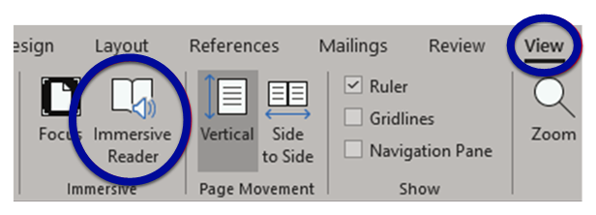
Immersive Reader: Word & OneNote
To start, click the View tab and then the Immersive Reader option

Slide 27
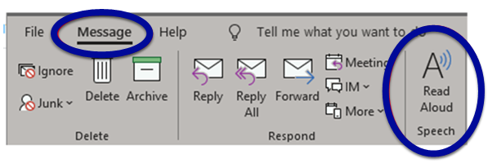
Immersive Reader: Outlook
From an opened email, click on the Message tab and then select the Read Aloud option.

Slide 28
Immersive Reader: Teams

Slide 29
Dictate Focus
Use speech-to-text to author content in Office
Dictate can be used in:
Word
Outlook
OneNote
PowerPoint

Slide 30
Dictate in Word

Slide 31
Dictate in Outlook

Slide 32
Dictate in OneNote

Slide 33
Dictate in PowerPoint

Slide 34
Microsoft Accessibility Resources
Accessibility Network
Microsoft Accessibility
Microsoft Inclusive Design
Microsoft Educator Center

Slide 35
Questions and Answers
Please post your questions in the Q&A panel by selecting the Q&A icon in your Zoom tool bar.

Slide 36
Thank you
University of Cincinnati
Accessibility Network
eitprogram@ucmail.uc.edu
Uc.edu/about/accessibility-network

