Slide 1
Accessibility Course Coordinator Training
Jessica Guess
August 3, 2021

Slide 2
Objective
Understand role, expectations, and responsibilities of course coordinator designation
What you can and can’t do as course coordinator
How to access scores to track completions
Options for reminding those who have not completed the requirements
How to help ensure enrollment list is accurate and up to date

Slide 3
Course coordinators: The basics
One person from each college or unit who has special permissions to view the gradebook for their designated section
Serve as a contact person to assist with enrollment/exemptions –not to make the decisions, but to serve as a point person to get that information from those in the college or unit who can make that decision
Check completions periodically and remind enrolled faculty and staff to complete the training as needed

Slide 4
What you can and can’t do in Canvas
Can
Can’t
Access the gradebook
Send messages
Post announcements
Enroll new people
Remove exempt people
Change grades
View sections other than your own

Slide 5
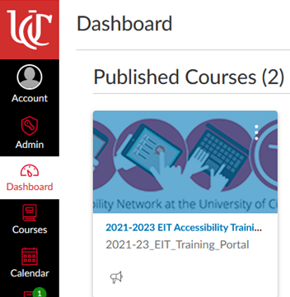
Accessing the course
Log into Canvas
Select the Course from your dashboard: 2021-2023 EIT Accessibility Training Portal

Slide 6
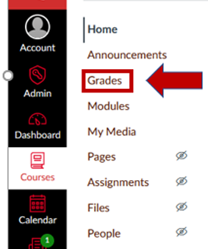
Accessing the Gradebook
Select Grades on the Left side course menu
This will pull up the gradebook and allow you to see completion scores for everyone enrolled in your section

Slide 7
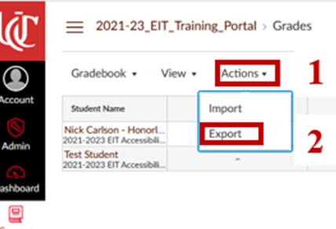
Exporting Gradebook to Excel
Select Actions along top menu bar
Select Export
This will open a dialogue box asking if you want to open the file in Excel or save it. It is your choice what you do (I typically open the file so I can edit/sort)

Slide 8
Reviewing the Excel file
Once you export the gradebook, you can delete any columns you don’t need (Canvas seems to have many extra columns that are not needed)
Format the remaining information into a table
Filter based on who have 150 points or more or on who has less than 150 to see who has completed and who still needs to complete it

Slide 9
Reminders: Announcements
Select Announcements from the left side course menu
Select + Announcement from the top right of the screen
Type your title and announcement and then use the drop down to select your section (This is the key step many people miss)

Slide 10
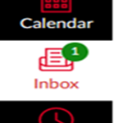
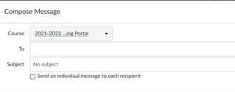
Reminders: Individual Messages
Select Inbox on the far right Canvas menu
Select the Compose button on the top right side menu
Select the course, select the name of the recipient, add a subject and message, send when complete

Slide 11
Maintaining an accurate enrollment
Periodically review the list to see if anyone is now exempt (retired, left UC, change in role) and send the names to me to remove from the course
Review any new hire lists I send and work with your department to determine if they need to be enrolled
Provide adjunct and GA/Student Worker lists for those who meet the criteria (I will reach out and ask for these)

Slide 12
Completing the training as a course coordinator
Because you are assigned the role of course coordinator, your completion can’t be recorded in the standard course.
A secondary (exact copy) has been created for you to complete your required training titled: [Course Coordinator] 2021-2023 EIT Accessibility Training Portal
This allows us to track your completions as well

Slide 13
The big question: What is the due date?
We have transitioned to a model of checking compliance training biennially
This fall a dashboard will be rolling out for deans allowing them to view and track accessibility related data
Training completion is one part of that
Colleges and units may set their own deadlines, so we encourage people to do the training for Fall

Slide 14
Q&A
Now is your chance to ask questions!

