Slide 1
Transition & Transformation: Fostering Student Success
Eileen Strempel Senior Vice Provost for Academic Affairs

Slide 2
The vast majority of students who begin at a 2-year school aim to earn a bachelor’s degree, but fewer than 15 percent achieve that goal within six years of community college entry.

Slide 3
For the more than one million degree-seeking students who start their education in a community college each year, successful transfer is an indispensable means to achieve that goal.

Slide 4
IMPROVING TRANSFER WITH AN EQUITY MINDSET
What does this mean to YOU?
Notes:
loss of public trust in higher education, signaled by the perception of a college education as a private commodity rather than a public good, has intensified calls for a demonstrated return on investment measured solely in terms of employability. Meanwhile disinvestments in public higher education, including cuts to the budgets of federal agencies that have provided crucial research funding on college and university campuses, mean that institutions are increasingly doing more with less. These trends threaten to undermine the implementation of educational practices and professional development programs critical to student success at every level and at all types of institutions. The result is a growing economic and racial segregation within the academy. Yet, efforts to restore public trust in the promise of liberal education and inclusive excellence are hampered by a prevailing national rhetoric that attempts to decouple higher education from the American dream. In response, those of us who believe that higher education is inextricably linked to our nation’s historic mission of educating for democracy must make visible the transformative power of colleges and universities, ensuring that we are effective communicators of, and participants in, the events of our time.

Slide 5
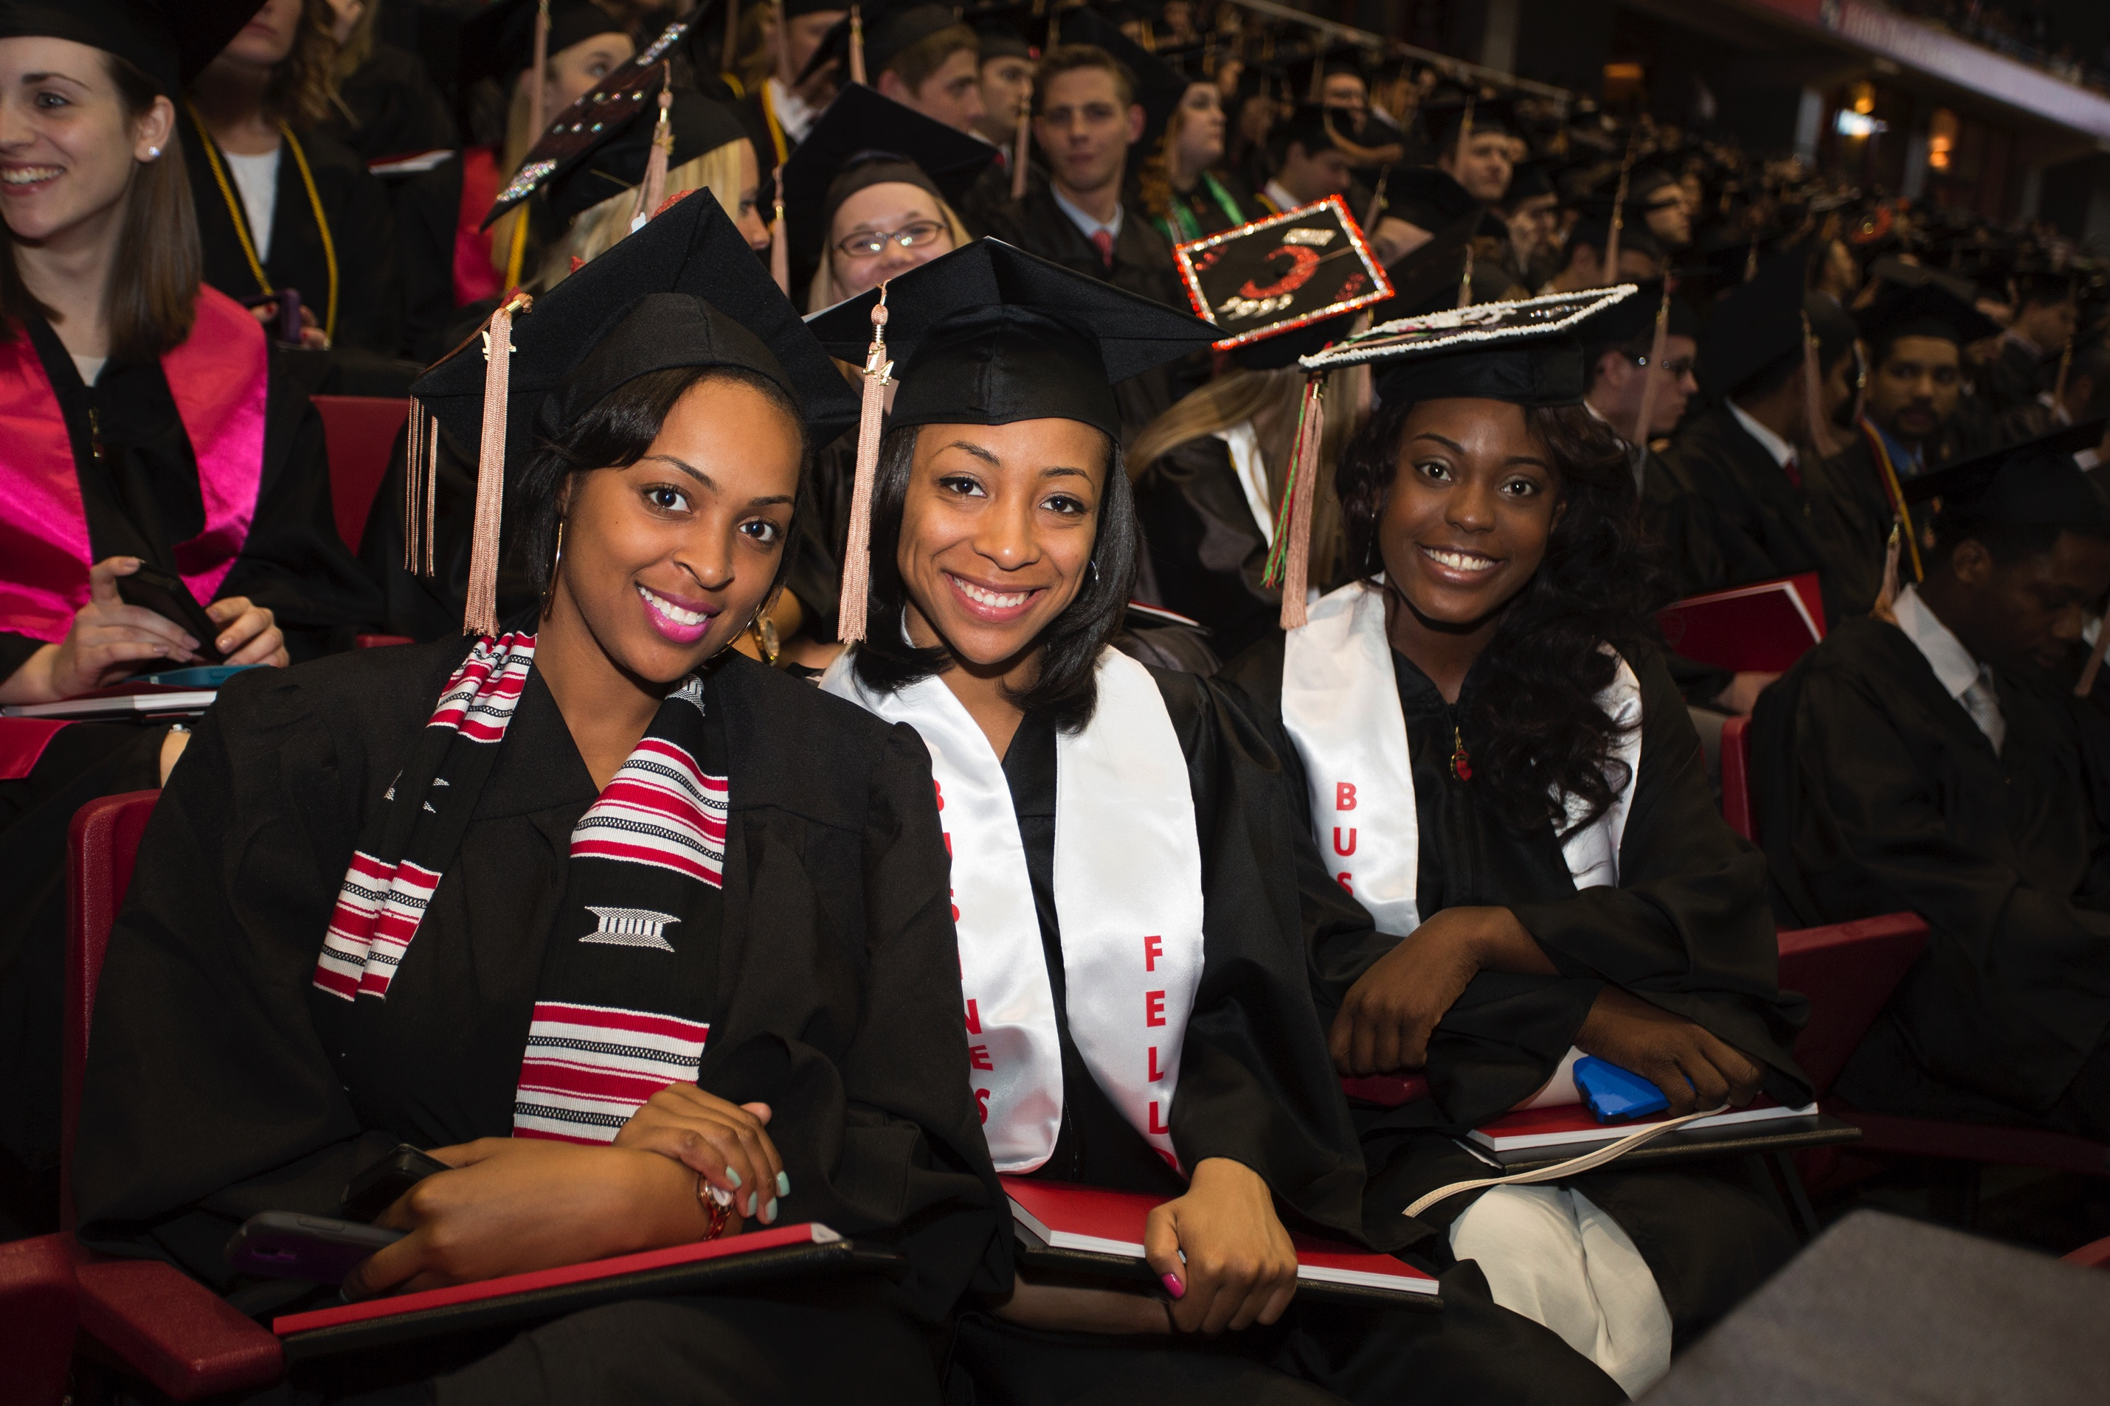
National Demographics of Students at 2-year Institutions (AACC, 2016)
For all students in higher
educational institutions in America:
57% of all Hispanics and
52% of all African Americans and
62% percent of Native Americans
45% of all American Undergraduates
attend a two-year school
Notes:
*Asian American and Pacific Islander students
are more likely to enroll at a community college than a selective four-year university
(Teranishi, 2008-; Campaign for College Opportunity, 2015)

Slide 6
“Democracy cannot flourish in a nation divided into haves and have-nots, and education plays a critical role in improving social mobility, carrying the potential to undermine the perpetuation of intergenerational inequality.” --Lynn Pasquerella

Slide 7
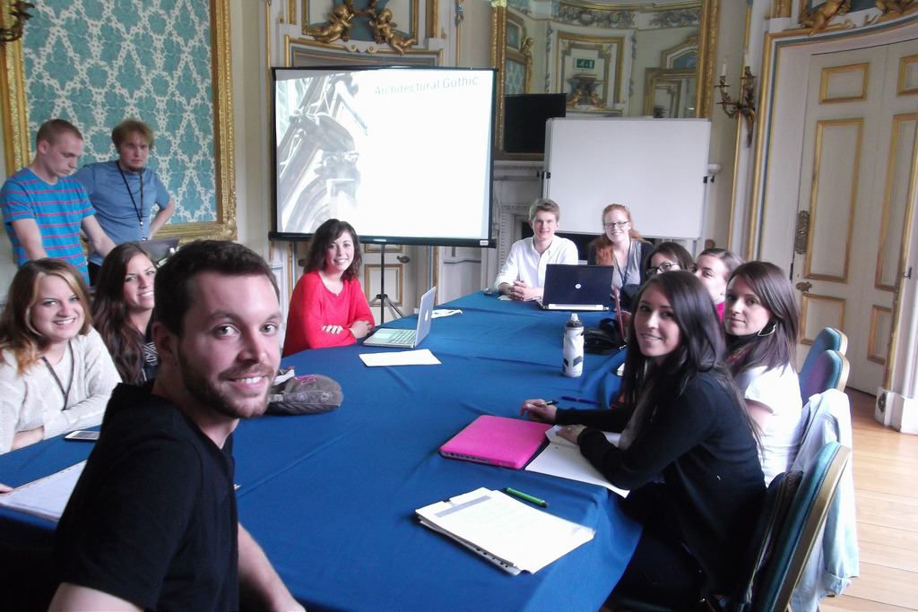
“It’s as if our society were deliberately trying to restrict opportunities and worsen income inequality.” David Leonhardt, New York Times on May 25, 2017
Notes:
If you ask us why we are here today…THIS IS IT.

Slide 8
Today’s Opportunity
National data shows vastly different outcomes for different institutions…..
….So, what we improve on our campuses DOES make a difference.

Slide 9
“If we are to make strides toward an equity-minded approach to higher education, we need to reject, once and for all, a ‘deficit perspective’ that focuses on what students are missing and instead offer evidence-based interventions through the targeting of cognitive, noncognitive, and psychosocial factors showcasing students’ assets. These strategies must span the curricular and cocurricular and extend throughout the college experience.”
--Lynn Pasquerella

Slide 10
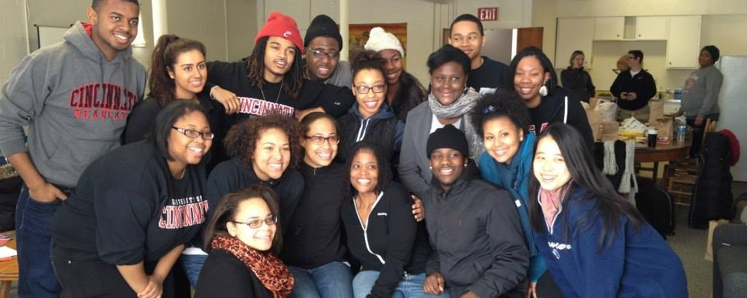
A cross-institutional “transfer-receptive ecosystem” is a powerful catalyst for individual and societal economic mobility and heightened lifetime earnings for low-income students.

Slide 11
Thought for the day as we together forge a “cross-institutional transfer student receptive ecosystem”…
“Thankfulness is a soil in which pride does not easily grow.” -Michael Ramsey
Notes:
Let’s go into the day together….with a spirit of selflessness and generosity.

Slide 12
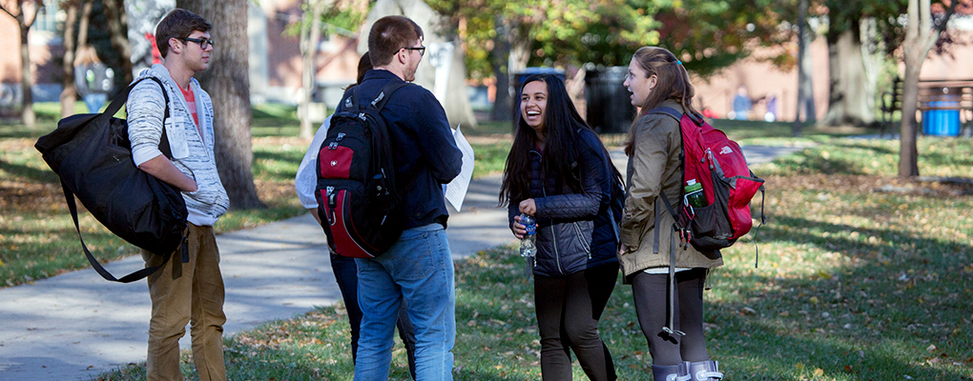
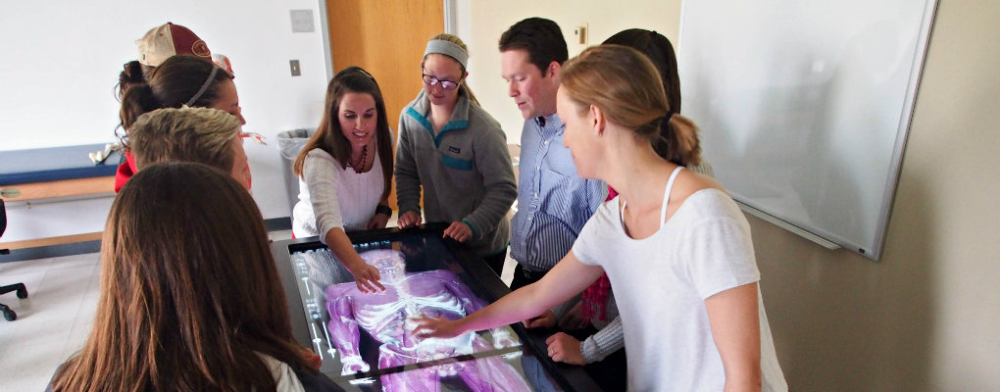
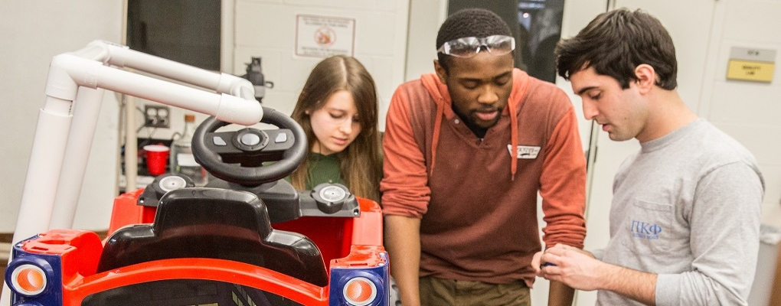
Miami University

Slide 13
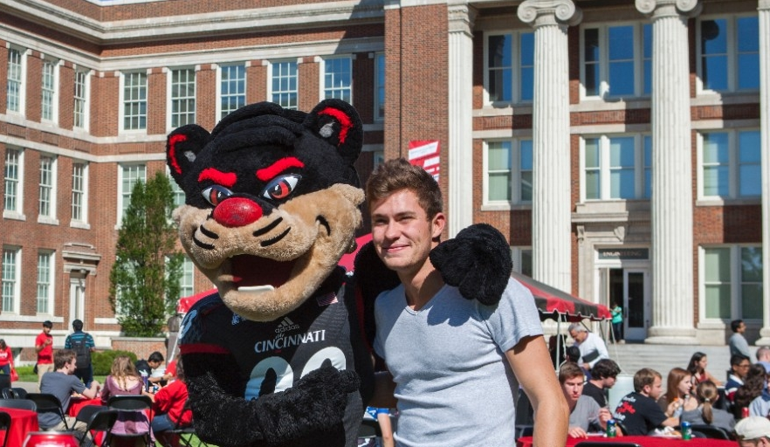
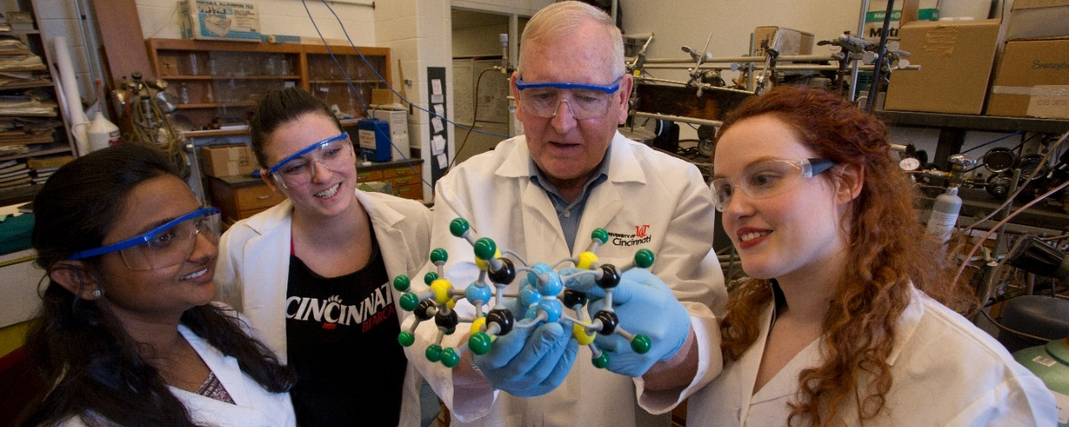
UC Clifton

Slide 14
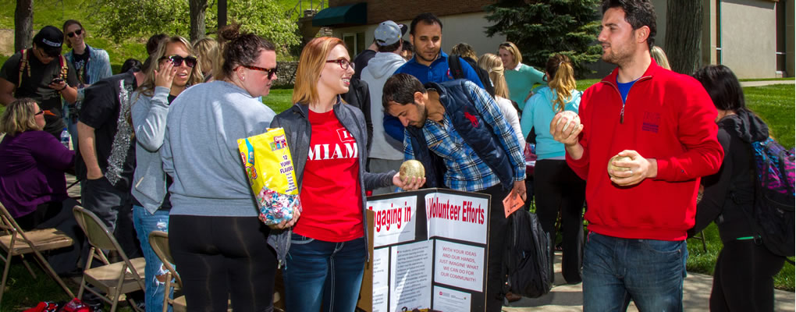
Miami Hamilton

Slide 15
UC Blue Ash

Slide 16
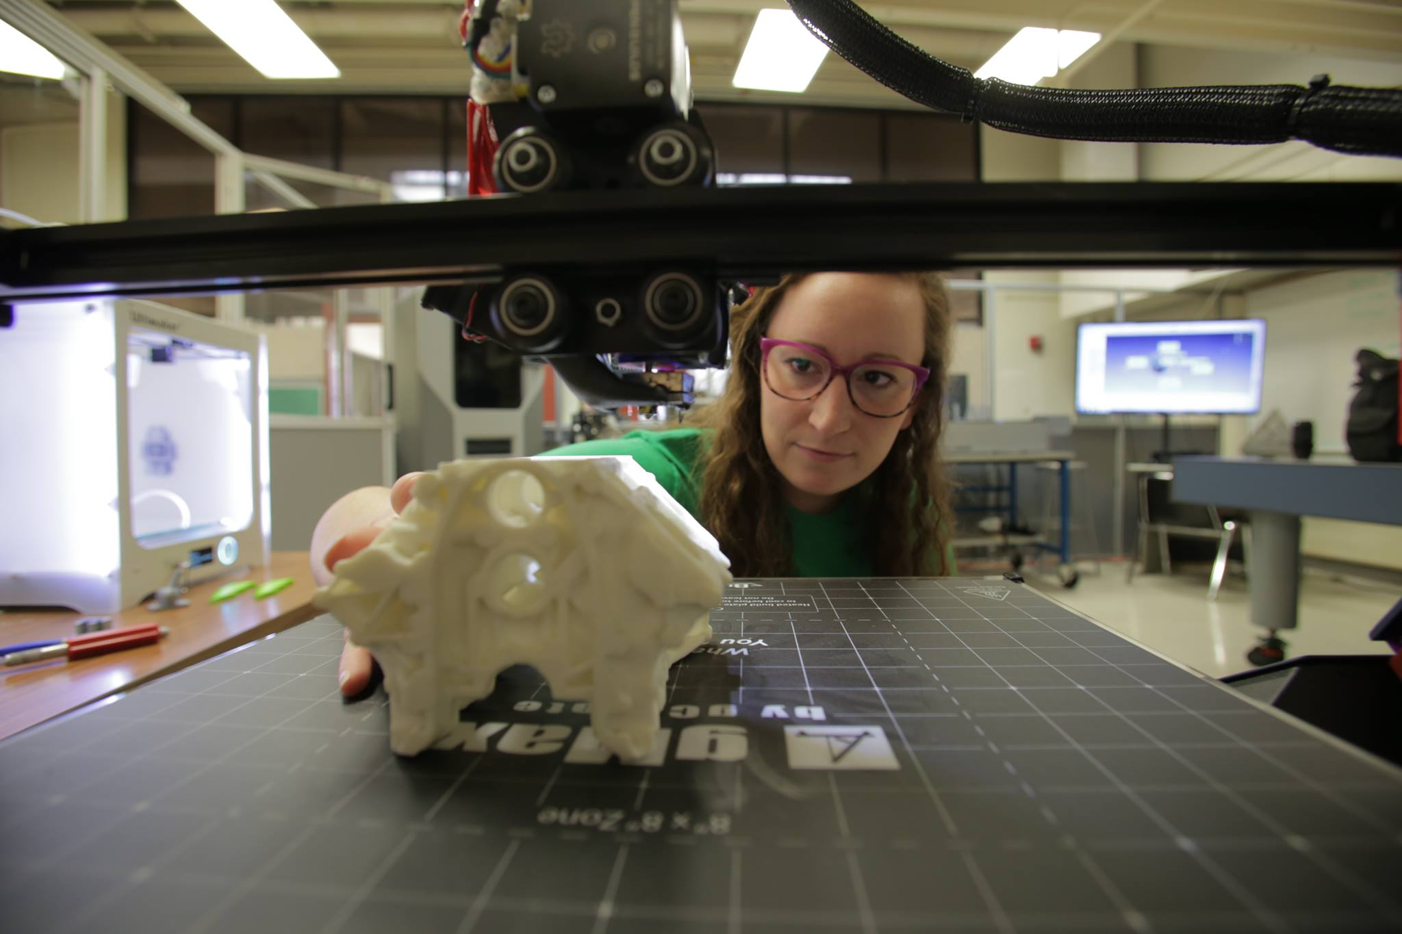
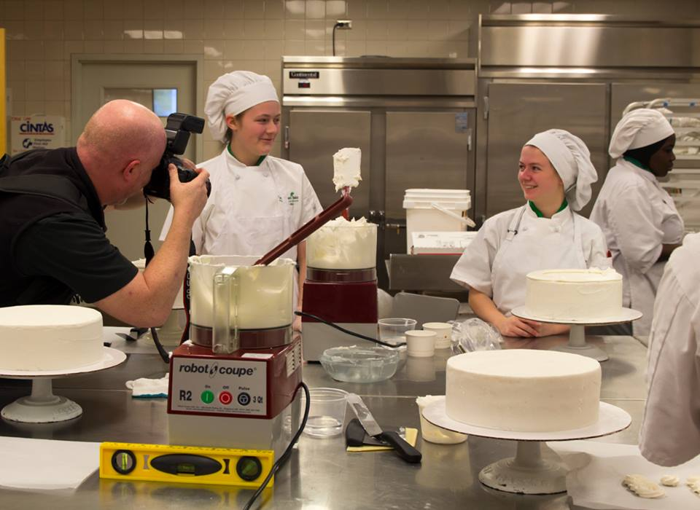
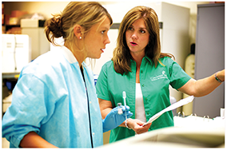
Cincinnati State Technical and Community College

Slide 17
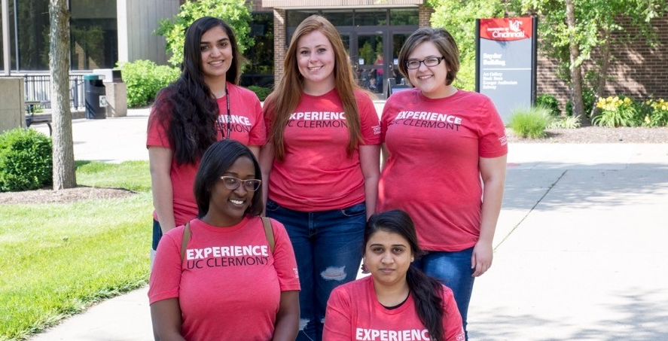
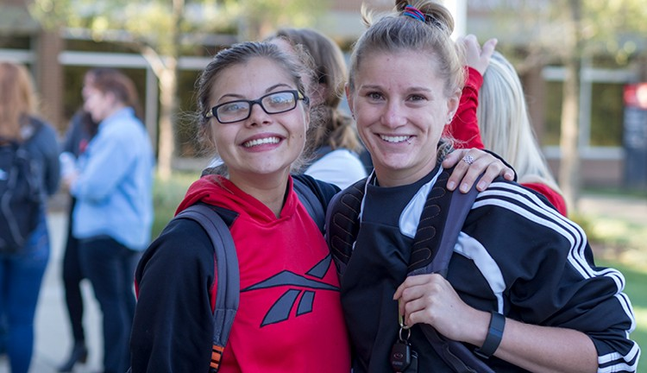
UC Clermont

Slide 18
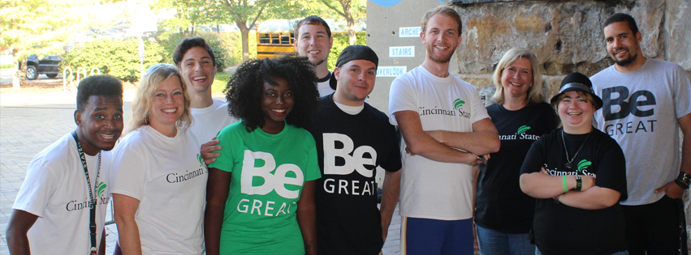
Cincinnati State-Hamilton

Slide 19
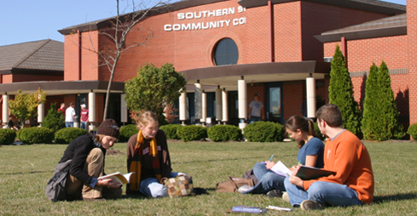
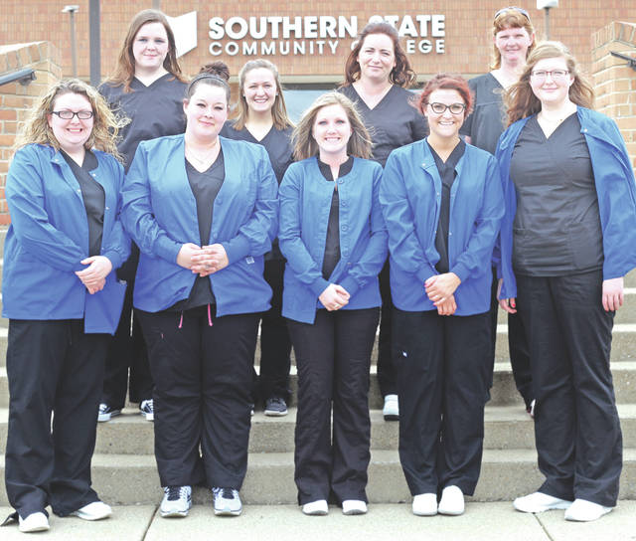
Southern State Community College

Slide 20
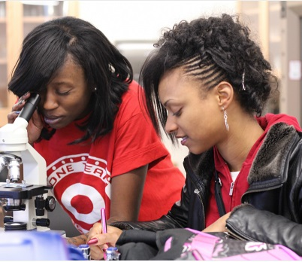
Chatfield College

Slide 21
The challenge for higher education in America is to provide access to all talented students, regardless of their socio-economic status. Fixing the transfer process is absolutely essential. There is too much at stake, for our students and our country. As a nation, if we recruit, admit, enroll, and support more community college students, ensuring their successful transfer and baccalaureate degree completion, we will positively impact the growing economic disparity in our country. Transition and Transformation: Fostering Transfer Student Success, vlm 2 (February 2018) Strempel & Handel

Slide 22
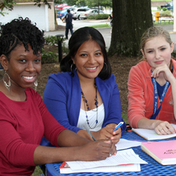
Thank you!
Eileen Strempel
Senior Vice Provost for Academic Affairs
University of Cincinnati
strempel@uc.edu

