Slide 1


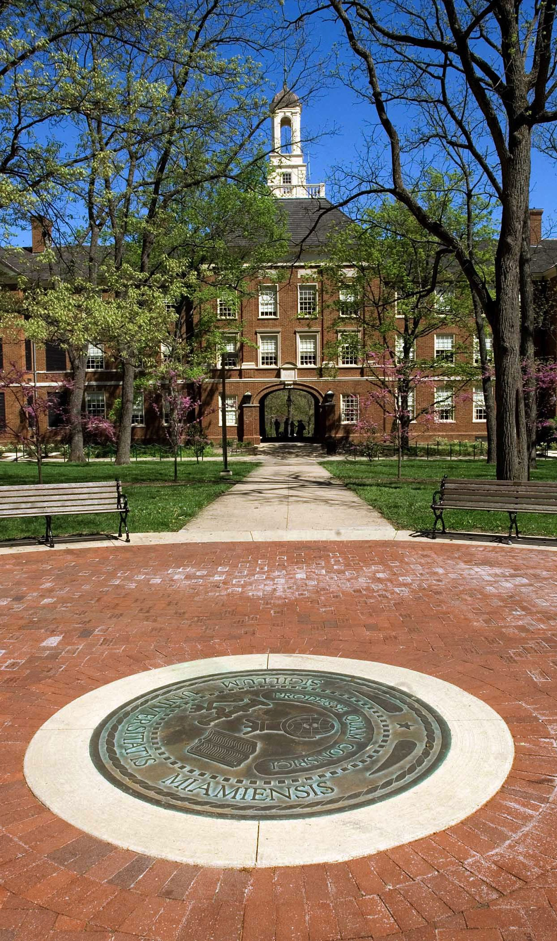


Transferring
To Miami University

Slide 2

MIAMI Oxford Campus: APPLICATION DATES
APPLICATION DEADLINE
June
1
DECISION NOTIFICATION
Rolling beginning in
February
Fall semester
APPLICATION DEADLINE
December
1
DECISION NOTIFICATION
Rolling beginning in
September
Spring semester

Slide 3
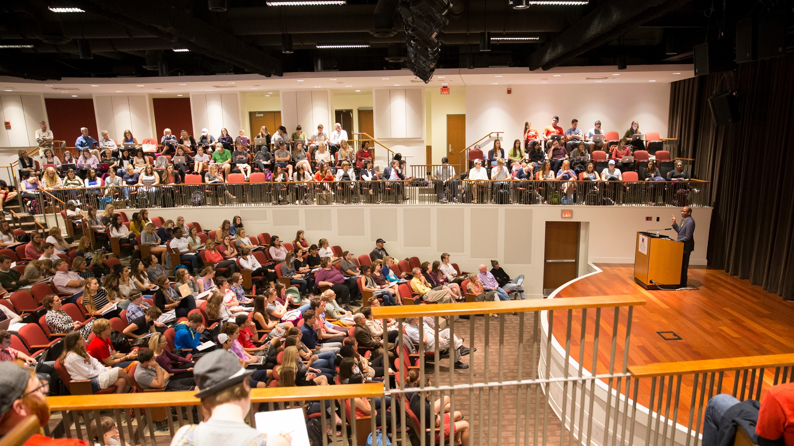
TRANSFER
APPLICATION
TRANSCRIPTS:
HIGH SCHOOL AND COLLEGE
APPLICATION
CHECKLIST
STANDARDIZED
TEST SCORES
LETTER OF RECOMMENDATION OR
MID-TERM REPORT (OPTIONAL)
$50 APPLICATION FEE

Slide 4
COMPREHENSIVE, HOLISTIC, & INDIVIDUALIZED
APPLICATION
REVIEW
DIVISIONAL CONSIDERATION

Slide 5
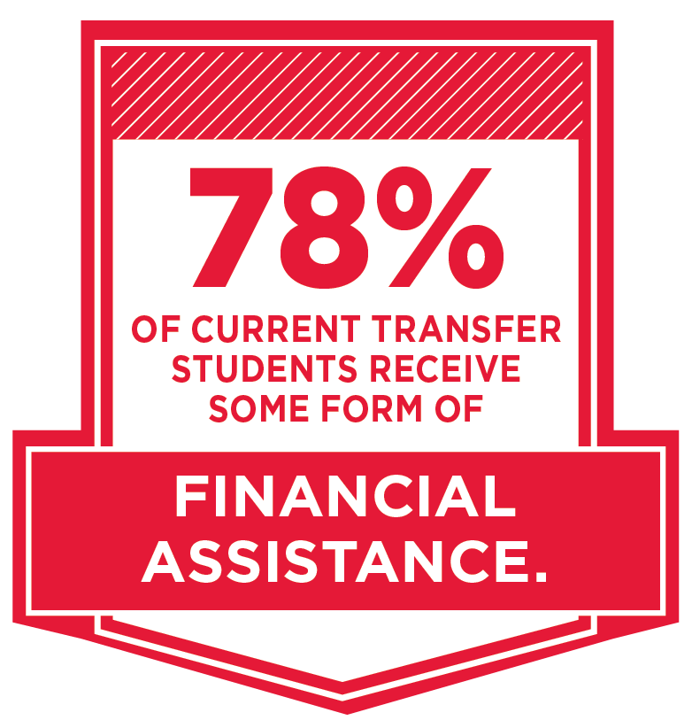
TUITION AND FINANCIAL AID
Ohio Residents
Tuition (Instructional Fee & General Fee): $14,958
Housing and Meals (Room & Board): $ 13,202*
Total: $28,160
Non-Ohio Residents
Tuition (Instructional Fee & General Fee): $34,210
Housing and Meals (Room & Board): $13,202*
Total: $47,412
Notes:
Talking points:
Looking at the details of tuition and financial aid you can see what this year’s costs are for in-state and out-of-state.
Add on an average room and board cost for at least the first two years, given the student is living on campus.
75% of our students receive some sort of aid to off set these costs, whether it’s need based or merit based.

Slide 6

FREE APPLICATION FOR
FEDERAL STUDENT AID
FAFSA
PRIORITY DEADLINE:
February 1
FAFSA.gov
Notes:
Talking points:
The free application for federal and student aid is important for anyone seeking any need based scholarships or loan opportunities through the school.
Changes to FAFSA allow families to file earlier now, prior to December 1. This could provide you the opportunity to see full financial packages from schools much earlier in the process than in years past.
FAFSA is not necessary for merit based scholarship consideration at Miami.

Slide 7


PREDICTABILITY AND TRANSPARENCY
Guarantees tuition, room and board, special purpose fees, and
course fees.
Includes 4 academic years (8 consecutive semesters, 4 winter
and 4 summer terms).
Scholarships retain full value.
Notes:
Talking points:
Miami is a solid collegiate investment and 2 things are needed for a good investment, the ability to plan effectively and outcomes.
Miami’s tuition promise takes care of the planning
From the time a student starts at Miami, their tuition, room and board rate card, and all class and special purpose fees will be locked in for four straight years
This allows for their scholarships to retain full value

Slide 8
TRANSFER SCHOLARHIPS
Ohio Residents
$1,500-$10,000
per year (renewable)
CONSIDERATIONS INCLUDE:
Articulation agreements
Associate degree earned
Cumulative GPA
Financial need (determined by the FAFSA)
Honors program participation at previous institution
Number of college-level credit hours earned
Phi Theta Kappa membership
Additional scholarships may be awarded for factors including diversity, audition, portfolio, intended area of academic interest, and athletic ability.
PRIORITY CONSIDERATION:
Spring semester: Apply by December 1
Fall semester: Apply by June 1
Non-Ohio Residents
$2,000-$15,000
per year (renewable)

Slide 9

Transfer Ambassador program
CREDIT EVALUATION and EQUILVALENCY
ACADEMIC
ADVISING
Transfer
student
resources
TRANSFER STUDENT RESIDENT HALL COMMUNITY
Transfer
Orientation
UNV101:
I AM MIAMI

Slide 10

Special Transfer Visit Opportunities:
Transfer Thursdays and Transfer Preview Days

Slide 11

Global Miami Plan
he
Miami’s founded on the belief that a liberal education provides best framework for life in a changing world.
All students – regardless of major – complete it over all 4 years of education.
Can include courses required for the major
Focuses on critical thinking, writing along with other outcomes
Notes:
Talking points:

Slide 12

Global Miami Plan
he
Foundation
English Composition (3 cr)
Arts, Humanities & Social Sciences (9 cr)
Global Perspectives (9 cr)
Natural Sciences (6 cr)
Math, Formal Reasoning, Technology (3 cr)
Notes:
Talking points:

Slide 13

Global Miami Plan
he
Upper Level Requirements
Intercultural Perspectives (3 cr)
Advanced Writing (3 cr)
Experiential Learning (0 cr)
Thematic Sequence (9 cr)
Capstone (3 cr)
Notes:
Talking points:

Slide 14

Questions?

