Slide 1
Ohio Department of Higher Education/ Ohio Articulation and Transfer Network Articulation & Transfer Initiatives

Slide 2
Overview
Statewide Attainment Goal
Ohio’s Transfer Guarantees
Advanced Placement
CLEP
Credit When It’s Due
General Education Initiative
Ohio Guaranteed Transfer Pathways
Ohio Math Initiative
One Year Option
3 + 1 Model Pathways
Transferology
Notes:
All thanks to you and your colleagues.

Slide 3
Statewide Attainment Goal
65% of Ohioans (ages 25-64), will have a degree, certificate, or other postsecondary workforce credential by 2025

Slide 4
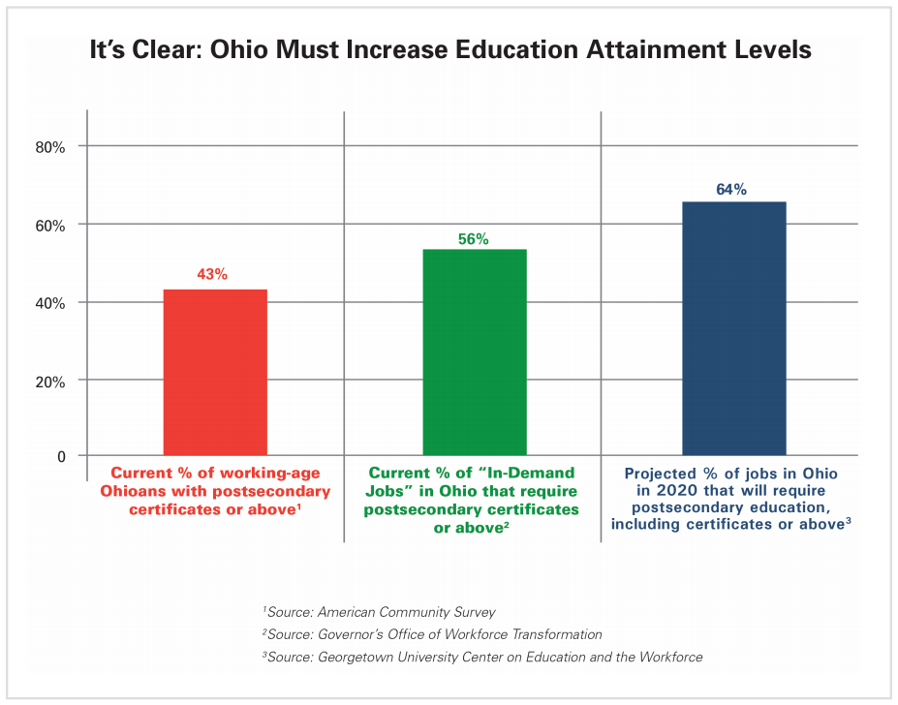
Statewide Attainment Goal

Slide 5
Ohio’s Transfer Guarantees
Ohio Transfer Module (OTM) - is defined as either a subset or the complete set of an institution’s general education requirements. 36-40 semester hours (1990) OTM Areas: English Composition/Oral Communication Math, Stats, & Logic Arts & Humanities Social & Behavioral Sciences Natural Sciences
How this works:
Block of transfer credit
Course to course equivalency
Matched to appropriate OTM area

Slide 6
Ohio’s Transfer Guarantees
Transfer Assurance Guides (TAGs) - statewide transfer initiative that guarantees the course equivalency and applicability of pre-major/beginning major courses within the degree pathways (2005)
Currently 52 TAG pathways in 13 discipline specific areas (close to 5,000 matches statewide)
Course X Submitted to Faculty Panel Course Y
Ohio Articulation Number (OAN)
Course X = OAN = Course Y

Slide 7
Ohio’s Transfer Guarantees
Career-Technical Assurance Guides (CTAGs) - advising tools that assist students moving from Ohio secondary and adult career-technical institutions to Ohio public institutions of higher education. (2007)
*20-24% of High School students are career-tech students
Some Fields Include : Air Transportation, Arts & Communication, Biotechnology, Business, Construction Tech, Education, Engineering & Science, Health Sciences, Hospitality, Human Services, Information Tech, Law & Public Safety, Manufacturing Tech, Marketing, & Transportation Systems
OTC/ Secondary Submitted to Faculty Panel Course Y
Course X Career-Tech Articulation Number (CTAN)
Course X = CTAN = Course Y

Slide 8
Ohio’s Transfer Guarantees
Military Transfer Assurance Guides (MTAGs) - streamline the awarding of college credit for military training, experience, and coursework. Incorporate into Ohio’s Transfer Guarantees where possible (2014)
*Currently 143 unique military courses matched to 317 guarantees (180 TAG matches, & 137 CTAG matches)
The military is treated like a new public institution in Ohio. OATN Director of Military Initiatives is essentially OTM, TAG, & CTAG coordinator. Military courses get sent to regular faculty panels.
Current large projects: Medics to Nursing, Foreign Languages, & Military Gen Ed – Multiculturalism/Diversity

Slide 9
Advanced Placement
Effective fall 2009
Guarantees college credit for any of the 36 AP tests
Must score a “3” or higher
Typically counts toward OTM or TAG credit
OATN research supports AP scores of 3-5 are equivalent to the learning outcomes associated with the corresponding college courses
https://www.ohiohighered.org/transfer/research

Slide 10
College-Level Examination Program
Full Implementation May 1 2018 (Phase I & II already in effect)
Guarantees college credit for most of the 33 CLEP tests
Faculty panels decided appropriate test scores
Typically counts toward OTM or TAG credit
Some are general electives and some are placement levels
*Largely used by Seniors (missing a graduation requirement) and the Military

Slide 11
Credit When It’s Due (CWID)
Started in 2013 to assist eligible students with obtaining an associate degree through collaboration between Ohio’s public institutions.
Focused on the concept of “Reverse Transfer”
2013-2016 3,750 associate degrees awarded (waiting on 2017 data)
Eligible Students are those who:
-Have at least 45 college-level semester hours from an Ohio public institution
-Have at least 20 college-level semester hours from a community college
-Minimum cumulative GPA of 2.0 at current university
-Do not already hold an associate or bachelor’s degree

Slide 12
General Education Initiative
Active discussion involving public institutions in Ohio regarding general education. (April 2 discussion)
Survey of institutions to get their thoughts
Do we need to change GE?
Do we need to change the Ohio Transfer Module?

Slide 13
Ohio Guaranteed Transfer Pathways
The goal is to establish statewide guaranteed transfer pathways from two-year to four-year degree programs in an equivalent field.
Looked at promising transfer practices
Developing pathways via cluster areas (meta-majors)
Meet with focus groups and institutional representatives (regional approach)
Build upon OTM & TAG foundations
First area out for endorsement was Business
Institutions then submit their pathway (Business was due Feb 14th)

Slide 14
Ohio Math Initiative
The Ohio Mathematics Initiative (OMI) is a collaborative effort of mathematics faculty members from the state’s public colleges and universities and Ohio high schools that is revisiting and rethinking mathematics courses and curricula and the relationship of mathematics to other disciplines
5 subgroups: New & Alternative Pathways, Revision of OTM Criteria, Communication & Outreach, Data Collection & Analysis, and Alignment Between Secondary & Postsecondary Content
3 Main Pathways: STEM (Algebra), Quantitative Reasoning, Statistics, (Maybe education)

Slide 15
One Year Option
To establish a One-Year Option credit articulation system by no later than June 30, 2014. This Option will allow graduates of Ohio Technical Centers who complete a 900-hour program of study and obtain an industry-recognized credential approved by the Chancellor to receive 30 college technical credit hours toward a technical degree upon enrollment in an institution of higher education.
To award block credit – ODHE has created 4 credit affirmation teams (Business & IT, Health, Agriculture & Services, and Trades). Those teams are reviewing 900+ hour programs (will eventually do 600-899 hour programs)

Slide 16
3 + 1 Model Pathways
HB49 – (Sec 381.570)Requires the chancellor, in consultation with IUC and OACC, to develop a model for piloting 3+1 agreements, where a student can attend a community college for the first 3 years of a bachelor's degree, and then complete the degree at a university with 1 additional year of study.
Upcoming meetings to feature presentations of successful 3+1 programs across Ohio.

Slide 17
Transferology
CollegeSource product that allows students to enter their prior college courses and learning experiences to find out in advance how they would transfer and apply toward a degree program at various colleges and universities.
(CAS to U.Select to Transferology)
*Participation fees covered by ODHE
Transferology – Student Facing
Transferology Lab – Faculty/Staff Facing
-Look for equivalencies
-”Test” Articulation Agreements
2017 stats – 48,153 Ohio students created NEW accounts, 144,740 sessions

Slide 18
Thank you for your great work and commitment to the work in Articulation and Transfer!!

Slide 19
Questions?

Slide 20
Contact Info
Jared Shank
Director, Military and Apprenticeship Initiatives
and Special Projects
Ohio Articulation and Transfer Network
Ohio Department of Higher Education
(614) 466-5812
jshank@highered.ohio.gov

