Slide 1
Transfer Initiatives and University Partnerships
Southwest Region
Transfer Student Summit
02/27/2018

Slide 2
Prioritizing Transfer
Kimberly Collins, Director of University Partnerships
Develop University Partnerships
Coordinate Transfer/Recruitment Events
Assist Chairpersons with Pathway Opportunities
Laura Hinkebein, Asst. Project Director for Transfer Initiatives
Develops Curriculum Transfer Agreements
Coordinates Reverse Transfer Process
Creates Online, Term-by-Term Pathways

Slide 3
Creating a Preferred Partnership with our University Partners
Identify Transfer Champions from the Community College and University to make up the Core Team
Admissions/Recruitment/Transfer
Registration
IT
Marketing
Create a vision and plan to improve transfer policies and practices
Update current articulation agreements
Create Curriculum Transfer Agreements
Determine GPA and admission requirements
Determine enrollment process and management of student database
Create a title for the transfer partnership that students can identify with and determine program benefits
Summer Orientation session
Academic Advisor assigned at both institutions
Participation in various aspects of campus life, clubs, organizations
Assign partnership ID card
Develop a financial aid prospectus that highlights tuition savings

Slide 4
Transfer Pathway Development
Goals:
Student Friendly
Term by Term Information
Course by Course Equivalencies
Upper Level Course Work
Clear Next Step Information
Career/ Extracurricular Information

Slide 5
Transfer Model Development
Transfer Data Review
TES
Masterfile
Transferology
Reports from 4-Year Partners

Slide 6
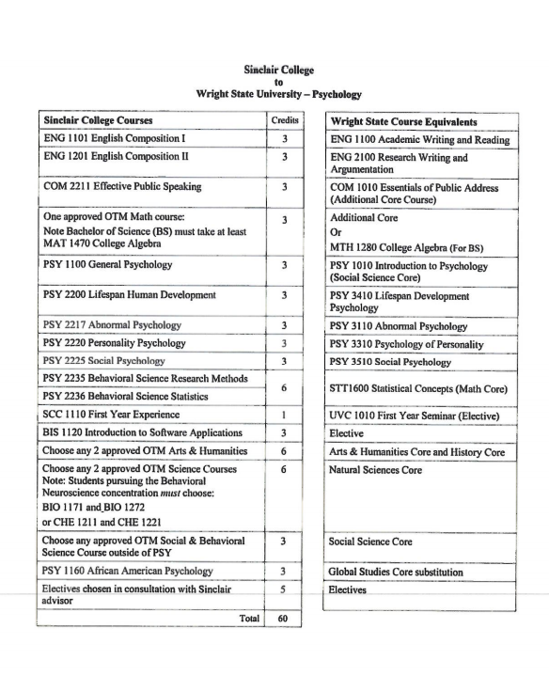
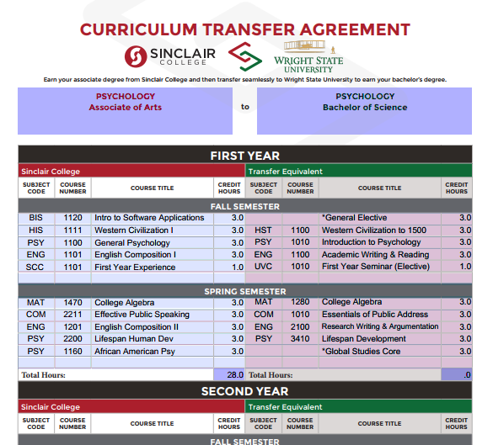
Transfer Model Development
Curriculum Transfer Agreement to Curriculum Transfer Pathway

Slide 7
Questions?

