Slide 1
Fostering a
Transfer Student Ecosystem
at the University of Cincinnati
Center for Pathways Advising and Student Success
Please download
our Transfer App
(if you like)

Slide 2
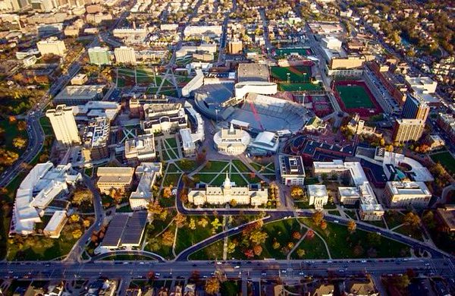
Our beautiful campus: 194 acres, 86 buildings, 13 parking garages

Slide 3
Identifying the Needs of Transfer Students
Since 2001, the number of students transitioning from a regional campus to our Clifton campus has increased upwards to 473%
External transfers have increase 158%
40% of students who graduated from UC in 2014-2015 were either transfer or transition students
Student to transfer to Clifton campus, on average, have a higher graduation rate

Slide 4
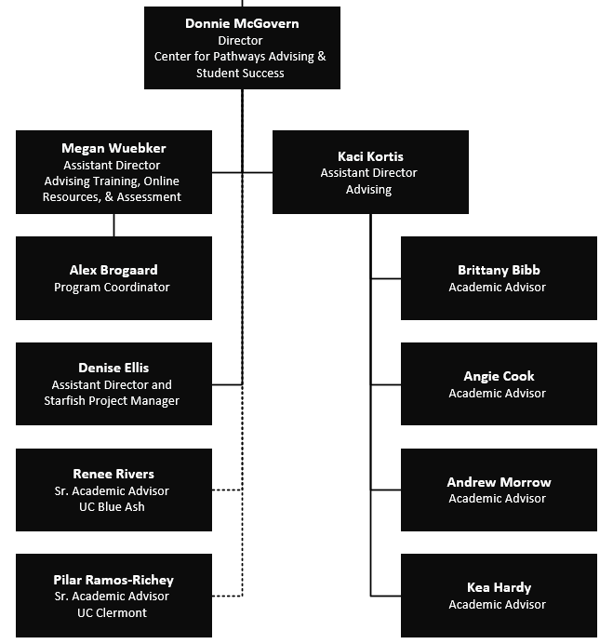
Center for Pathways Advising & Student Success
Pathways Advising
Transfer Advising
Transition Advising
Major Change Advising
Non-Matriculated Advising
Oversight of Starfish Connect and Early Alert
Advisor Training, Professional Development, Online Resources, and Assessment

Slide 5
Pathways Advising
Advising, not admissions
Fostering a consistent transfer/transition friendly ecosystem at UC
Help for students who fall in the cracks
One Stop Advising Center (triage)
Help students make connections

Slide 6
Transferology Getting a head start
Any Student Can…
create an account on transferology
input their classes into Transferology
run “What If” degree audit reports
database that reports pull from is up-to-date
Can help students to…
formulate advising questions
plan future semesters

Slide 7
Pathways Advising Transfer Students
Prospective students
referred from Community Colleges
referred One Stop (financial aid), Admissions, or other departments
Can set up appointment (preferred) or walk-in
Appointments allow for maximum preparation

Slide 8
Pathways Advising Transfer Students
Topics Covered with Prospective Students
Eligibility for intended major
Advising questions about credit applicability
Assistance with Transferology (unofficial transfer credit)
Deadlines and considerations
Creating a pathway to a degree based on individual record
Introduce students to resources and programming
Personalized referrals to advising resources

Slide 9
Pathways Advising
Our Structure:
Walk-in and Appointments welcome!
HIGHLY SUGGEST transfer students make an appointment so we can look more deeply into their full situation.
If a student has been shuffled students – we can help point them in the right direction
Central Location – University Pavilion, 556-9000 www.uc.edu/transfer

Slide 10
Programming Specific to Transfers
Pathways Advising Welcome Day
In-Person Welcome Day for transfer students
Full day and Mini Days
About 300 attendees since Fall 2016
Overwhelmingly positive feedback
Online Orientation (Transfer Guide)
Transfer Workshops each week
Planned Student Organizations
Transfer Ambassadors
Tau Sigma
Cincinnati Pathways Scholars Program

Slide 11
Please complete the session evaluation. Your feedback will help us continue to offer high quality presentations.
Thank you!
www.uc.edu/pathways
513-556-9000
Kaci.kortis@uc.edu
Renee.rivers@uc.edu
#NACADA2017

