Slide 2
Baccalaureate Programs
Applied Administration
(Bachelor of Technical & Applied Studies)
Radiation Science Technology
(Bachelor of Radiation Science Technology)

Slide 3
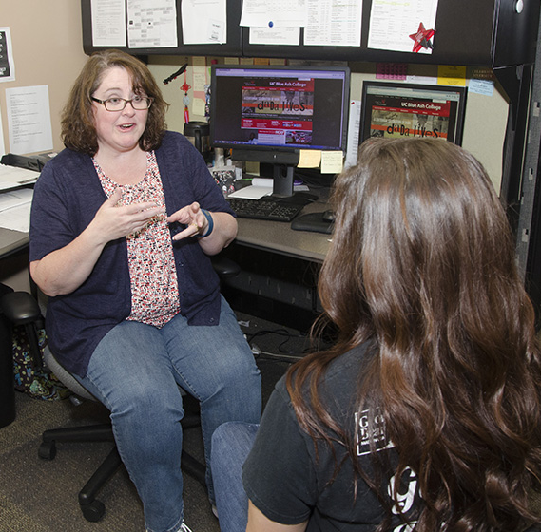
Applied Administration
Designed for students or professionals with an associate degree in an applied or technical field (AAS, AAB, ATS, etc.)
Program focuses on building effective communication, collaboration, and leadership skills
Ideal for those who want to move into supervisory or administrative positions in their field
Features face-to-face, hybrid, and fully online classes
www.ucblueash.edu/btas

Slide 4
Radiation Science Technology
Designed for students who have earned an associate degree in medical imaging or radiation therapy and hold a national certification.
Offers career advancement in leadership, management, and education
Fully online program
www.ucblueash.edu/brst

Slide 5
Barriers to Completion
Curricular alignment
Catalog year
Making connections

Slide 6
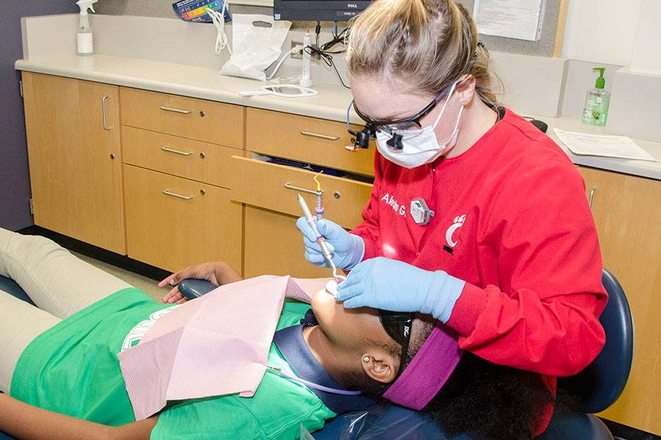
Key Initiatives
Reverse transfer
Curricular alignment
Transition advisor

