Slide 1


Exploring Miami University Regionals
Ohio Southwest Region Transfer Summit
February 27, 2018

Slide 2

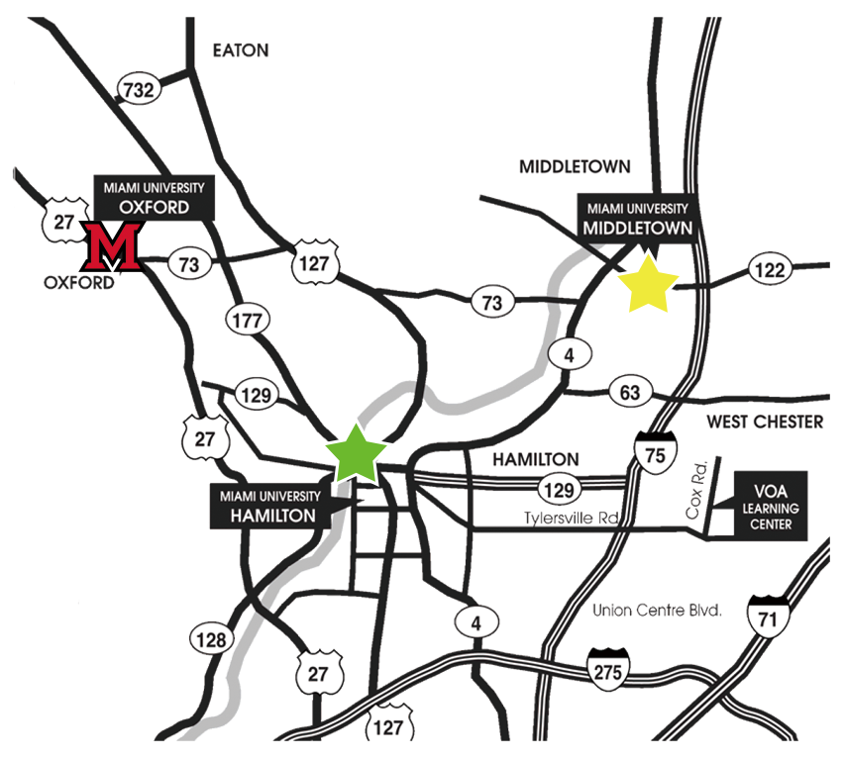
Middletown ➞ Oxford
35-40 minutes
Middletown ➞ Hamilton
25-30 minutes
Hamilton ➞ Oxford
25-30 minutes

Slide 3
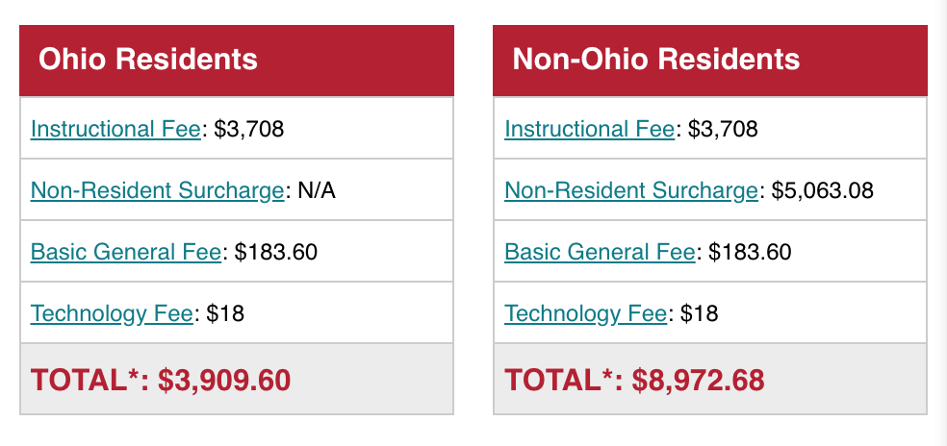
Affordability
Notes:
Upper division rates

Slide 4



Transforming the Regional Campuses DEGREES OFFERED
2012
Primarily Associate,
Relocate Campus
2017
13 Associate,
17 Bachelors & 1 Masters

Slide 5


Slide 6


Slide 7
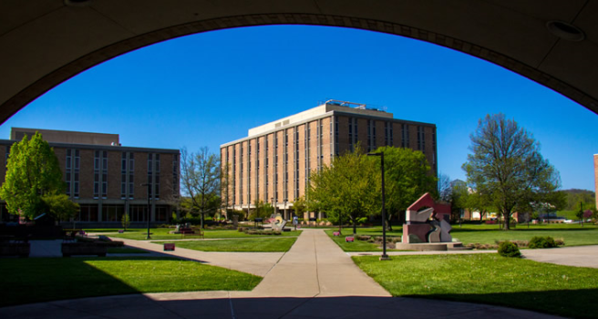
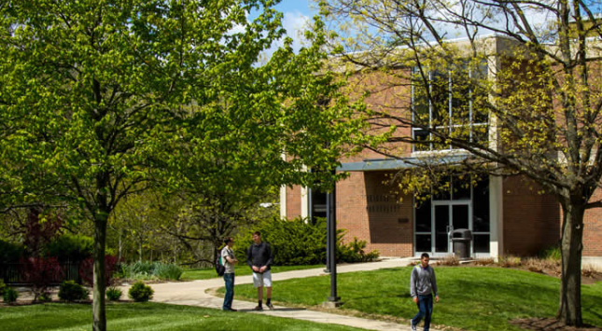
Regionals By the Numbers
Approximately 4000 at Hamilton
Approximately 3000 at Middletown
Approximately 160 full-time faculty and 200 full-time staff

Slide 8
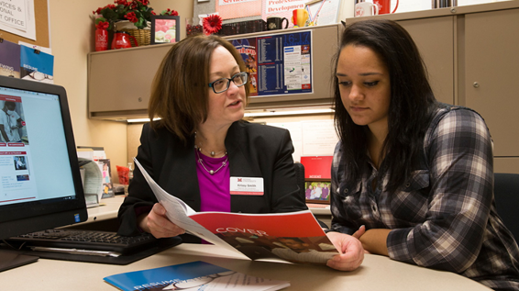
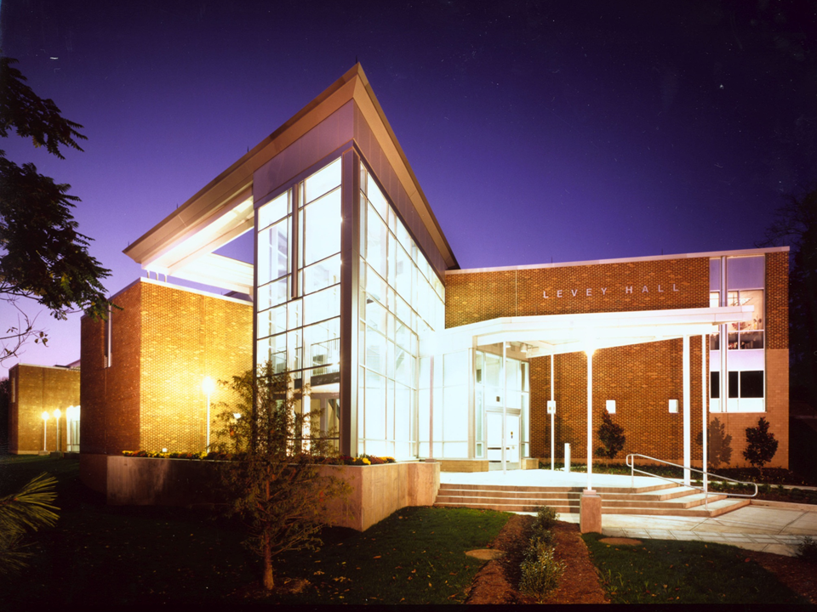
Admission Criteria
First-time college students are automatically admitted with a high school diploma, GED or alternative education
Transfer students must have a minimum GPA of 2.0 and be in “good academic standing”
Admission into certain programs, such as Nursing and the Farmer School of Business is selective. Please contact a Counselor for clarification

Slide 9

Notes:
Regional Exploration Days are offered once a month on both campuses, these are the dates and times for those,
Middletown Hamilton
Mon. 2/19 Tues. 2/20 2:30-4:30
Tues. 3/13 Wed. 3/14 9:30-11:30
Wed. 4/25 Tues. 4/24 2:30-4:30
Tues. 5/15 Wed. 5/16 9:30-11:30
Wed. 6/13 Tues. 6/12 2:30-4:30
Thurs. 7/26 Tues. 7/24 9:30-11:30
And Talk and Tours are pretty much every other day from 9:00-10:00am alternating campuses and every Monday evening from 5:00-6:00pm alternating campuses.
If it's too much to put on a slide, students will be able to see the visit date options when they register online.

Slide 10



CONNECT WITH US:
MiamiOH.edu/Regionals
@MiamiRegionals
@MURegDean
#MiamiOHRegionals
facebook.com/
MiamiOHRegionals
youtube.com/user/
MiamiRegionals

