Slide 1

STEM Transfer Pathways at Cincinnati State

Slide 2
ASSOCIATE OF SCIENCE at Cincinnati State
HALF A BACHELOR’S DEGREE AT HALF THE COST!

Slide 3
Transfer Degrees
The Associate of Science Degree is designed to transfer.
Students start here, graduate with an Associate’s degree, then move on to a 4-year college or university to complete a Bachelor’s or Baccalaureate degree.
Programs allow students to complete up to half of their college curriculum at a fraction of the cost of a 4-year school!

Slide 4


Bachelor Degree Bound Progression
Student Starts at Cincinnati State in AS Degree
Takes General Studies classes to fulfill Ohio Transfer Module as well as Introductory classes for her/his field of study that will transfer to a baccalaureate institution
Student Graduates with AA or AS degree!
In his/her final year, student applies to baccalaureate institution
Final transcript sent to receiving institution with graduated status
Takes remaining courses to complete major requirements for baccalaureate degree, and graduates from receiving institution!
Student starts as Junior at baccalaureate institution with general education complete or nearly complete.

Slide 5
Associate of Science Degree
Customized to the degree and the school to which the student intends to transfer
Popular majors are: Biology, Chemistry, Pre-Med, Pre-Pharmacy
Credit Hour Breakdown
Ohio Transfer Module Core | 38 Credits Minimum
English Composition | 6 Credits
Public Speaking | 3 Credits
Arts/Humanities | 6 Credits
Social/Behavioral Sciences | 6 Credits
Major’s Level Science | 8 Credits
Mathematics | 3 Credits
Additional OTM Math/Science | 6 Credits (often used for prereq coursework)
Additional Graduation Requirements | 26 Credits
First Year Experience | 1-3 Credits
Career Exploration Course | 2 Credits
Co-op/Internship | 2 Credits
Directed Electives | 19-21 Credits
Electives both in the Transfer Module and the Directed Electives category are chosen in consultation with an advisor to meet the needs of the school and program to which the student intends to transfer.
Program Chair: Jen Martin

Slide 6
Cooperative Education
Cincinnati State has over 2900 business partners in its mission to promote Cooperative Education!
Co-op Coordinators work with each student to create a plan that best fits his or her needs
Some co-op sites for our Science Majors include:
  P&G
  Cincinnati Zoo
  Newport Aquarium
  Advanced Testing Labs
  Children’s Hospital
  Q Labs
  Flavor Producers

Slide 7
Some Challenges
Many of our students come in needing prerequisite coursework, which may set them back in their major’s level coursework
Many of our students are “non-traditional” meaning that scheduling can pose an issue
Transfer of credits is still seen as insecure by some students

Slide 8
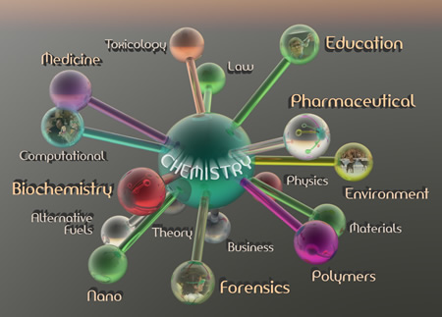

Slide 9
Cincinnati State Chemistry Faculty
Mary Repaske
  B.S., University of Texas at Austin
  PhD, Biochemistry, University of Wisconsin, Madison
Laura Morris
  B.S., Northern Kentucky University
  PhD, Analytical Chemistry, University of Cincinnati

Slide 10
Chemistry At Cincinnati State
Transfer Assurance Guide Courses
General Chemistry (CHE 121/122 and 131/132 labs)
  A two-semester general chemistry course for science majors
Organic Chemistry (CHE 201/202 and CHE 211/212 labs)
  A two-semester organic course for science majors

Slide 11
Chemistry At Cincinnati State
Ohio Transfer Module Courses
Fundamental Chemistry (CHE 110)
An inorganic chemistry course for non-majors
Bio-Organic Chemistry (CHE 111)
  An organic/biological chemistry course for non-majors
General, Organic, and Biological Chemistry (CHE 115)
  An integrated chemistry course for nursing and allied health students covering foundational concepts of general, organic, and biological chemistry

Slide 12
OGTP Curriculum Map for Chemistry
RECOMMENDED DEGREE MAP
First Year
SEMESTER 1 |  |  | SEMESTER 2
Course Name & # | Credit Hours |  | Course Name & # | Credit Hours
First Year Experience Course | 1-3 |  | ENG 102 or ENG 103 | 3
ENG 101 or ENG 101A | 3-4 |  | HUM 190 | 2
CHE 121 & 131 | 5 |  | CHE 122 & 132 | 5
MAT 251 | 5 |  | MAT 252 | 5
OTM Social/Behavioral Science | 3 |  | OTM Arts/Humanities | 3
Total Semester 1 Credit Hours | 17-20 |  | Total Semester 2 Credit Hours | 18
Second Year
SEMESTER 3 |  |  | SEMESTER 4
Course Name & # | Credit Hours |  | Course Name & # | Credit Hours
COMM 110 | 3 |  | CHE 202 & 212 | 5
CHE 201 & 211 | 5 |  | PHY 202 | 5
PHY 201 | 5 |  | OTM Arts/Humanities | 3
OTM Social/Behavioral Science | 3 |  | Part-Time Co-op | 1
Part Time Co-op | 1
Total Semester 3 Credit Hours | 17 |  | Total Semester 4 Credit Hours | 14

Slide 13
Teaching at Cincinnati State
Small Class Size: 18 – 24 students per lecture section
Collaborative Teaching Style: Group learning and problem solving
No Teaching Assistants: All instructors credentialed with Master or PhD in Chemistry or Chemical Engineering
Laboratory:
  Non-majors courses limited to 20 students
  General Chemistry TAG lab courses limited to 12 students working individually
  Organic TAG lab courses limited to 10 students working individually
  Laboratory spaces renovated Summer 2013

Slide 14
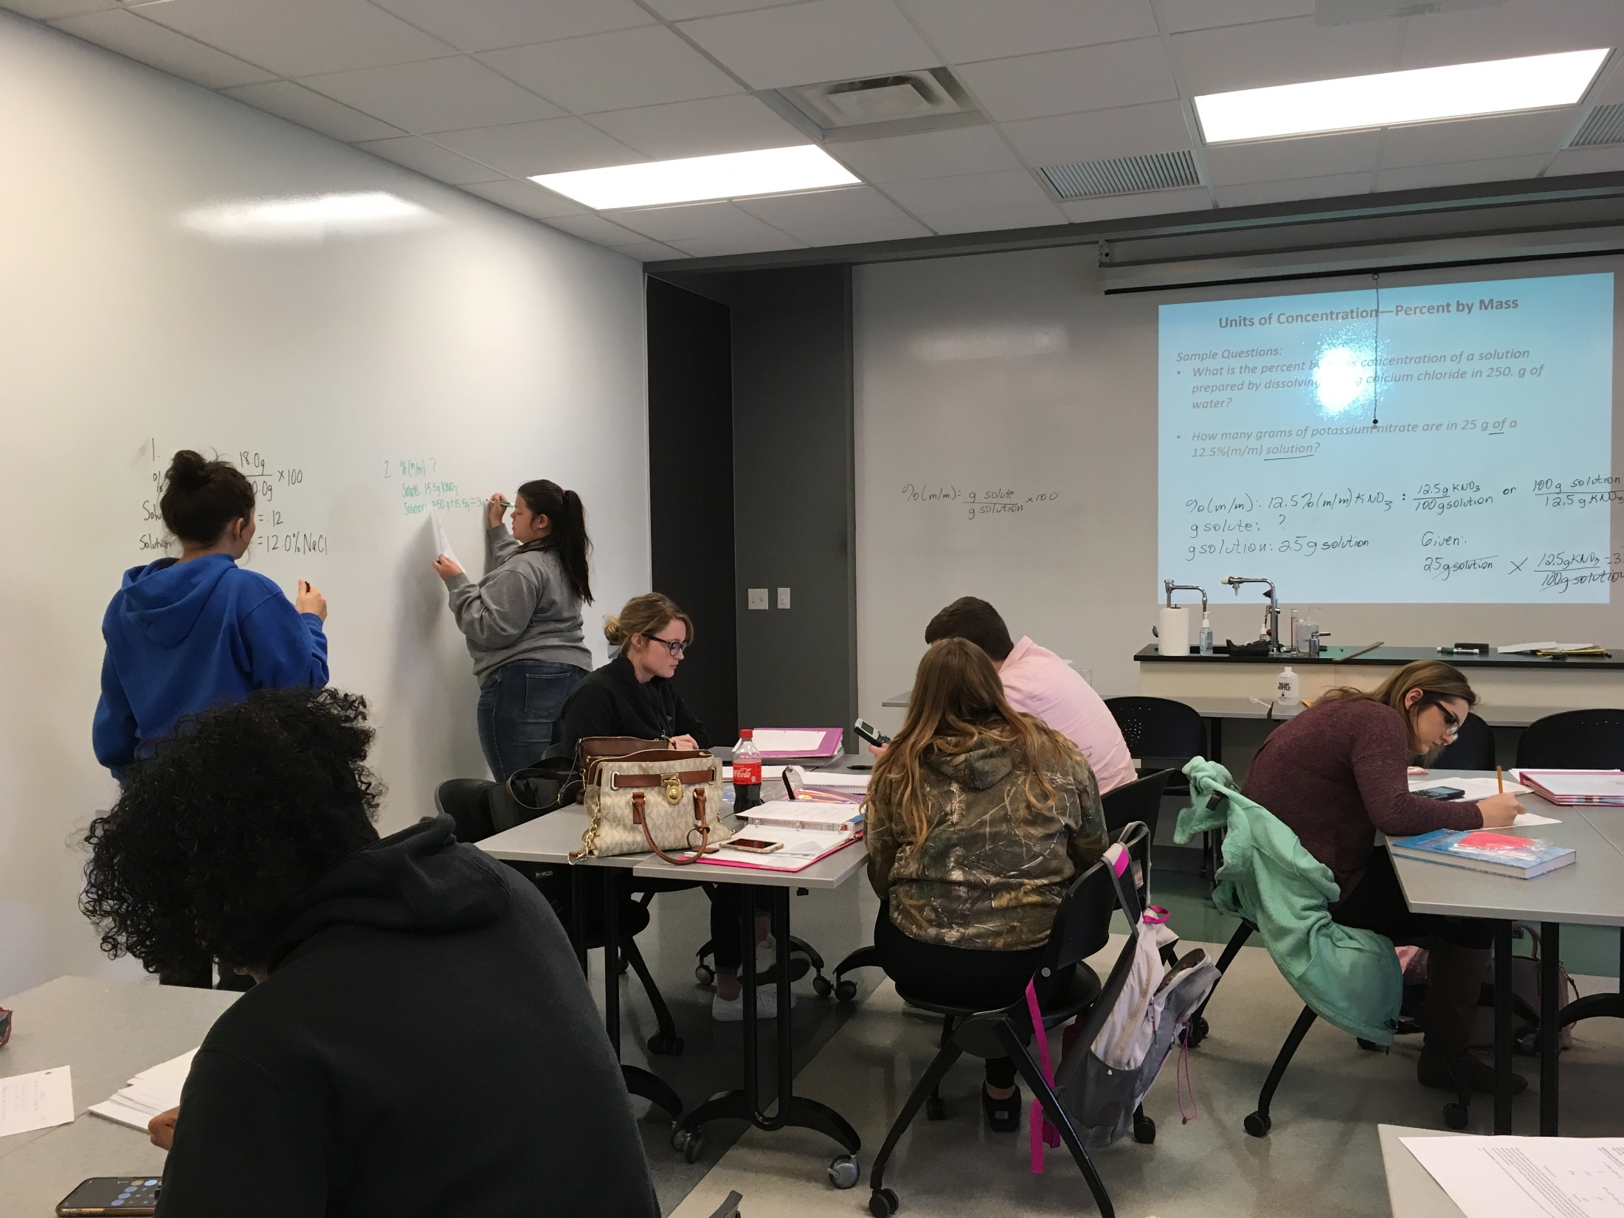
Work in the Classroom at Cincinnati State

Slide 15
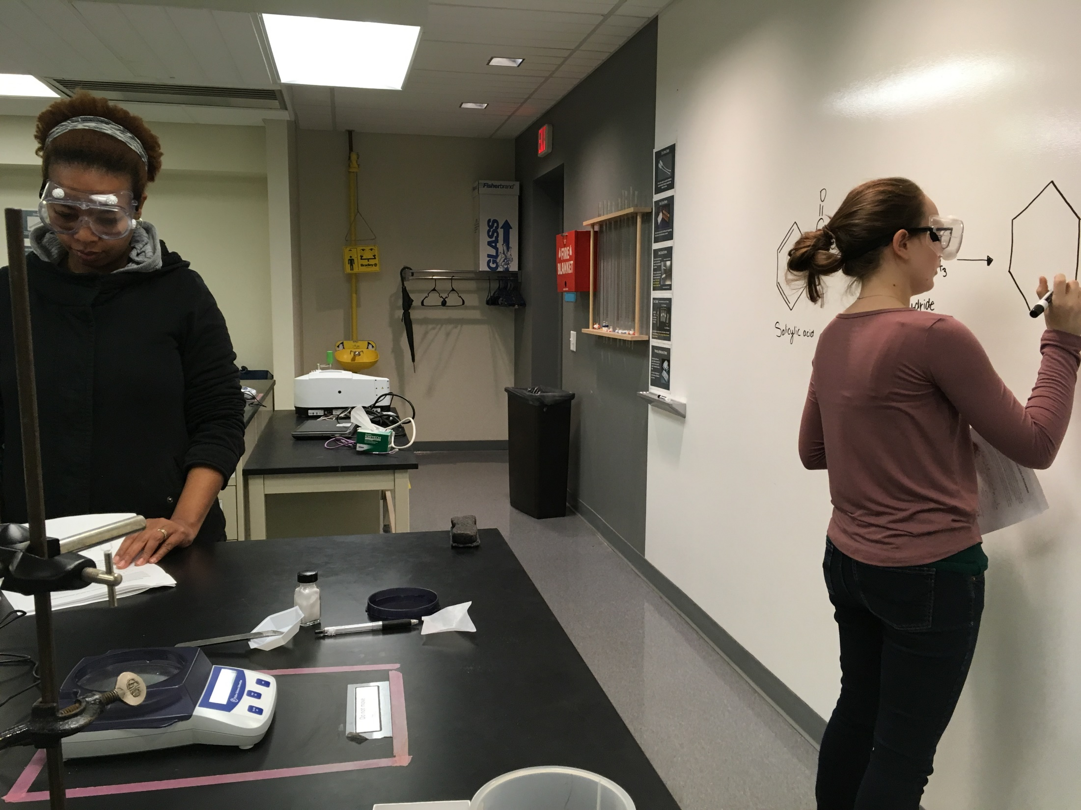
Solution Prep at Cincinnati State
Labs/Solution Prep

Slide 16
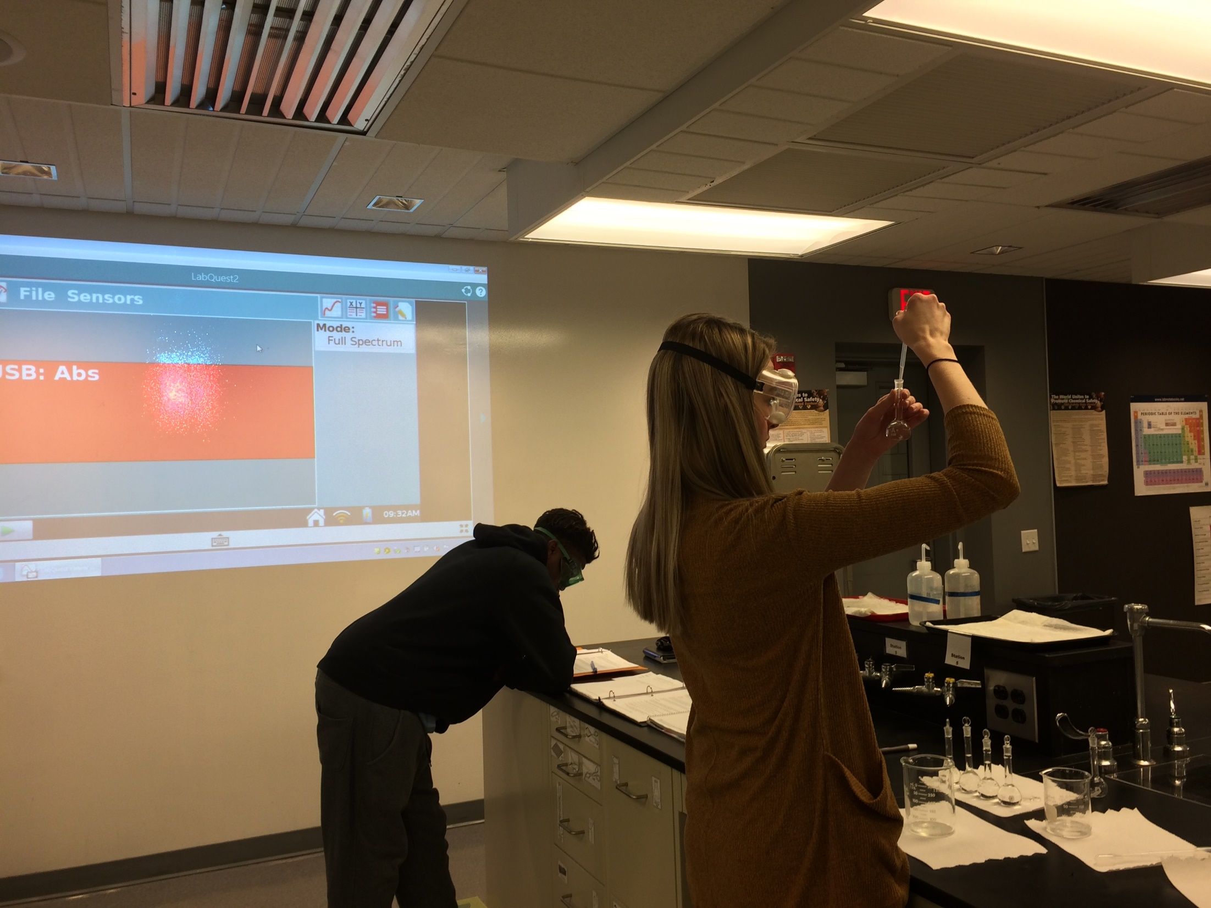
Labs and Solution Prep at Cincinnati State

Slide 17
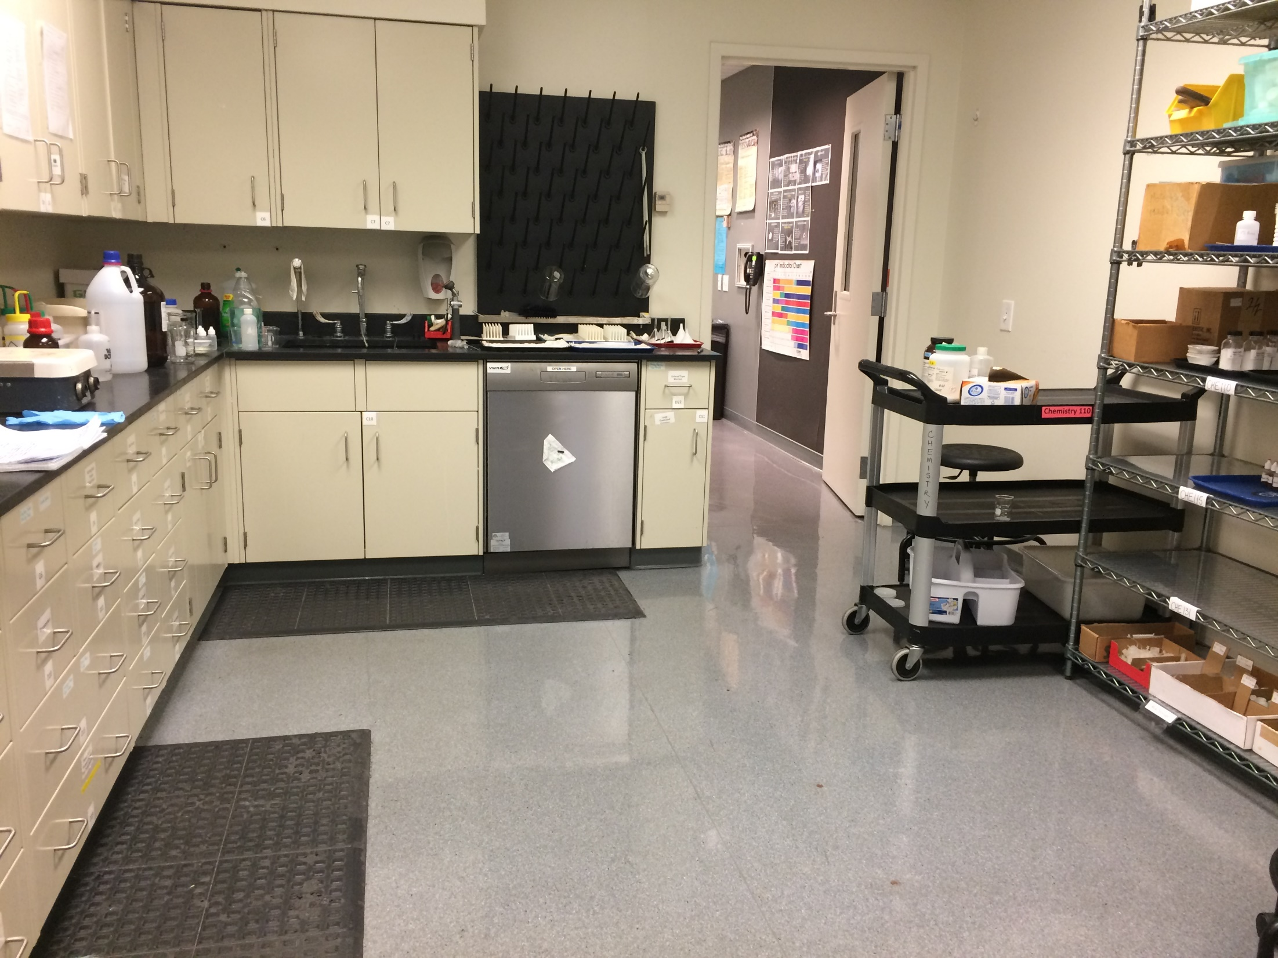
Chemistry Prep Room at Cincinnati State

Slide 18
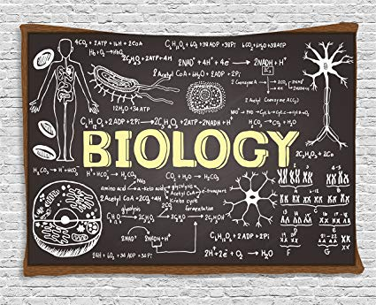

Slide 19
Cincinnati State Biology Faculty
Dave Bryan
Milene Donlin
Susan Herking
Julianna Johns
Greg Klein
Jessica Loomis
Mike Quinones
Peggy Rolfsen
Mark Tiemeier

Slide 20
Biology At Cincinnati State
Transfer Assurance Guide Courses
General Biology (BIO 131/132)
  A two-semester general biology course with lab for science majors
Pathophysiology (BIO 240)
A course on fundamental clinical concepts of disease processes

Slide 21
Biology At Cincinnati State
Ohio Transfer Module Courses
Anatomy and Physiology (BIO 151 and 152)
A course with lab on the structure and function of the human body.
Biology: Unity of Life (BIO 111 and 112)
  A course on characteristics shared by all living organisms

Slide 22
OGTP Curriculum Map for Biology
RECOMMENDED DEGREE MAP
First Year
SEMESTER 1 |  |  | SEMESTER 2
Course Name & # | Credit Hours |  | Course Name & # | Credit Hours
First Year Experience Course | 1-3 |  | ENG 102 or ENG 103 | 3
ENG 101 or ENG 101A | 3-4 |  | HUM 190 | 2
CHE 121 & 131 | 5 |  | CHE 122 & 132 | 5
BIO 131 | 5 |  | BIO 132 | 5
OTM Social/Behavioral Science | 3 |  | OTM Arts/Humanities | 3
Total Semester 1 Credit Hours | 17-19 |  | Total Semester 2 Credit Hours | 18
Second Year
SEMESTER 3 |  |  | SEMESTER 4
Course Name & # | Credit Hours |  | Course Name & # | Credit Hours
COMM 110 | 3 |  | CHE 202 & 212 | 5
CHE 201 & 211 | 5 |  | PHY 151 OR PHY 201 | 4-5
MAT 251 | 5 |  | OTM Arts/Humanities | 3
OTM Social/Behavioral Science | 3 |  | Part-Time Co-op | 1
Part Time Co-op | 1
Total Semester 3 Credit Hours | 17 |  | Total Semester 4 Credit Hours | 13-15

Slide 23
Advantages of Cincinnati State
Small Class Size
Same instructor for lecture and lab
No TA’s
Lab renovations taking place this academic year
Abundant tutoring opportunities
Full-time faculty hold 10 office hours per week
~ 60% of sections taught by full-time faculty (as of FA18)

Slide 24

QUESTIONS???

