Slide 1
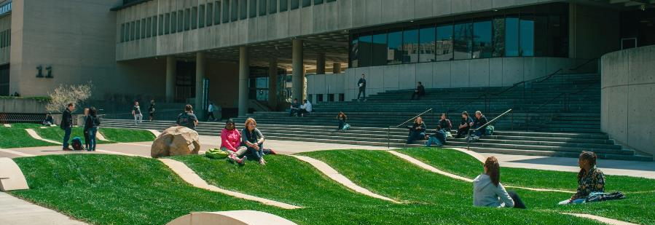
Southwest Ohio Region Transfer Summit
BIOLOGY

Slide 2
Our Faculty
15 full-time, tenure-track faculty
11 with doctoral degrees
4 with master’s degrees
28 adjunct faculty
558 sections of biology courses 17-18AY
63% taught by FT
27% taught by adjuncts

Slide 3
Our Students
Total FTE in BIO 17-18AY: 514
Total FTE in BIO 18/FA: 259
Total headcount in BIO 17-18AY: 4,725
# BIO majors enrolled 18/FA: 229
# Graduates 17-18 AY: 23
50% enrolled in 4 yr university/college
Notes:
501 bio majors total
Over the past 5 years 50% of grads each year enroll in a 4 yr institution

Slide 4
Articulation Agreements
University of Cincinnati
Biology A.S. → Biology B.A.
Biology A.S. → Biology B.S.
Urbana
A.S. degree → B.S. degree
Wright State University
Biology A.S. → Biology B.A.
Biology A.S. → Biology B.S.
Biology A.S. → Biology B.S. with Applied Physiology
https://www.sinclair.edu/about/offices/provost/articulation-transfer/articulation-agreements/

Slide 5
Biology A.S. Curriculum
Course | Title | Credits
 | Ohio Transfer Module: Social & Behavioral Sciences Elective | 6
 | Ohio Transfer Module: Arts & Humanities Elective | 6
 | Multicultural Elective | 3
BIO 1171 | Principles of Biology I | 5
BIO 1272 | Principles of Biology II | 5
CHE 1211 | General Chemistry I | 5
CHE 1221 | General Chemistry II | 5
ENG 1101 | English Composition I | 3
ENG 1201 | English Composition II | 3
MET 1131 | Personal Computer Applications for Engineering Technology | 1
SCC 1101 | First Year Experience | 1
 | (COM 2206 OR COM 2211 OR COM 2225) | 3
BIO 2222 | Evolution | 3
BIO 2225 | Ecology | 4
BIO 2235 | Genetics | 4
BIO 2236 | Lab for Genetics | 0
MAT 1450 | Introductory Statistics | 4

