Slide 1
Transfer Partnerships and Residencies at Cincinnati State

Slide 2
Bachelor Degree Programs offered on Cincinnati State’s Clifton Campus by:
Earn a Bachelor’s Degree Without Leaving Cincinnati State’s Clifton Campus
Cincinnati State Programs
Bachelor of Applied Science in Land Surveying
Bachelor of Science in Culinary and Food Science
Wilmington College Cincinnati
Mount St. Joseph University
Miami Regionals
Coming Soon????

Slide 3
Other College Incentives:
UC Pathway Advising Center: CState students can utilize this service on the UC campus to receive guidance on what courses are best for their future major.
Other services coming soon…
CState2NKU: is a dual enrollment program for CState student intending to transfer to NKU. This provides a number of benefits including, guidance from NKU Advisors, and access to student services at NKU.
2

Slide 4
Resident Partnerships at Cincinnati State
Processes, opportunities, challenges, lessons learned and uniqueness:
Advisor Communications to remain on the same page:
House all articulation agreements in the Transfer Center
Communicate memos for both overarching and pathway agreements that are new or updated
Working to post all articulation agreements on the Transfer Center Webpage
Resident school advisors partner with Cincinnati State Advisors
How is the Registrar’s Office involved in what capacity at both institutions?
It’s not! Our resident partners have their own administrative offices and classrooms so students transferring to a residential program goes through only that institution
Outreach:
Meet and Greets
New Advisor Trainings
Classroom Visits for Co-Op students each semester
How to Measure Program Success:
Completion/Graduation
Work closely with faculty, staff, and transfer to ensure student success and graduation
Challenges:
Lack of internal communication
Marketing and Signage

Slide 5
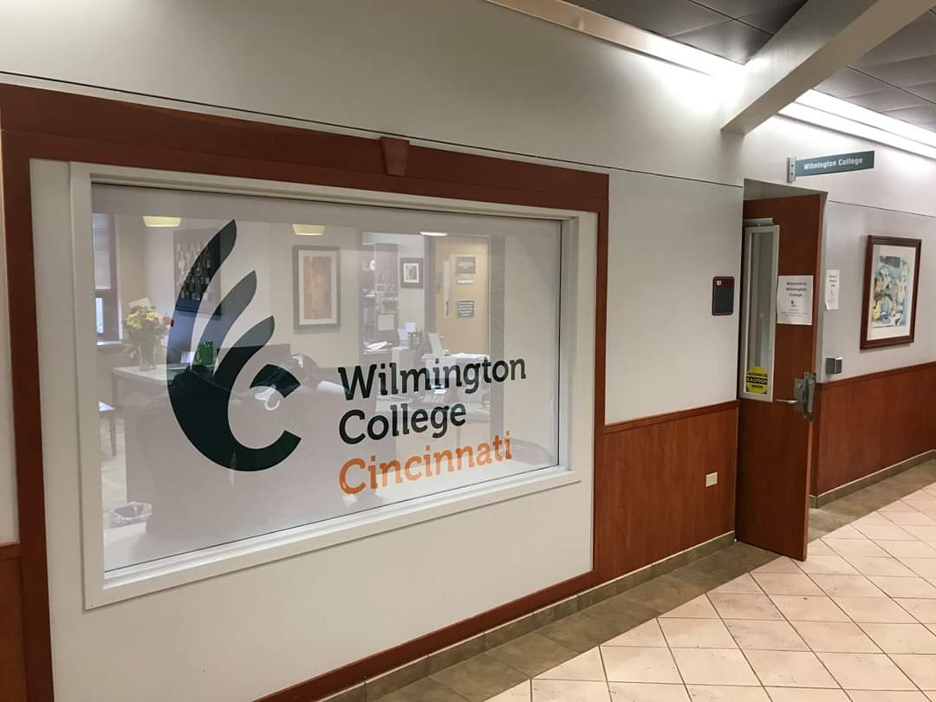
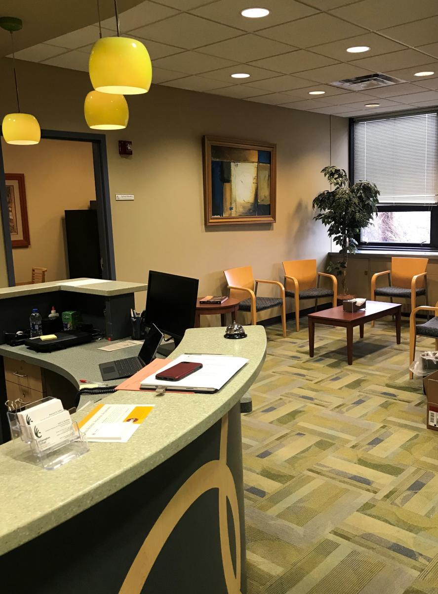
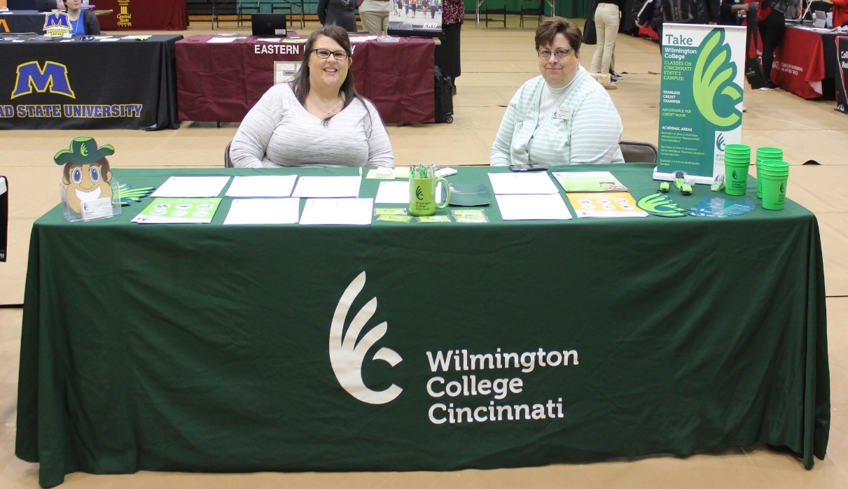
2
Cincinnati State to Wilmington College – Cincinnati
Sharron Colón, Associate Director for External Programs

Slide 6
Resident Background
How collaboration came about: WC and CState formed a partnership in 2003 (17 years+) to offer on-site, evening classes for adult learners. WC also created specific degree completion pathways for technical programs at CState to have smoother transfer options.
Specific programs:
Accounting
Business Administration with concentrations in Finance and Management
Strategic Organizational Leadership
Education Studies
Multimedia studies
Liberal Studies

Slide 7
Eligibility Requirements
Must earn a degree from Cincinnati State?
Students who earn an associate’s degree from CState receive a scholarship for a discounted tuition rate.
Students without a CState associate’s degree can enroll at a higher per credit hour rate.
GPA etc.
2.5 GPA is required, however if a prospect’s GPA is below 2.5, they can be admitted on a 1 semester probationary period in which they must earn a grade of “C” or higher in each class they are enrolled in.

Slide 8
Instructional Model
On-ground, face-to-face
On-site classes meet 1 night a week. Classes run in a 7 week and 15 week format.
Online
Classes run in a 7 week and 15 week format.
Hybrid
Classes meet face-to-face on a hybrid schedule. Typically this consists of every other week. Can be offered in 7 week and 15 week courses.

Slide 9
Student Benefits
Dual Advising
Access to Cincinnati State Students’ Services
General Education Certified
Tuition Discount
Double Majors
Credit Transferability (67 from CState, and up to 97 in combination from a 4-year institution)

Slide 10
QUESTIONS???

Slide 11
2
Cincinnati State to Mount St. Joseph University
Amy Wolf, Assistant Director of Adult and Transfer Recruitment

Slide 12
Resident Background
How collaboration came about:
Recruitment effort
Community need
Confidence in the pathway
Dual Associates: Core and Major Hours
Maximize transfer
Three (3) Education tracks w/licensure
Primary Education Licensure (Pre-K through 5th grade)
Special Education (up through grade 12)
Dual Primary/Special Education Licensure

Slide 13
Eligibility Requirements
Must earn a Early Childhood Education degree from Cincinnati State
2nd Associate (Associate of Arts-not required before transfer)
7-8 additional classes
2.8 transfer GPA needed for the School of Education
2.0 transfer GPA for general university admission
Early advising is key!
Getting the program out there

Slide 14
Instructional Model
Fall semester start for major courses/program (fall/spring)
Core = any semester
On-ground at Cincinnati State with a blend of online
4:00pm face-to-face start time and later
Availability to complete any practicums and student teaching during the day
Remaining core courses = online 7-8 weeks
Also available on campus at MSJ face-to-face: day/evening
Alternate EDU courses with courses delivered at
MSJ = benefits

Slide 15
Student Benefits
Dual Advising
Cincinnati State and MSJ Advising
Credit Transferability (90 credits)
Seamless transfer
Access to Mount student services/campus resources
Online orientation program
Stackable Transfer Scholarships
Connections Scholars program
Only 4-5 semesters to earn a Bachelor’s

Slide 16
QUESTIONS???

Slide 17
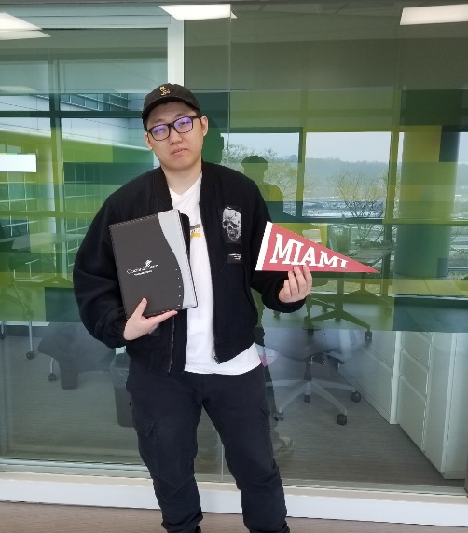
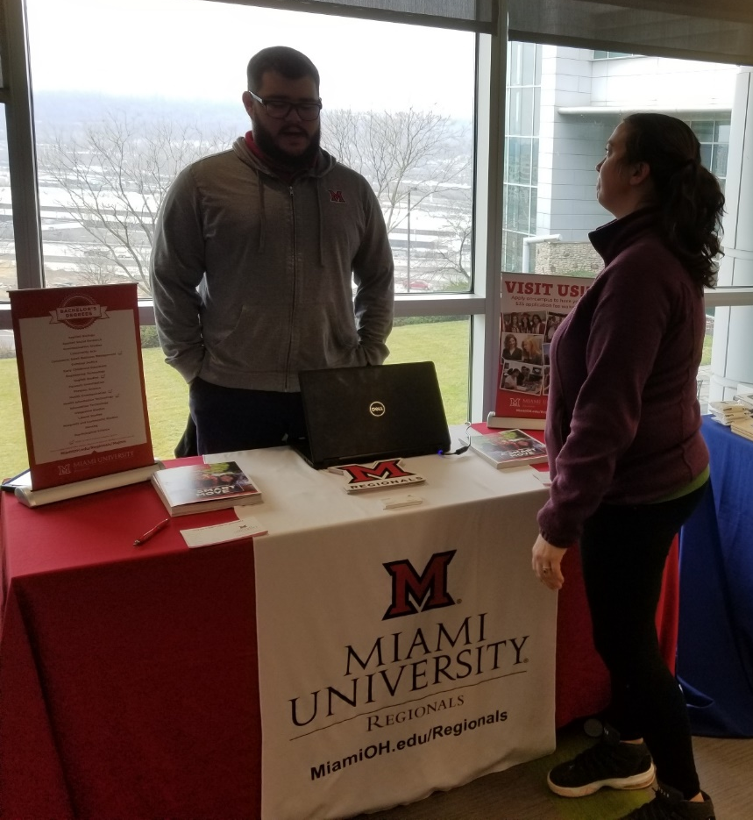
2
Cincinnati State to Miami Regionals
Larry Feist, Program Chair of Electro-Mechanical Engineering Technology

Slide 18
Resident Background
How collaboration came about: Miami Regionals are regional, community-based campuses of Miami University, a highly-regarded public university with a national reputation. Miami began teaching in Hamilton and Middletown in the fall of 1946 and excepting Cincinnati State transfers in the 1970s.
Specific Programs
Electrical & Computer Engineering Technology (ECET) (Distance Option)
Electro-Mechanical Engineering Technology (EMET) (Distance Option)
Mechanical Engineering Technology (MET)

Slide 19
Eligibility Requirements
Must earn an Associate Degree in Electrical, Mechanical, Electro-Mechanical or similarly titled Engineering Technology program at Cincinnati State.
An earn degree completes the Ohio Transfer Module at Cincinnati State.
An earned degree will be considered Gen. ED. Certified by the Miami Engineering Technology (ENT) department.

Slide 20
Instructional Model
Advantages of Virtual Learning
Virtual ≠ Online:
Face-to-face interaction with the instructors during the lecture.
Instruction is delivered directly to students via WebEx
Students have the ability to work in the lab equipment at their local college and will perform the experiments with the direct and live supervision of a Miami University instructor.

Slide 21
Student Benefits
Dual Advising via Cincinnati State liaison
Access to Cincinnati State Students’ Services
General Education Certified through Ohio Transfer Module
Tuition Discount.
Credit Transferability is flexible since Miami transfers ¾ of the Bachelor courses from Cincinnati State
Courses offered in the evening to accommodate work/internship students
100% job placement rate for graduates

Slide 22
QUESTIONS???

