Slide 1
Notes:
Kathy -- Introductions

Slide 2
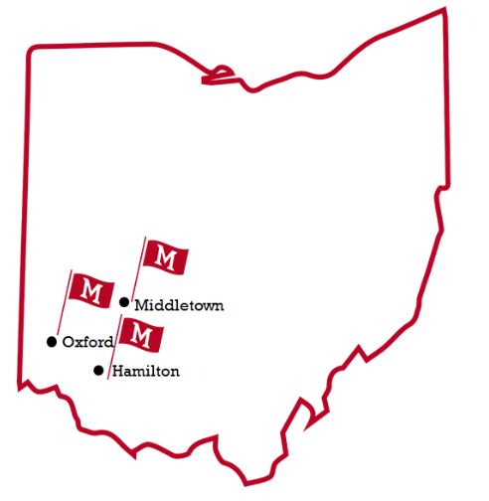
#ONEMiami
OXFORD
19,934 UG and Graduate Students
Undergraduate and Graduate Degrees
Main Campus
Residential
REGIONALS
5,000 students
2 Campuses - Hamilton and Middletown
19 bachelor programs, 4 fully online (e-campus)
Open enrollment
Notes:
Ann/Kathy will split

Slide 3
Notes:
Kathy
Process:
Identifying key individuals who can execute the steps for a partnership
Sustaining momentum with the partnership
Engaging campus leadership to energize partnership and build awareness
Identify “good fit” programs -- pathways that make sense for students

Slide 4
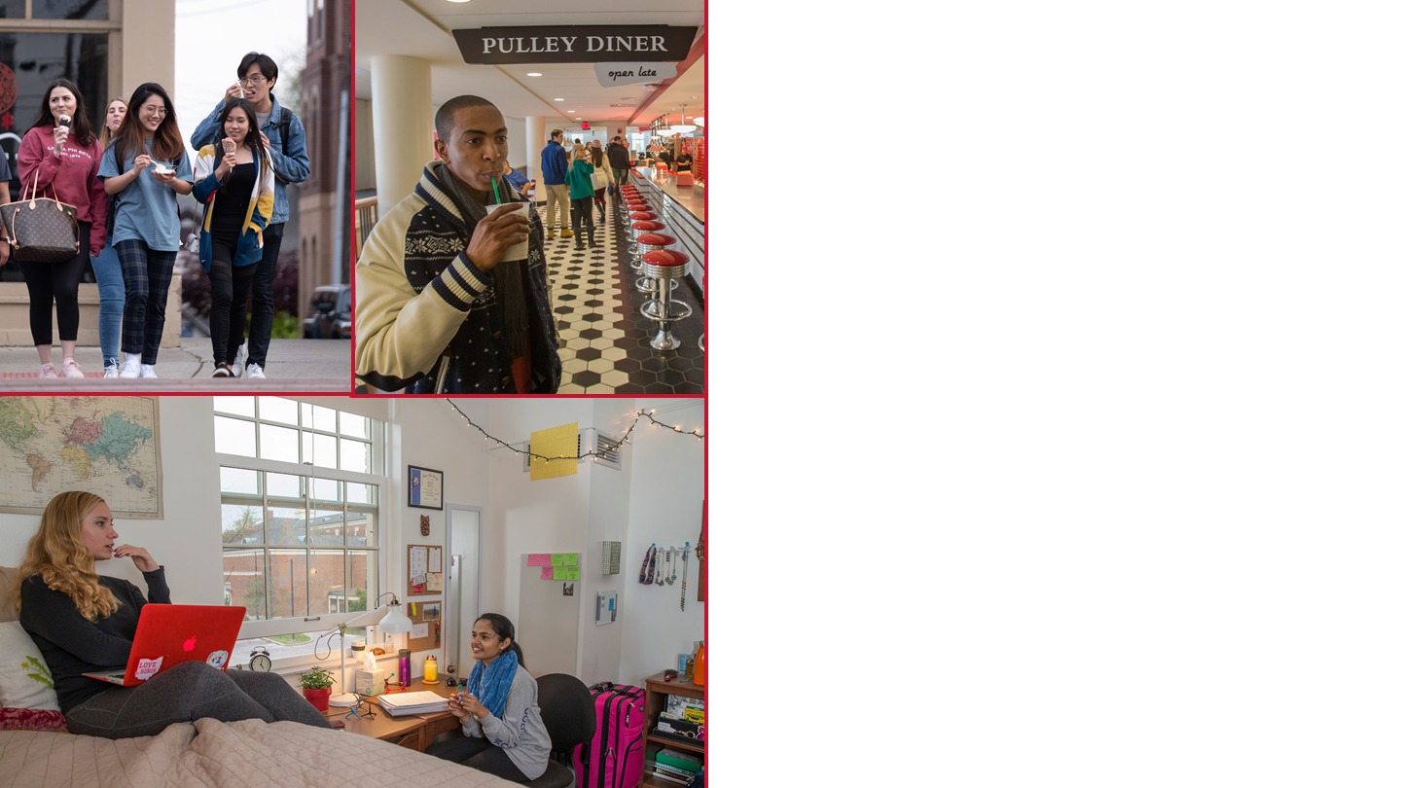
Research
Transfer to Miami
Community Colleges
Purpose
Build and formalize relationships with Ohio community colleges
Model and Infrastructure
Intentional and Seamless
Notes:
Kathy will fill in
Number of Articulations: 6
Overarching Agreement (Oxford)
Honors Agreement (Oxford)
Social Work (Oxford)
Engineering Tech (Regionals)Commerce (Regionals)
English Studies (Regionals) -- newest articulation

Slide 5
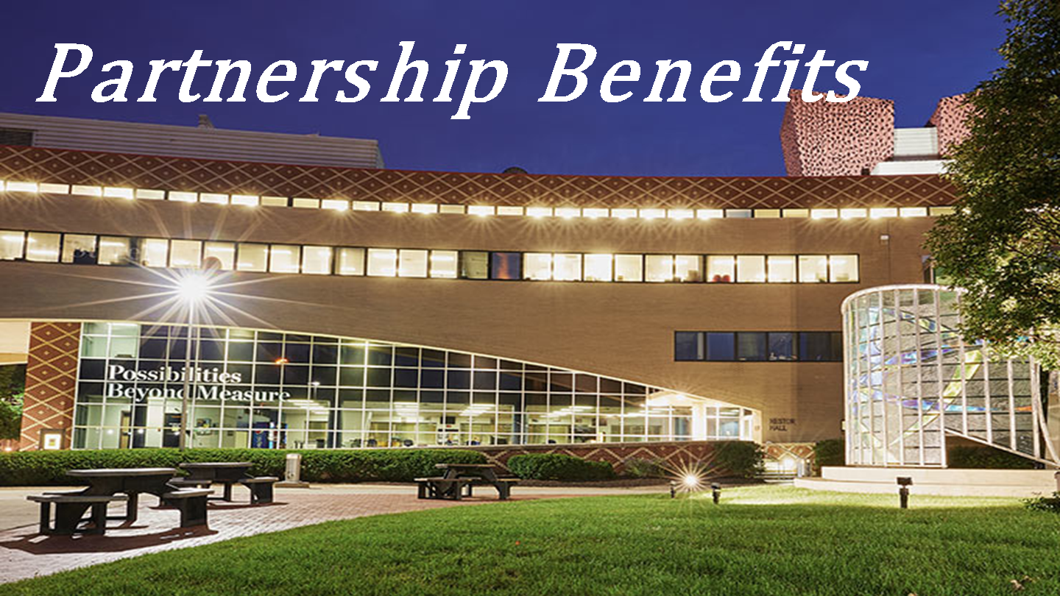
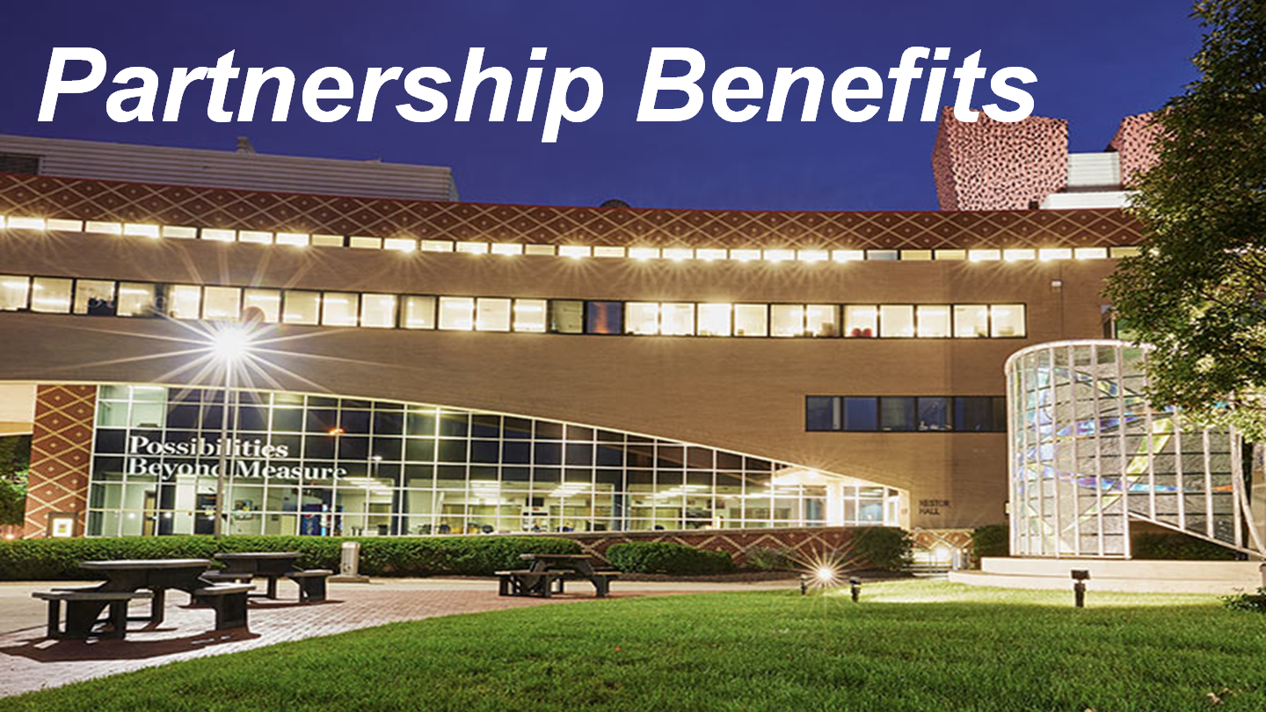
Notes:
Sarah

Slide 6
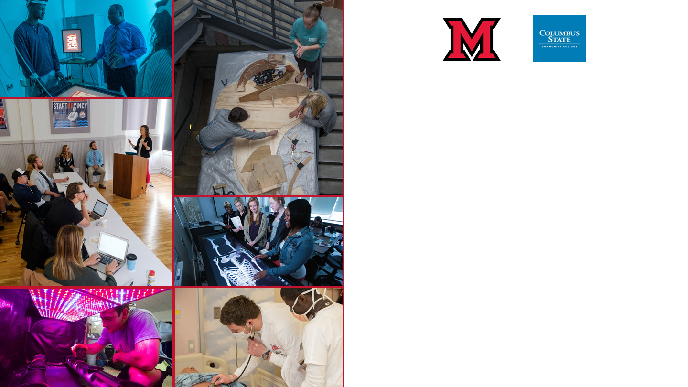
Priority/Early registration for table visits
Opportunity to sit in the Transfer Center for advising appointments
Special events for only Preferred Pathways Partners
Opportunity to host a Student Success Workshop each semester
Institutional Blackboard site
Co-located distance learning courses with Engineering Technology
Notes:
Sarah

Slide 7
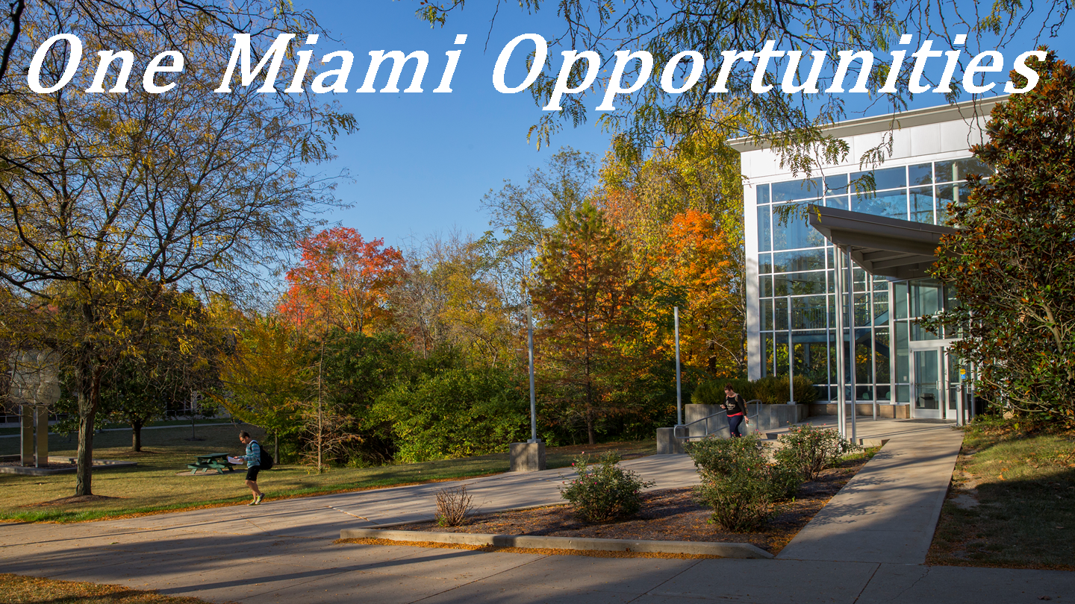
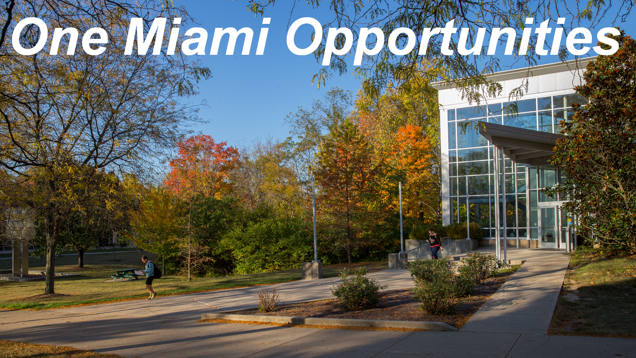
Notes:
Ann

Slide 8
The opportunity to travel together and show a dual front at college fairs
Ability to spread out visit dates between two campuses to ensure Miami visibility
Miami Destination Day
Advisor Visit Day (opportunity for advisors to visit both campuses)
Ability to offer best of both campuses for CSCC students
Notes:
Ann

Slide 9
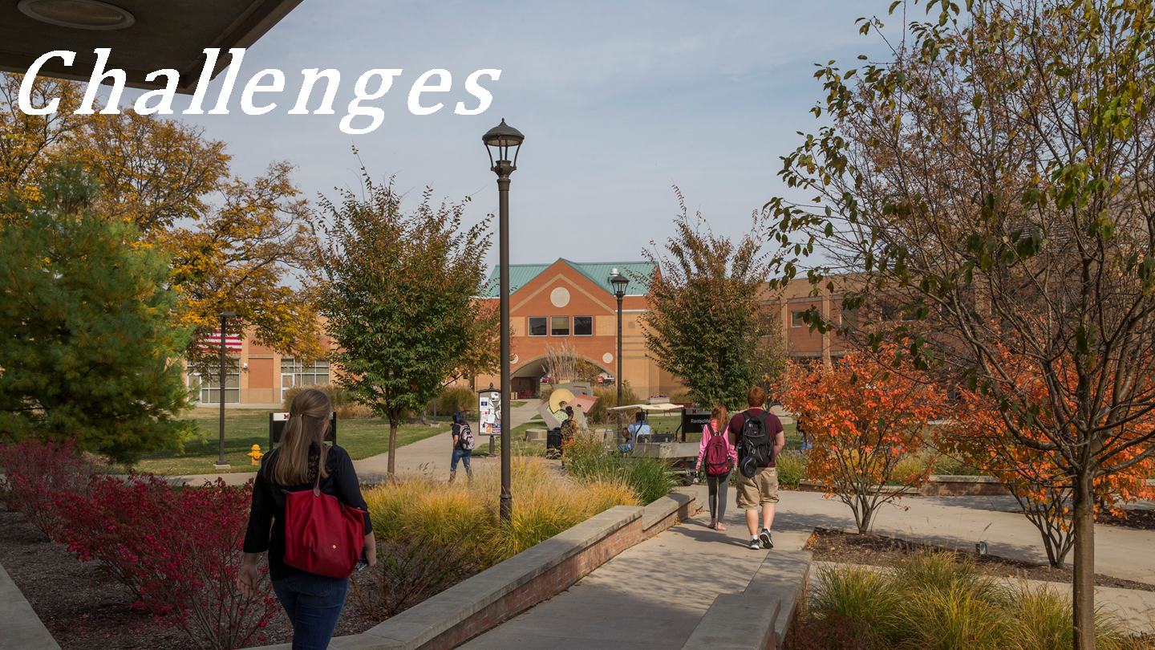
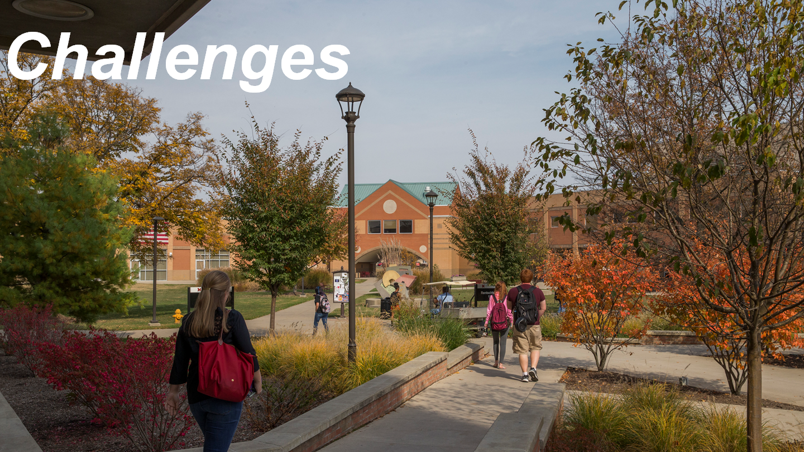

Slide 10
Involvement of advising
Campus fit
Program Name / Locations
Geographical Location
Course Equivalencies
No access to student names
Blackboard Site restrictions
Notes:
Ann/Kathy

Slide 11
Notes:
Kathy/Ann

Slide 12
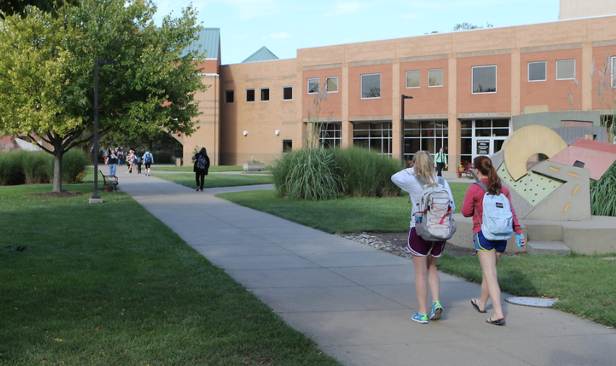
Manage Expectations
Program Management and Support is Key
Formalized Process for Agreements
Notes:
Kathy/Ann
What are the reasons now vs. then?
We want to be a part of the success for our students (numbers and trends)
Articulation support - post signing: Providing continuing support to the partner to keep articulations top of mind.
Managing expectations with internal and external constituents
Connection to community college coordinator.

Slide 13
Questions?

