Slide 1
University of Cincinnati Partnerships

Slide 3
Institutional Agreements
Active:
Columbus State Community College
Cuyahoga Community College
Edison State Community College
Gateway Community & Technical College
Parkland College
Southeast Community College
Southern State Community College
Terra State Community College
Zane State Community College
In-Progress :
Cincinnati State Technical & Community College (renewal; lapsed June 2019)
Eastern Gateway Community College
Sinclair Community College (renewal; lapsed June 2019)
Rachel Fulton
Rachel.Fulton@uc.edu
https://www.uc.edu/aas/creditevaluation/articagree.html
Notes:
Rachel

Slide 4
Articulation Agreements
Agreements by UC College (as of 1/15/2020) | # of Active Agreements | # of In Progress Agreements
Arts & Sciences | 20 | 8
College Conservatory of Music | - | -
Education, Criminal Justice, and Human Services | 3 | 79
Engineering & Applied Science | 4 | 1
Business | 5 | -
Design, Architecture, Art & Planning | - | 3
Nursing | 9 | 1
Allied Health Sciences | 31 | 33
TOTAL | 72 | 125
Initiated by UC College or Partner Outreach
Facilitated by College Credit Services
Informed/Validated by UC College and External Partner
Rachel Fulton
Rachel.Fulton@uc.edu
https://www.uc.edu/aas/creditevaluation/articagree.html

Slide 5
How UC Helps Students Transition
Prior to Enrollment
Pre-Application/Enrollment Advising
1 on 1 advising discussing applicability and future plans
Unofficial evaluation
Transfer Previews (Admissions, Friday afternoons)
Referrals as appropriate
www.uc.edu/pathways • pathways@uc.edu • 513-556-9000
Notes:
Kaci

Slide 6
How UC Helps Students Transition
After confirmation
Transition advising
Canvas (online) transfer guide
In person Transfer Welcome events (8 total starting in March)
Encouraging colleges to create special transfer programming
www.uc.edu/pathways • pathways@uc.edu • 513-556-9000
Notes:
Kaci

Slide 7
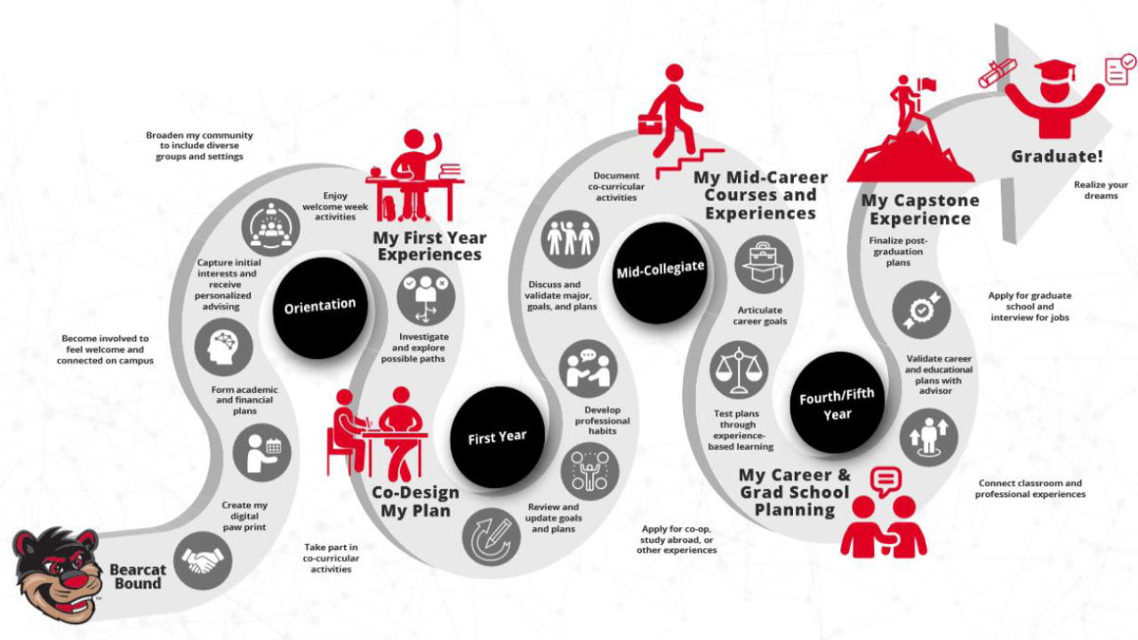
Developing Belonging
Bearcat Promise
SALD Experience UC (tracks for student engagement)
Networking events
Ambassador/
Mentor programs
www.uc.edu/pathways • pathways@uc.edu • 513-556-9000
Notes:
Kaci

Slide 8
On the Roadmap
Dual Admit - Fall 2021
(UCBA, UC Clermont, Cincinnati State)
Bearcat Promise
Civitas Degree Maps / Career Plans
Transfer Toolkit
NACADA 2021 - Cincinnati
www.uc.edu/pathways • pathways@uc.edu • 513-556-9000
Notes:
Donnie

Slide 9
