Slide 1
Presented by: Joe Murray
Director of Advising and Retention Services, Hamilton Campus
Member of the AAI Development Team
Co-Chair, NACADA First Generation Interest Group, 2007-12
Co-founder of OHIO REACH for foster youth
Certified Appreciative Advisor

Slide 2
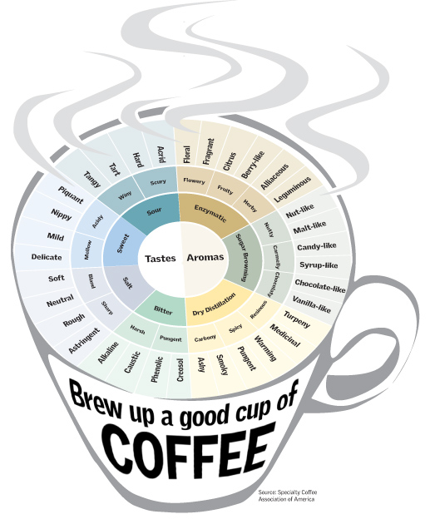
Life is Like Coffee
http://www.flickspire.com/m/SimpleTruths/LifeIsLikeCoffee

Slide 3
So, how do we keep the focus on our students?
MY Goals for today….
REMIND you of what you already know.
STIMULATE what you may have forgotten.
CHALLENGE you to think and act in new ways to connect with your students and each other.

Slide 4
Appreciative Advising Definition
“Appreciative Advising is the intentional collaborative practice of asking positive, open-ended questions that help students optimize their educational experiences and achieve their dreams, goals, and potentials.”
Bloom, J. L., Hutson, B. L., & He, Y. (2008). The appreciative advising revolution. Champaign, IL: Stipes Publishing.

Slide 5
The Six Phases of Appreciative Advising
Disarm
Discover
Dream
Design
Deliver
Don’t Settle
Bloom, J. L., Hutson, B. L., & He, Y. (2008). The appreciative advising revolution. Champaign, IL: Stipes Publishing.

Slide 6
Appreciative Advising Phases
Disarm – Recognizing the importance of first impressions, create a safe, welcoming environment for students.
Discover - Utilize positive open-ended questions to draw out what they enjoy doing, their strengths, and their passions. Listen to each answer carefully before asking the next positive question.
Bloom, J. L., Hutson, B. L., & He, Y. (2008). The appreciative advising revolution. Champaign, IL: Stipes Publishing.

Slide 7
Appreciative Advising Phases (continued)
Dream - Help students formulate a vision of what they might become, and then assist them in developing their life and career goals.
Design – Help students devise concrete, incremental, and achievable goals.
Bloom, J. L., Hutson, B. L., & He, Y. (2008). The appreciative advising revolution. Champaign, IL: Stipes Publishing.

Slide 8
Appreciative Advising Phases (continued)
Deliver – The students follow through on their plans. The advisor is there for them when they stumble, believing in them every step of the way and helping them continue to update and refine their dreams as they go.
Don’t Settle – The advisor challenges the student to proactively raise the student’s internal bar of self- expectations
Bloom, J. L., Hutson, B. L., & He, Y. (2008). The appreciative advising revolution. Champaign, IL: Stipes Publishing.

Slide 9
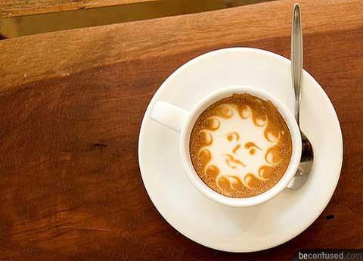

Slide 10
Disarm Phase
Disarm
Recognizing the importance of first impressions, create a safe, welcoming environment for students
Bloom, J. L., Hutson, B. L., & He, Y. (2008). The appreciative advising revolution. Champaign, IL: Stipes Publishing.

Slide 11
Which grade would you want to talk about?
Disarm
English - A
History - A
Biology - B
Phys Ed - B+
Math - F
Rath, T., & Clifton, D. O. (2004). How full is your bucket? Positive strategies for work and life. New York: Gallup Press.

Slide 12
Important Advisor Behaviors
Disarm
Sit in the chair your students sit in
Decorating your office in a personal way
Webpage has picture & a blurb about each advisor
Meeting students at the door
Bloom, J. L., Hutson, B. L., & He, Y. (2008). The appreciative advising revolution. Champaign, IL: Stipes Publishing.

Slide 13
Nonverbal Immediacy Behaviors
Disarm
Gestures
Vocal Variety
Smiling at students
Relaxed body posture
Removal of distractions
Eye contact
Professional casual dress
Direct Quotes from Rocca, K. A. Presentation at the “Student Motivations and Attitudes: The Role of the Affective Domain in Geoscience Learning” conference, Northfield, MN. February 12, 2007

Slide 14
Verbal Immediacy Behaviors
Disarm
Calling students by name
Use of Inclusive pronouns
Unrelated small talk
Feedback to students
Asking for student feedback
Use of own first name
Direct Quotes from Rocca, K. A. Presentation at the “Student Motivations and Attitudes: The Role of the Affective Domain in Geoscience Learning” conference, Northfield, MN. February 12, 2007

Slide 15
What’s inside?
Discover

Slide 16
Discover Phase
Discover
Utilize positive open-ended questions to draw out what they enjoy doing, their strengths, and their passions. Listen to each answer carefully before asking the next positive question.
Bloom, J. and Martin, N.A. (2002, August 29). Incorporating appreciative inquiry into academic advising. The Mentor: An Academic Advising Journal, 4 (3). http://www.psu.edu/dus/mentor/020829jb.htm

Slide 17
Important Advisor Behaviors
Discover
Ask positive open questions that help us learn our students’ stories.
Taking mental notes of the student’s:
Strengths
Skills
Passions
Accomplishments
Bloom, J. L., Hutson, B. L., & He, Y. (2008). The appreciative advising revolution. Champaign, IL: Stipes Publishing.

Slide 18
Important Discover Advisor Behaviors
Discover
Advisor self-discloses personal stories as appropriate
Advisor is comfortable with silence
Advisor treats student as if he/she is full of potential
Advisor is non-judgmental
Advisor is mindful of diversity/multi-cultural issues
Advisor is authentic
Bloom, J. L., Hutson, B. L., & He, Y. (2008). The appreciative advising revolution. Champaign, IL: Stipes Publishing.

Slide 19
Discover Questions for Students
Discover
Describe three life events that have made you into the person you are today.
Since coming to this institution, what is something you’ve accomplished that you are proud of?
Who are the most important role models in your life? Why? What qualities in them do you hope to emulate?
Habley, W. R., & Bloom, J. L. (2007). Giving advice that makes a difference. In G. L. Kramer (Ed.), Fostering student success in the campus community (pp. 171–92). San Francisco: Jossey-Bass.

Slide 20
Dream Phase
Dream
Help students formulate a vision of what they might become, and then assist them in developing their life and career goals
Bloom, J. and Martin, N.A. (2002, August 29). Incorporating appreciative inquiry into academic advising. The Mentor: An Academic Advising Journal, 4 (3). http://www.psu.edu/dus/mentor/020829jb.htm

Slide 21
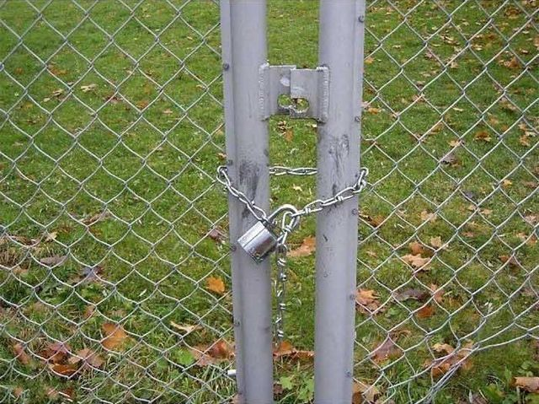
Take the Chains off the Dreams!

Slide 22
i I

Slide 23
Important Advisor Behaviors
Dream
Listen purposefully
Make connections between information from the Discover phase and dreams being shared during this phase. Is there congruency between the two phases?
Encourage students to be open to the possibilities and remind them that there is more than one right answer
Bloom, J. L., Hutson, B. L., & He, Y. (2008). The appreciative advising revolution. Champaign, IL: Stipes Publishing.

Slide 24
Dream Questions for Students
Dream
Magazine/Journal question
When you were 8 years old, what did you say you wanted to be when you grew up? What about now?
If salary, education, and time were irrelevant, what is your ideal job?
Bloom, J. L., Hutson, B. L., & He, Y. (2008). The appreciative advising revolution. Champaign, IL: Stipes Publishing.

Slide 25
Design Phase
Design
Help students
devise concrete,
incremental, and achievable goals
Bloom, J. and Martin, N.A. (2002, August 29). Incorporating appreciative inquiry into academic advising. The Mentor: An Academic Advising Journal, 4 (3). http://www.psu.edu/dus/mentor/020829jb.htm

Slide 26
Design Phase Developing an Action Plan
Design
Work together to set goals and specific sub-goals
Establish a realistic timeline for accomplishment of goals
Clarify who is responsible for what by what date
Bloom, J. L., Hutson, B. L., & He, Y. (2008). The appreciative advising revolution. Champaign, IL: Stipes Publishing.

Slide 27
Design Questions for Students
Design
What can you do in the next week to move one step closer to at least one of your goals?
Let’s brainstorm on the resources you will need to accomplish these goals and objectives.
How will you celebrate the accomplishments of these goals?
Habley, W. R., & Bloom, J. L. (2007). Giving advice that makes a difference. In G. L. Kramer (Ed.), Fostering student success in the campus community (pp. 171-192). San Francisco: Jossey-Bass.

Slide 28
Deliver Phase
Deliver
The students follow through on their plans. The advisor is there for them when they stumble, believing in them every step of the way and helping them continue to update and refine their dreams as they go.
Bloom, J. and Martin, N.A. (2002, August 29). Incorporating appreciative inquiry into academic advising. The Mentor: An Academic Advising Journal, 4 (3). http://www.psu.edu/dus/mentor/020829jb.htm

Slide 29
Important Advisor Behaviors
Deliver
Review what you have accomplished in this session
Review the student’s responsibilities and your responsibilities and the deadlines you have co-established
Encourage the student to contact you with any problems or concerns
Reiterate your confidence that the student can indeed accomplish the goals set forth
Bloom, J. L., Hutson, B. L., & He, Y. (2008). The appreciative advising revolution. Champaign, IL: Stipes Publishing.

Slide 30
Deliver Phase Questions for Students
Deliver
How and when will you keep me updated on your progress?
What will you do if you run into roadblocks?
What will you do if you think your goals may be changing?
Habley, W. R., & Bloom, J. L. (2007). Giving advice that makes a difference. In G. L. Kramer (Ed.), Fostering student success in the campus community (pp. 171-192). San Francisco: Jossey-Bass.

Slide 31
Ending the Conversation
Deliver
“Do you have any questions for me?”
“Is there anything else that I should have asked you?”
“Thanks so much for coming in – I really enjoyed meeting with you. Please don’t hesitate to contact me if you have any questions.”
Shake hands and escort them out of the office
Bloom, J. L., Hutson, B. L., & He, Y. (2008). The appreciative advising revolution. Champaign, IL: Stipes Publishing.

Slide 32
Don’t Settle Phase
Don’t Settle
The advisor challenges the student to proactively raise the student’s internal bar of self- expectations
Bloom, J. L., Hutson, B. L., & He, Y. (2008). The appreciative advising revolution. Champaign, IL: Stipes Publishing.

Slide 33
Don’t Settle
“Good is the enemy of great”
Collins, J. (2001). Good to great: Why some companies make the leap and others don’t. New York: HarperCollinsPublishers.

Slide 34
Don’t Settle Questions
Don’t Settle
You have done great so far, but what is one thing that you could do even better?
If you were going to raise your own internal bar of expectations, what would that mean?
What would happen if I challenged you to become the best you that you could possible become? What would you need to do differently?
Bloom, J. L., Hutson, B. L., & He, Y. (2008). The appreciative advising revolution. Champaign, IL: Stipes Publishing.

Slide 35
Appreciative Advising Course Overview Next Class: January 27 - March 24, 2013 Registration Deadline: December 14, 2012 http://www.ed.sc.edu/conferences/appreciativeadvising/apadv_course.asp
The Appreciative Advising course is designed to be a community of learners (instructors included). There will be opportunities for you to interact with other community members each week. These opportunities will include both discussion board conversations, as well as optional live chat dialogues. Actively participating in our community will enhance your own experience and the experiences of all of the other learners in our community.

Slide 36
Want to learn more?
Certification
http://appreciativeadvising.net/
Are You on Facebook?
If so, please join the
Appreciative Advising group
Journal of Appreciative Education
http://libjournal.uncg.edu/ojs/index.php/jae/index

Slide 37
Questions?

